Slide 1

Paginated Reports.. When to use and how to create
February 20, 2025
Danni Olson
dannio@microsoft.com
Danni (Ortman) Olson | LinkedIn

Slide 2
February 20, 2025 — 11 am pst/2 pm est
Description: This session will focus on the creation of Paginated reports.
Paginated reports are intended for printing or sharing. They are referred to as paginated because they are formatted to fit well on a page. These reports display all data in a table format, even if the table spans multiple pages.
Power BI Report Builder is the dedicated tool used for authoring paginated reports within the Power BI service. Discover best practices, tips, and tricks

Slide 3
Interactive vs. Paginated
Export, PDF, Dynamic Report
Export, many choices, Paginated Report

Slide 4
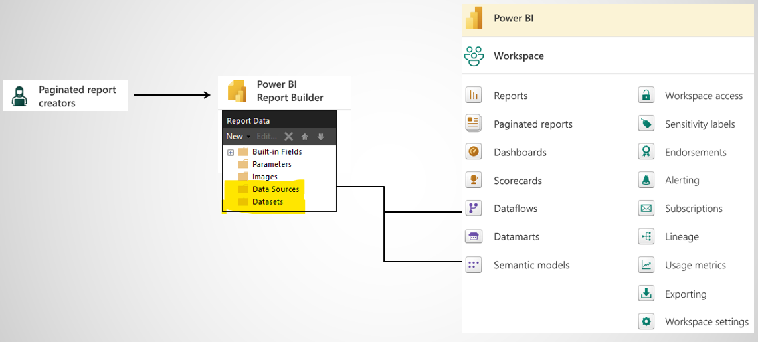
Simple Creation of Data Sources
&
Data Sets
Inside the PBI Service
  Creating DataSource and DataSet using PBI Service
Inside of PBI Desktop
  Create DataSource and Data Set using DAX in Desktop

Slide 5
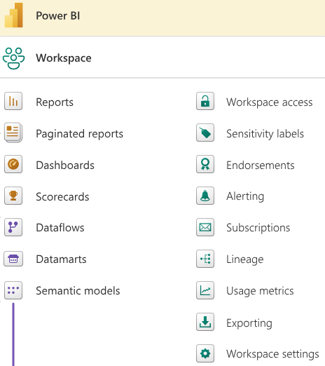

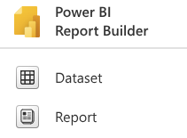
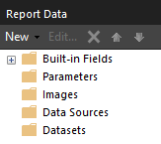

Slide 6
Demo Power BI Report Builder
Data Source and Data Set – See previous slide
  A data source is the connection information to a particular resource, like SQL Server. Add a Data Source
  Create a Data Set - A dataset is the saved information of the query against the data source, not the data. The data always resides in the DataSource
Create a Table, Report Title, Page Number
  Create Report Title and Page Number
Create a Parameter
  Create parameters for paginated reports in Power BI Report Builder - Power BI | Microsoft Learn
Visualizations/Reports
  Tutorial: Create a paginated report and upload it to the Power BI service - Power BI | Microsoft Learn
Additional Learning
  No more Report Builder for Power BI Paginated Reports??? (youtube.com)
  Enabling Power BI Paginated Report Drill! (youtube.com)
  Create a date range parameter with Power BI Paginated Reports (youtube.com)
  Create paginated reports - Training | Microsoft Learn
  JTM-16: Create a Paginated Report from Power BI Dataset (Using Power BI report builder) (youtube.com)
  How to improve user experience when using date parameters in the paginated report - Power BI (youtube.com)
Data Source
DataSet
Report Title and Page Number
Parameters
Upload Report
Export / Subscribe
What are paginated reports in Power BI?

