Slide 1
Storytelling
Danni Olson
Microsoft
Notes:
INSTRUCTORS:
Presentation notes are only provided when there’s relevant information beyond what is presented in the slide.
Consider preparing for your class by watching the online course videos, found at https://aka.ms/deviad-online-course
To prepare a classroom presentation, please enter your instructor name and company.
To prepare for instructor demonstrations, you should complete all student labs. Be prepared to commit them to memory to demonstrate during class.

Slide 2
Resources on Data Visualization for Power BI
1 Day hands-on workshop for Power BI Practitioners (Business Analysts, Citizen Developers and Professionals) covering the practice of visualizing data and using best practices in Power BI
A complete and free workshop available: presenter deck, demo scripts, step-by-step guide, dataset Content is updated Power BI Instructor Led Training | Microsoft Power BI

Slide 3

What is Story Telling with Data
Today’s World is Full of Data
  Volume
  Velocity
  Variety
We are drowning in data!!
© 2021 Microsoft. All rights reserved.
Notes:
Gartner analyst Doug Laney defined data growth challenges and opportunities as being three-dimensional, i.e. increasing volume (amount of data), velocity (speed of data in and out), and variety (range of data types and sources). Gartner, and now much of the industry, continue to use this "3Vs" model for describing big data.
Back in the day, we thought getting 3 megs of data was a big deal, but now it is almost overwhelming so it becomes more important to tell that story with visuals that make sense and help tell that story.
(Image Source: https://www.shutterstock.com/image-photo/help-needed-drowning-mans-hand-sea-126729563?src=YZo4g5pNUVnuH7SpoYua5g-1-10 purchased by Slalom 17.04)

Slide 4
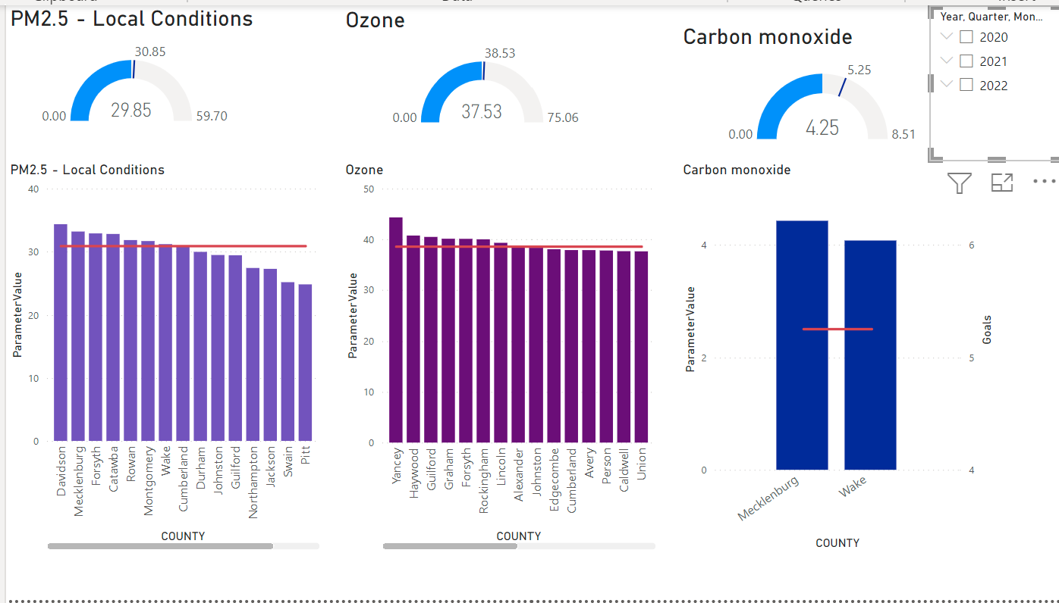
See Reports with Common Issues
Hard to tell the story with some visuals because there is so much going on in the page.
Notes:
Gartner analyst Doug Laney defined data growth challenges and opportunities as being three-dimensional, i.e. increasing volume (amount of data), velocity (speed of data in and out), and variety (range of data types and sources). Gartner, and now much of the industry, continue to use this "3Vs" model for describing big data.
Back in the day, we thought getting 3 megs of data was a big deal, but now it is almost overwhelming so it becomes more important to tell that story with visuals that make sense and help tell that story.
(Image Source: https://www.shutterstock.com/image-photo/help-needed-drowning-mans-hand-sea-126729563?src=YZo4g5pNUVnuH7SpoYua5g-1-10 purchased by Slalom 17.04)

Slide 5
Memory
Iconic Memory
Iconic memory
Short Term memory
Long Term
Memory
Can take large volumes of data
Lasts only a fraction of a second
99% of information discarded unless useful
Only “interesting data” is passed to Short Term Memory
© 2021 Microsoft. All rights reserved.
Notes:
Iconic memory is like a sieve under a faucet. Everything passes through unless it is worthy enough to stick – refer to the slide for the additional talking points
There are two strategies to make the iconic memory work (next slide)

Slide 6
Iconic Memory
Spark the Iconic Memory – Mute the background noise
Things that can distract
Bright colors all over the report
Thick borders every where
Grid lines
Too much precision with numbers
No highlights
© 2021 Microsoft. All rights reserved.
Notes:
Mute the background noise – remove all distractions
Highlight key items – No highlights are bad.
(Image Source: Slalom under contract with Microsoft)

Slide 7
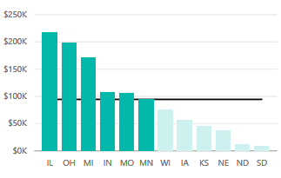
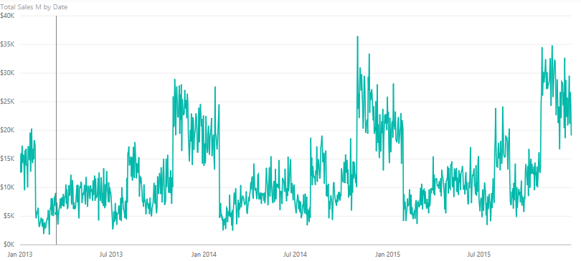
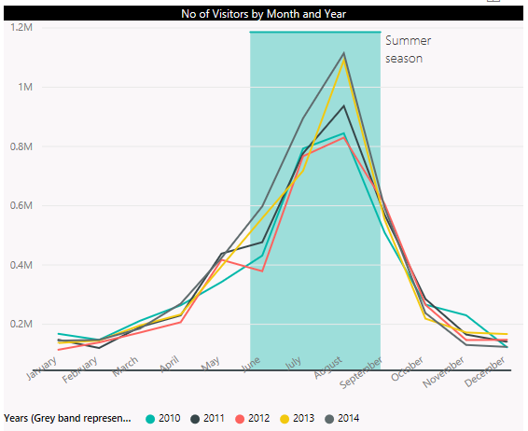
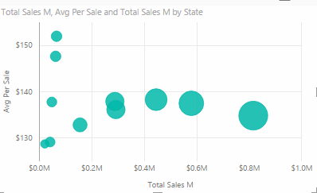

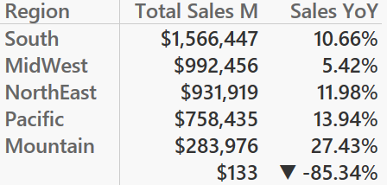
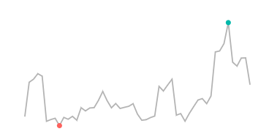
Iconic Memory
Spark the Iconic memory – Precognitive attributes
Very Precise Quantitative Perception: Length and 2D Positioning
Not Very Precise Quantitative Perception: Width, Size, Intensity, Blur
No Quantitative Perception = Orientation, Shape, Enclosure, Added Marks
© 2021 Microsoft. All rights reserved.
Notes:
Talk about what Pre-cognitive attributes mean
- Attributes that you recognize without paying thought to and interpret “intuitively”
Talk about how some of these attributes have quantitative encoding and how some do not
Tell that this is based on work done by Stephen Few
No Demo yet.
(Image Source: Slalom under contract with Microsoft)

Slide 8
Data Structure and Data Grain
Think Agile!!
Top 6 Questions to answer
Learn about your audience needs
Who? What? When? Where? How Many? Why?
Rapid
Prototype
Start Visuals with Sample Data
User feedback
Use Whiteboard or Storyboard
to plan POC
Build visuals in tool
User feedback
Notes:
Top Questions and YOUR STORY
This should be a whiteboard type exercise.
Have your data available handy if possible to even see if the visuals you want to come up with are possible and tell the right story. This process used to take a long time but with the technology of today, it can become a much faster way to prototype by working agile.
First learn your audiences needs (top 5 can be top 3-7) but what are the top questions that need to be answered. Do you need to know how many tickets are in red status, do you need to know how many customers are staying engaged and what type of social media are they using and for how long.
Get your top 5 questions and then find out what data you need to have to get these answered. Who has it, who do I need to get it from, can I get it today.
While I still have my stake holders in the room, use the whiteboard to scribble out the concept. What types of visuals like a tree map or a stacked column chart. Then take pictures of the white board and then when you get the first set of sample data into power bi, then start to create the visuals, Get back to your stake holders and show them the new visuals, with Power BI you can make changes right away.
And then as soon as you have your first initial pass at this is usually when you get access to your end data. Power BI is great at being able to map to the new data so you don’t have to break the visuals you created.
(Image Source: Slalom under contract with Microsoft)

Slide 9
Convert the Story to a Date Model
List your big questions:
What are my Environmental Numbers for a Selected Year and County?
How are my Environmental Numbers doing Year Over Year?
How are my Numbers trending for various counties?
How are my Numbers doing by Air Quality Measurement, County, Year, Month?
Which counties are performing best to worst by Air Quality Numbers ?
What are you measuring?
How are you describing or slicing?
© 2021 Microsoft. All rights reserved.
Notes:
Top Questions and YOUR STORY
Have students take notes or jot down THEIR top question
Have them parse out their MEASURES
Have them call out their Attributes
(Image Source: Slalom under contract with Microsoft)

Slide 10
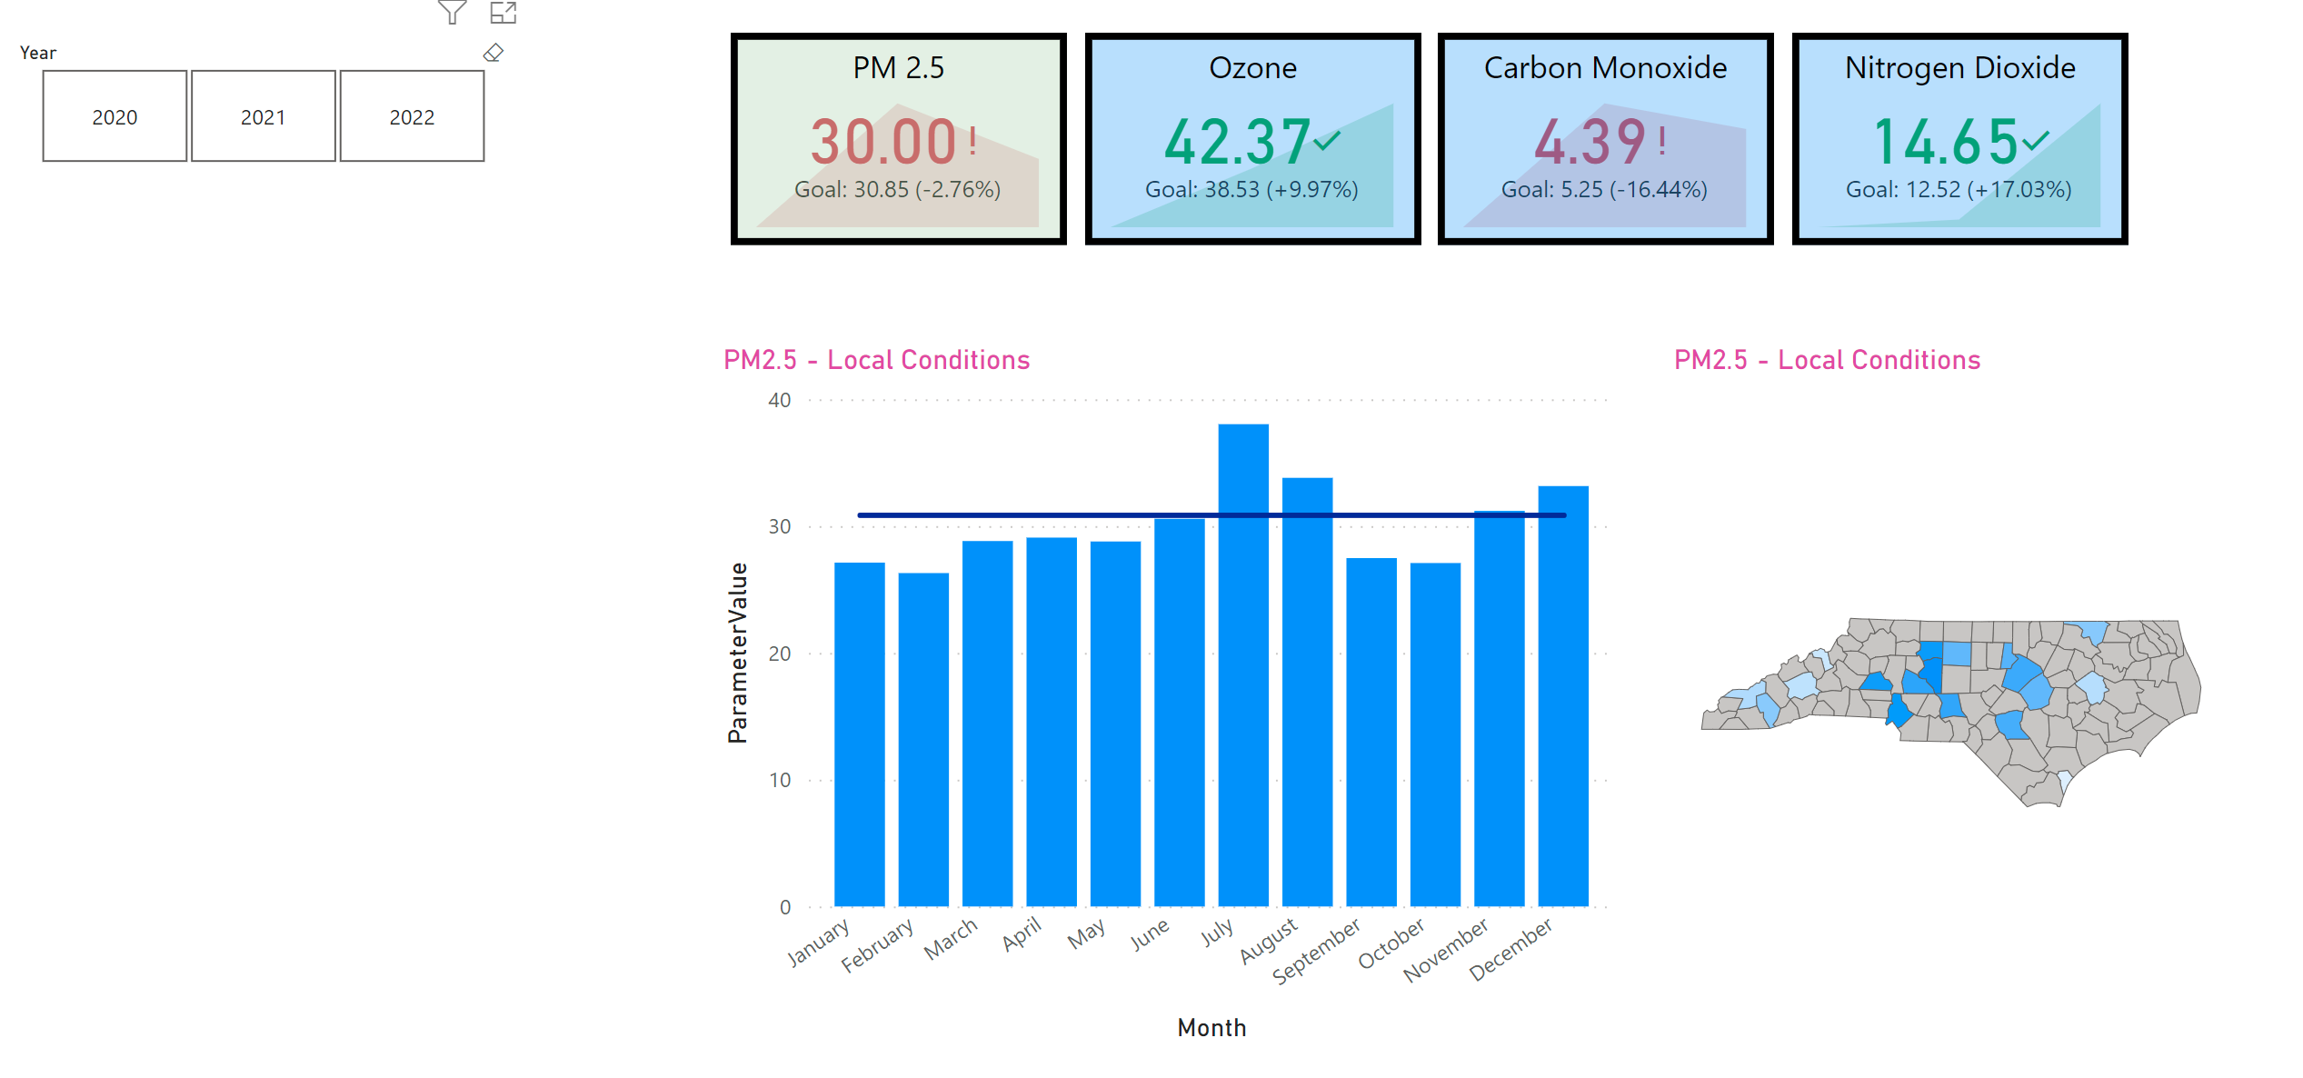
Create a Clean Layout with Details
Power BI Story Telling

Slide 11
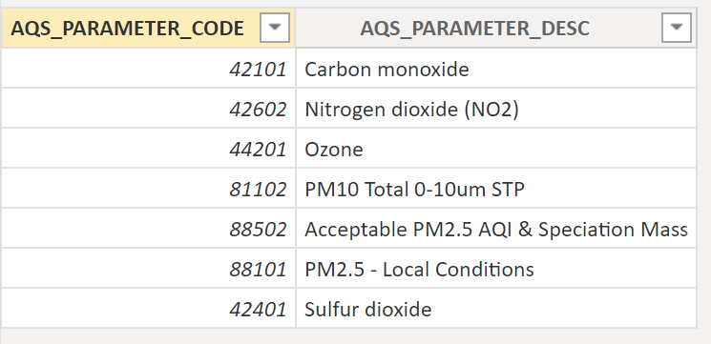
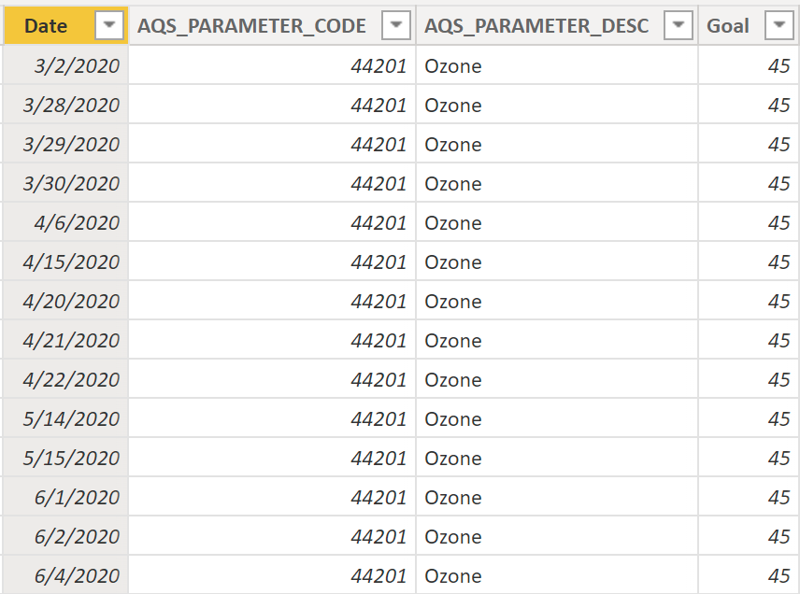
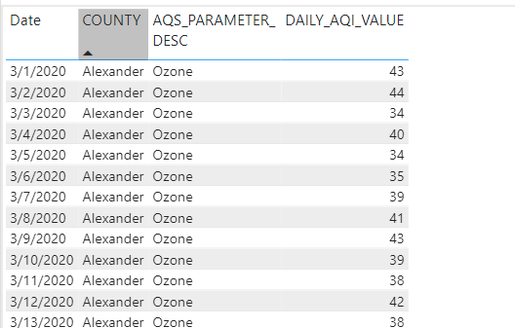
Demo
Create Report:
  Story Telling Report
Sample Data
  Environmental Parameters
  Target/Goals
  Facts/Data

Slide 12
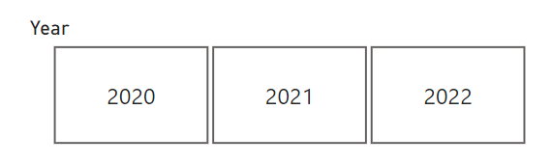
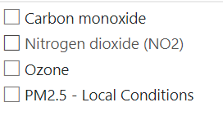
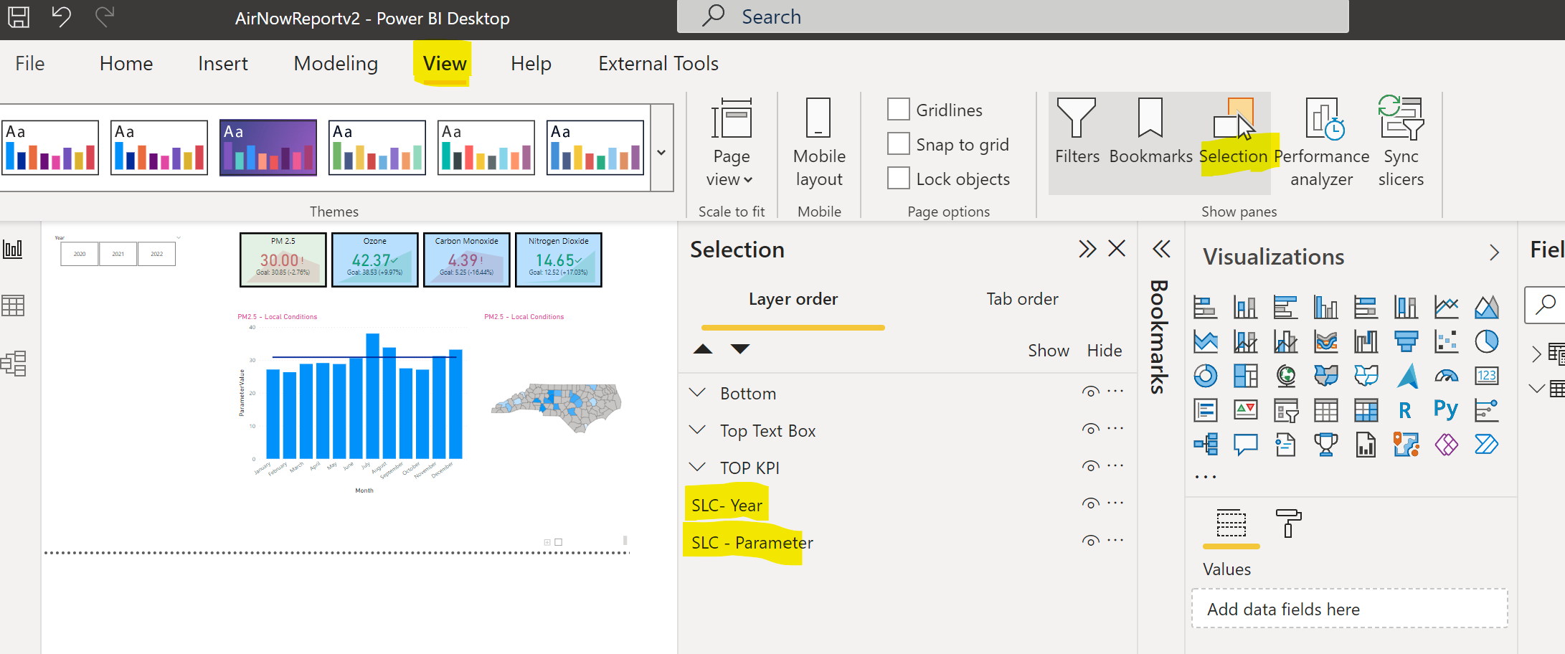
Demo Slicers
Slicers in Power BI - Power BI | Microsoft Docs – Horizontal
Filter Parameters
Name my Slicers

Slide 13
Create Measures
Goals = AVERAGE(Goals[Goal])
ParameterName = MIN(Parameters[AQS_PARAMETER_DESC])
  Demo return
ParameterValue = AVERAGE(Data[DAILY_AQI_VALUE])

Slide 14
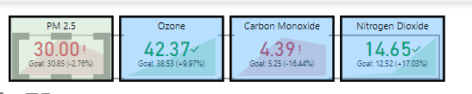
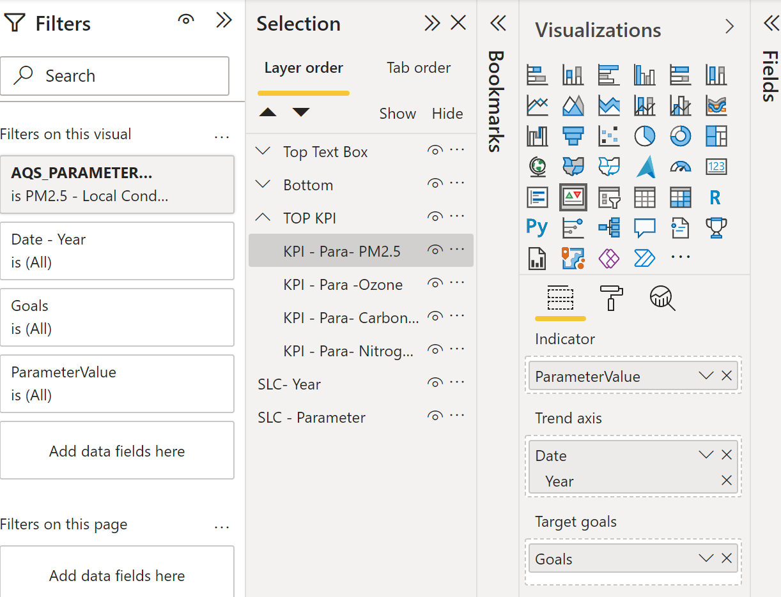
KPIs
Add KPI Viz
  Key Performance Indicator (KPI) visuals - Power BI | Microsoft Docs
Add Data Fields
Filter on One Parameter
  Format filters in Power BI reports - Power BI | Microsoft Docs
Turn off Cross Highlighting
  Change how visuals interact in a report - Power BI | Microsoft Docs
Name and Copy and Paste to create additional three KPIs
Group and Remove KPI Titles Plus Remove Background Color
  Use grouping in Power BI Desktop - Power BI | Microsoft Docs
Check Cross Highlighting

Slide 15
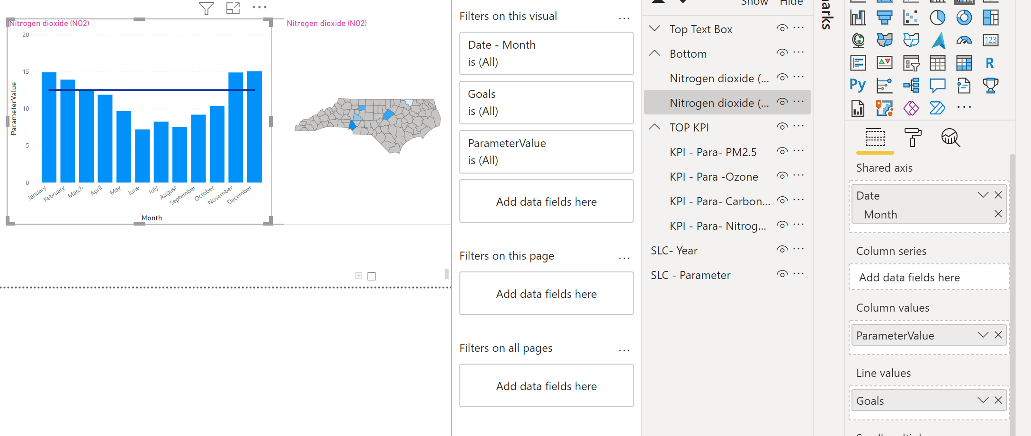
Create Chart and Map
Create Line/Cluster Viz
  Combo chart in Power BI - Power BI | Microsoft Docs
Change the Title to the Measure Parameter Name
Create Shape Map
  Use Shape maps in Power BI Desktop (Preview) - Power BI | Microsoft Docs
  TOPO JSON By State resource: topojson/countries/us-states at master · deldersveld/topojson · GitHub
Change Title of Shape Map
Group the NEW Charts

Slide 16
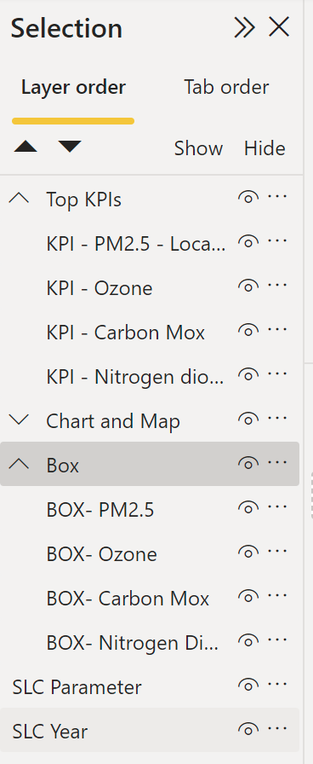
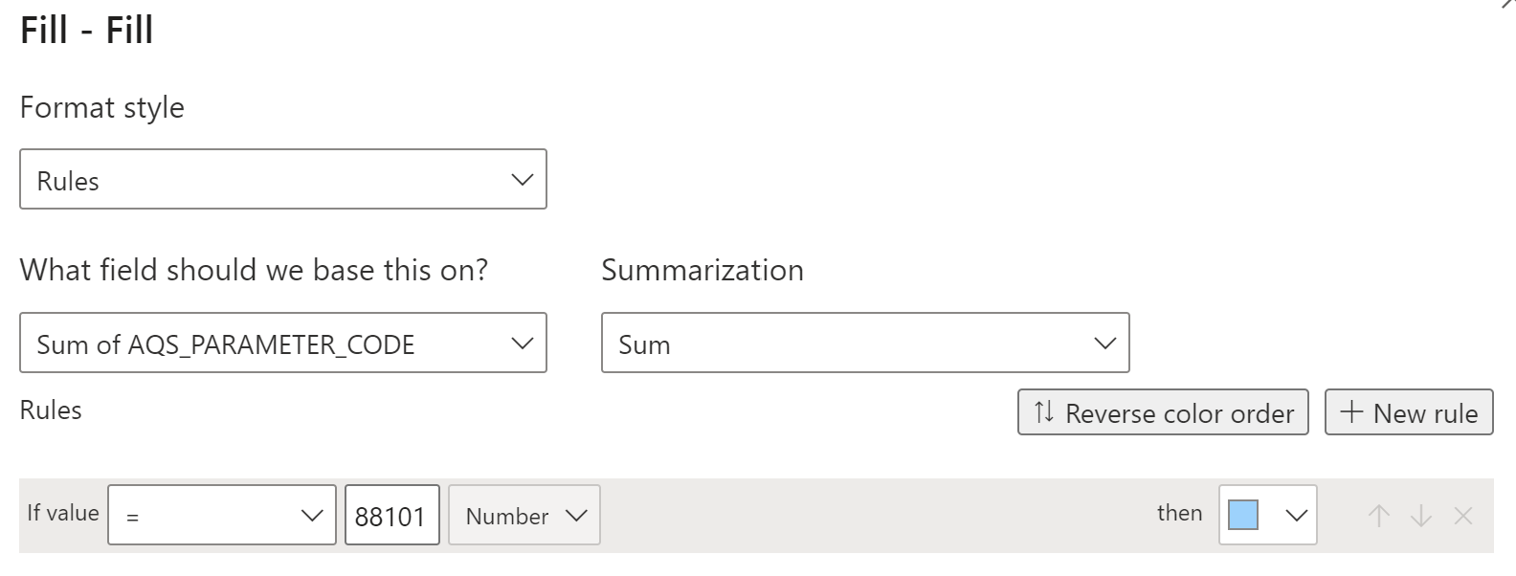
Need an ACTION BOX.. Shapes
Create a Shapes, Rectangle
Add Text for Box (Sz 12)
  Type the Parameter Name
Vertical Alignment
Name the Shape
  BOX- NAME
You want the box to be one color when ACTIVE and Another when NOT ACTIVE..
  Change the Fill and base it on a Rule
Move your BOX Over your KPI
Name your BOX
Create 3 more boxes
Create a group for Boxes

Slide 17
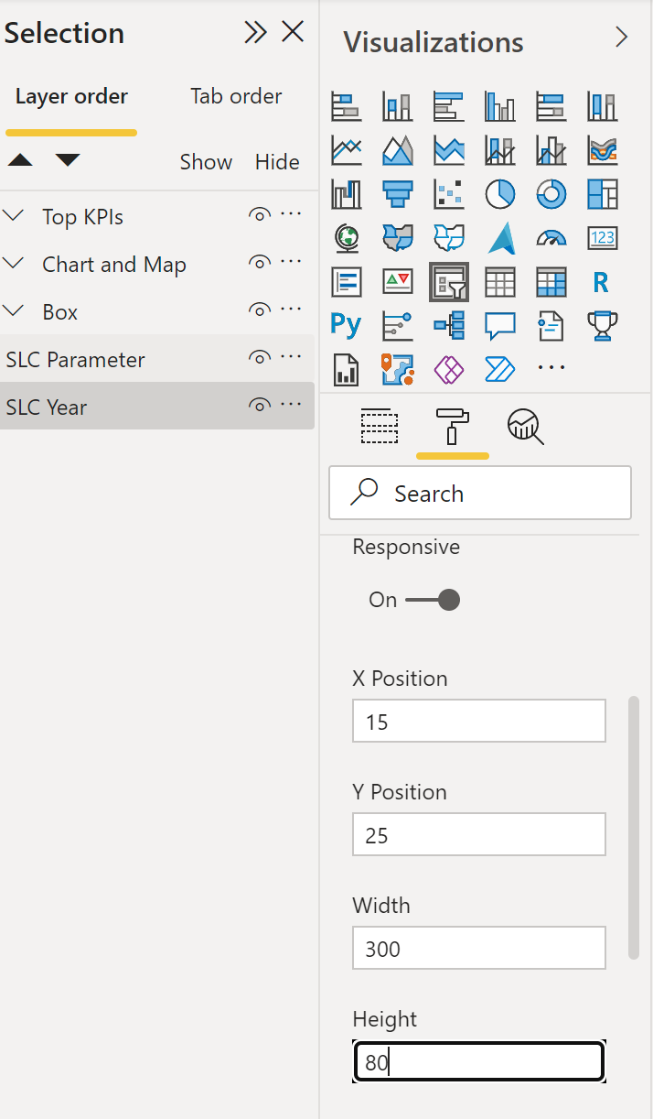
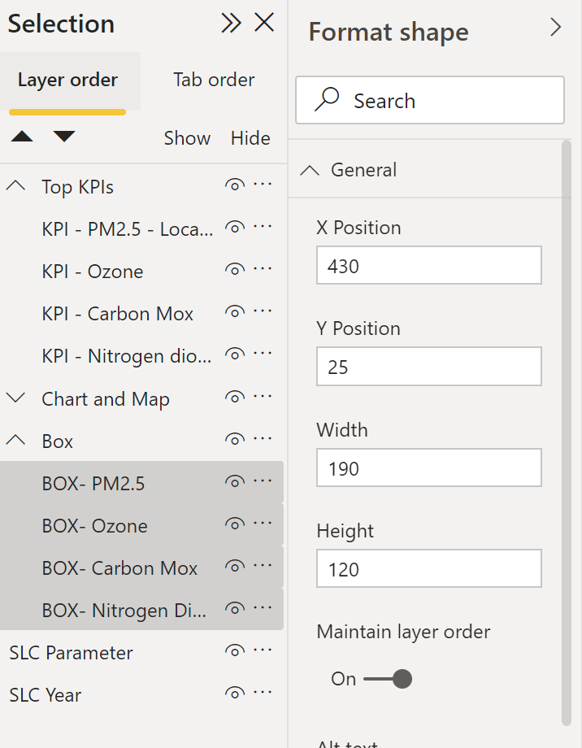
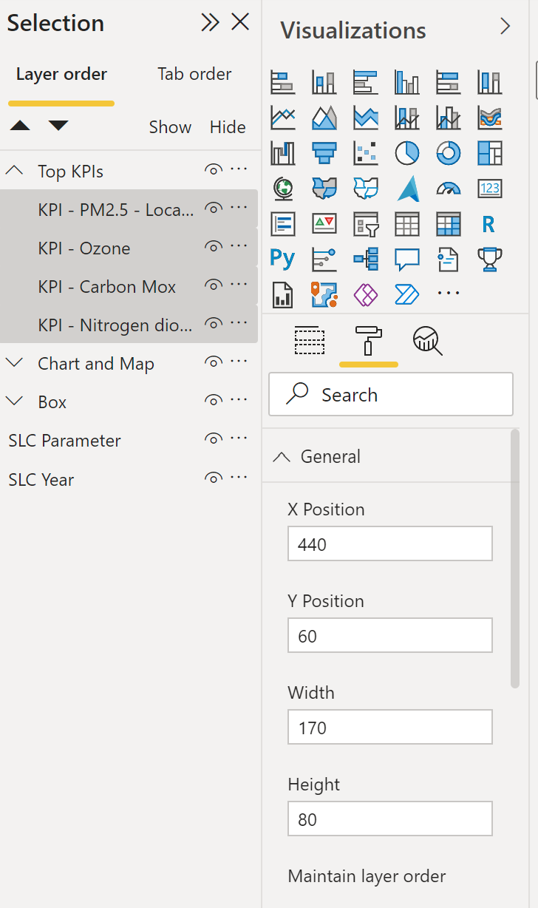
Time to Format our Report
Format Year Slicer (size, location, text)
Format All my Boxes
  Location and Size of Box
Format All KPIs
  Text Size, Location and Size pf KPI

Slide 18
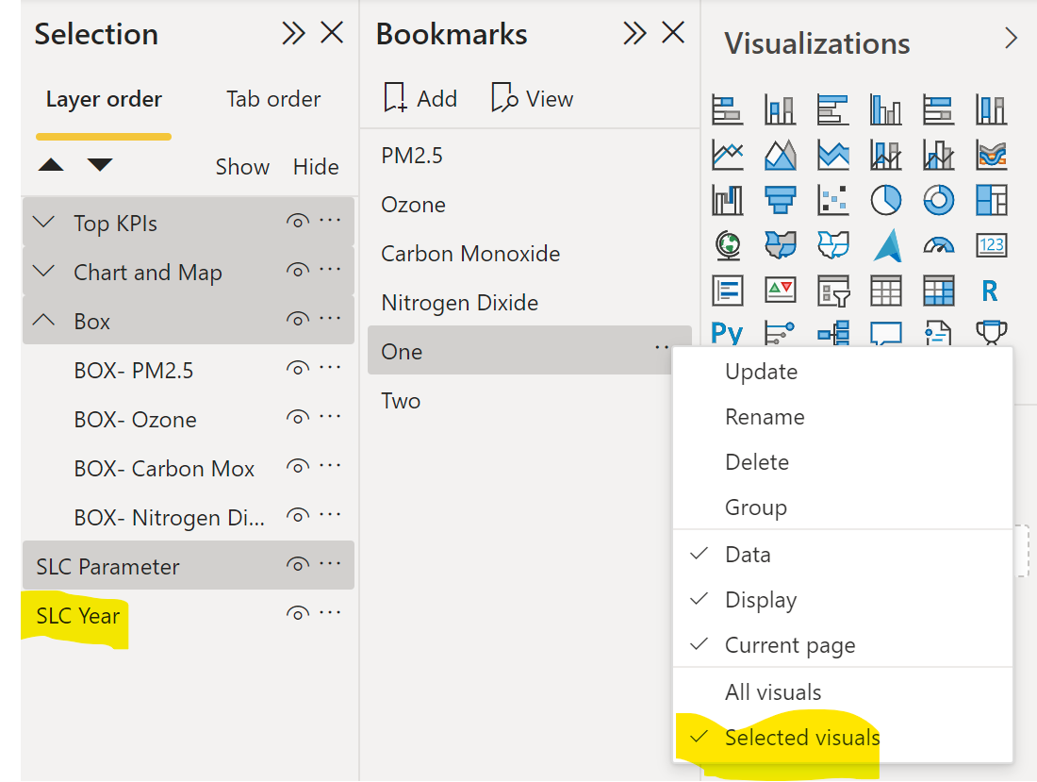
Bookmarks – Put ACTION into our Report
Create your Screen the way you want it then create the BOOKMARK
  Create report bookmarks in Power BI to share insights and build stories - Power BI | Microsoft Docs
Name your Bookmarks
Need to remove the change in Year
  Advanced Bookmarks and Buttons in Power BI for improved navigation (designmind.com)
Create Remaining Bookmarks

Slide 19
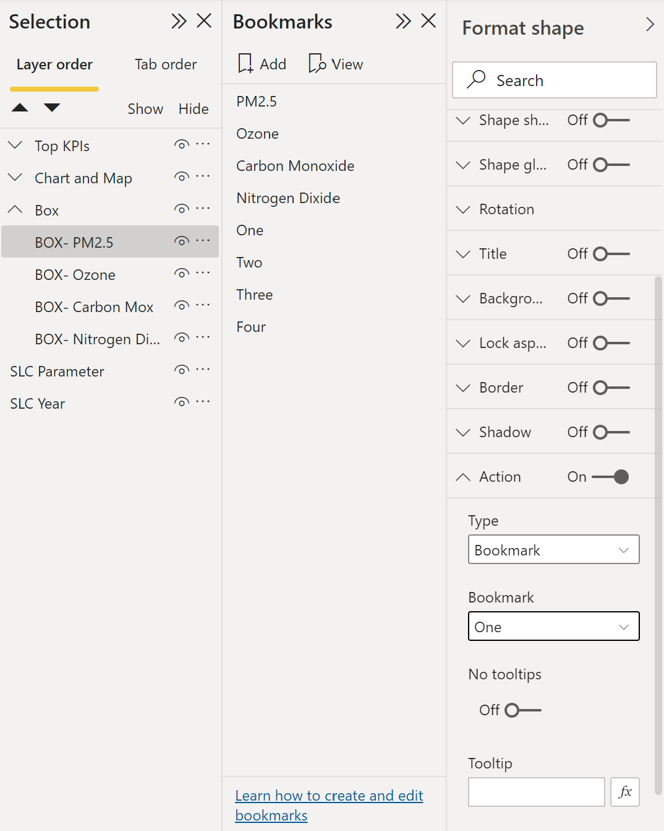
Bookmarks – Put ACTION into our Report
Assign the Bookmark Action to your Boxes

Slide 20
Thank You
Please Complete Survey: https://forms.office.com/r/9cJnWg75Di
Additional Slides for your review
What is Data Storytelling | Microsoft Power BI
Download Training Power BI Instructor Led Training | Microsoft Power BI
Introduction to Data Storytelling with Power BI – YouTube
Power BI Storytelling: A Practical Application by Meagan Longoria - YouTube

Slide 21
Power BI Support Resources
  Contact Support
  Report Errors, Issues – Support.PowerBI.com
  Resources
  Community.PowerBI.com – Community Forum
  Report Theme Gallery – A showcase for stunning report themes
  Data Stories Gallery – Get inspired with Data Stories by other Power BI users
  R-Visuals Gallery – Get inspired by others use of R for analyzing their data
  Store.office.com – Custom PBI visuals and R visuals you can download and use in your story
  Power BI Blog - weekly updates
  User Voice for Power BI – Vote on (or submit) your favorite new ideas for Power BI
  Issues.PowerBI.Com – log issues with the community
  Whitepaper - Creating an Enterprise Class Dashboard Solution with Power BI
  Guided Learning Self Service Power BI training
  DAX Formula Language – syntax for DAX
  DAX Patterns – Great website to learn new patterns for the DAX Language
  Power Query Formula Language – syntax for the “Query” language
  Paletton.com – a color scheme generator
  https://unicode-table.com/en/ – Unicode Character Table
  Theme Generator
  Contrast Analyzer: a tool that creates a “lens” to show how people with different visual disabilities might see your reports
  Charticulator: a tool that helps to build custom visuals
© 2021 Microsoft. All rights reserved.
Notes:
External Support Resources for Microsoft – Hide this slide for the internal version

Slide 22
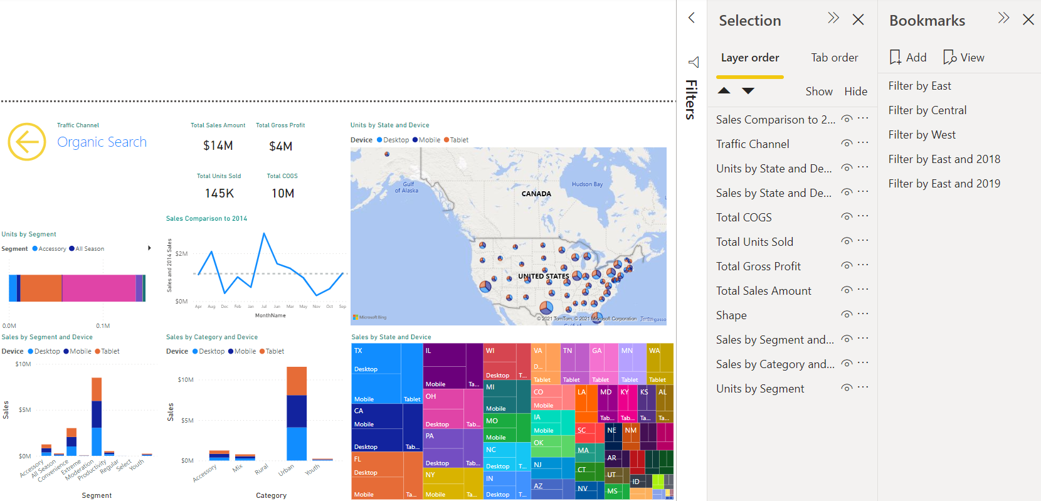
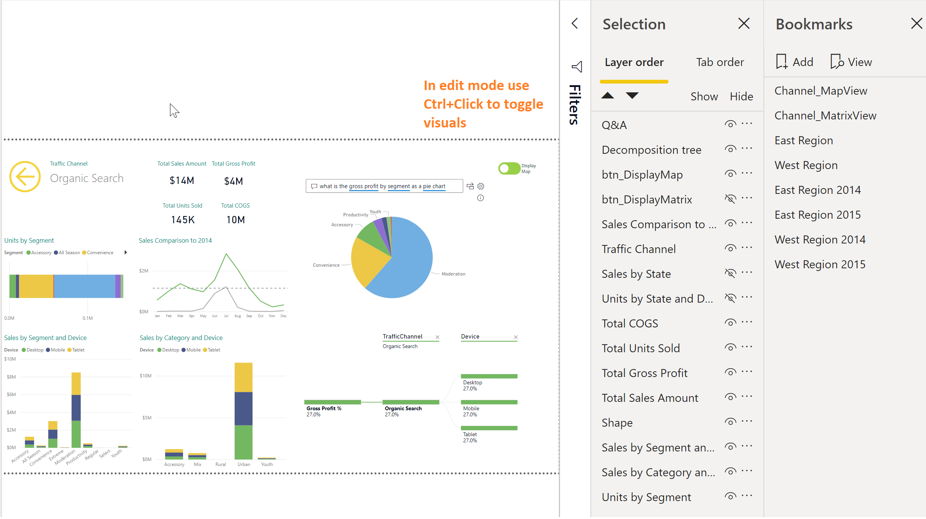

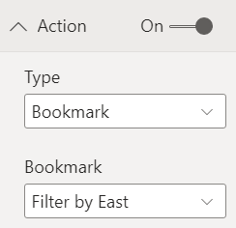
Report Channel – Bookmarks and Toggles
Bookmarks let you save interesting states as part of your report. Once you have a list of bookmarks, you can use these in several ways including organizing and transitioning visuals:
Includes the current page
Any filters and slicers selected
Sort Order
Which visuals should appear on the report
Use Selection pane to choose visuals for bookmarks
Manage Bookmarks on the Bookmark pane
  Add creates bookmark
  Update updates existing bookmark (…)
Assign bookmarks to images/shapes from the Format Pane – Link Section
  Turn link ON
  Type = Bookmark
  Assign Bookmark name
© 2021 Microsoft. All rights reserved.
Notes:
Demo:
Show how to turn on the Bookmark and Selection panes
Click between bookmarks to show how the page updates
Clicking on View in the Bookmarks pane enable user to see how bookmarks will appear in Service.
Use Imported images (or shapes) and assign them to the proper Bookmarks on the format pane
When using Toggles to link to Bookmarks, they should be the opposite bookmark for what the toggle is showing
You can also make your own back button by adding a shape or image to the report and turning on the Back button toggle

Slide 23
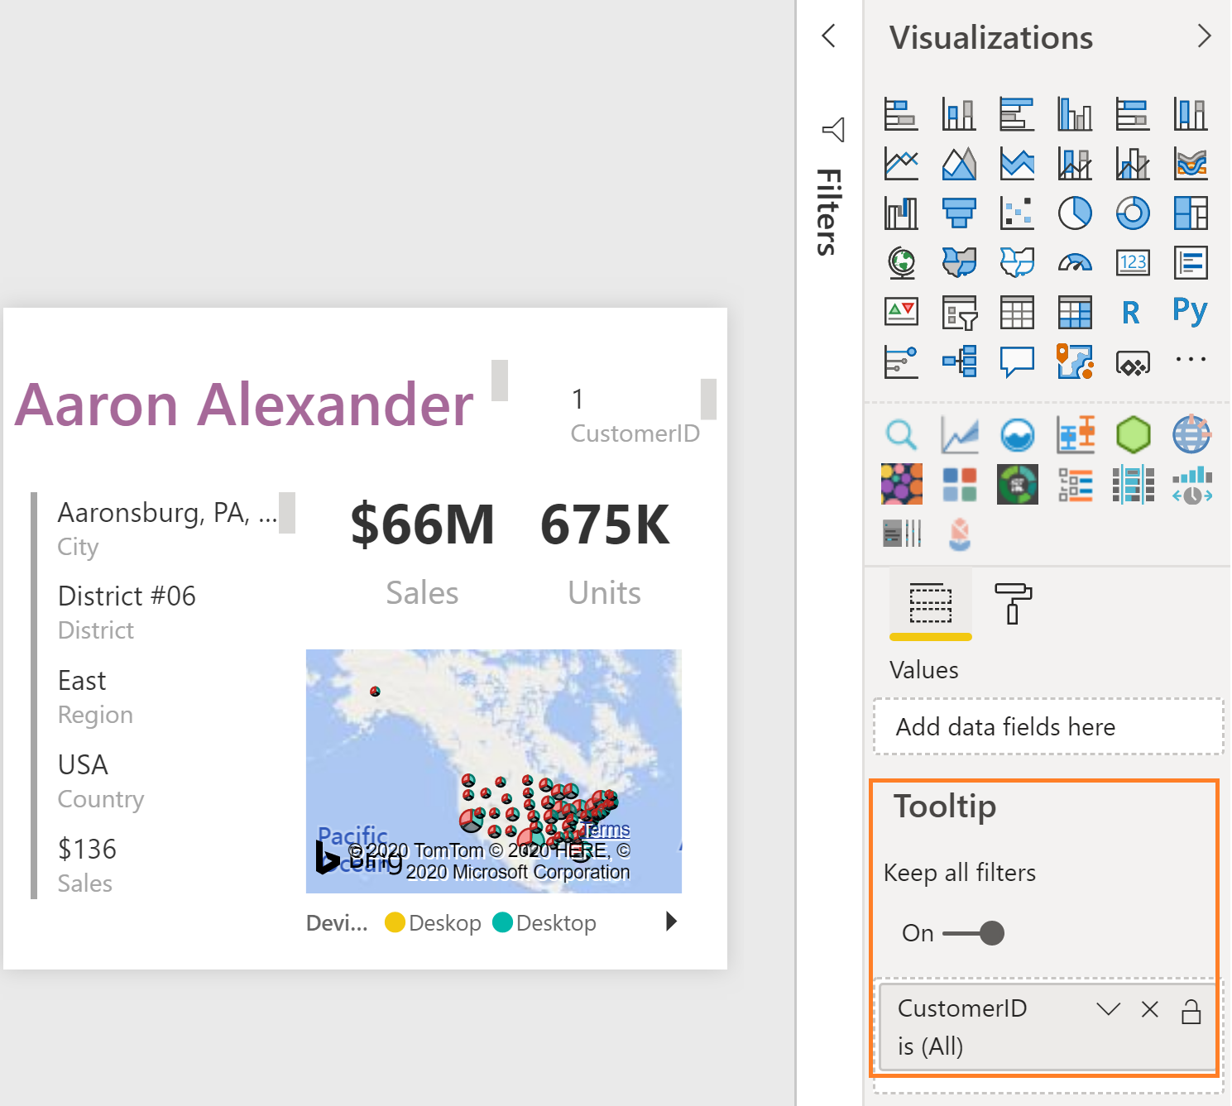
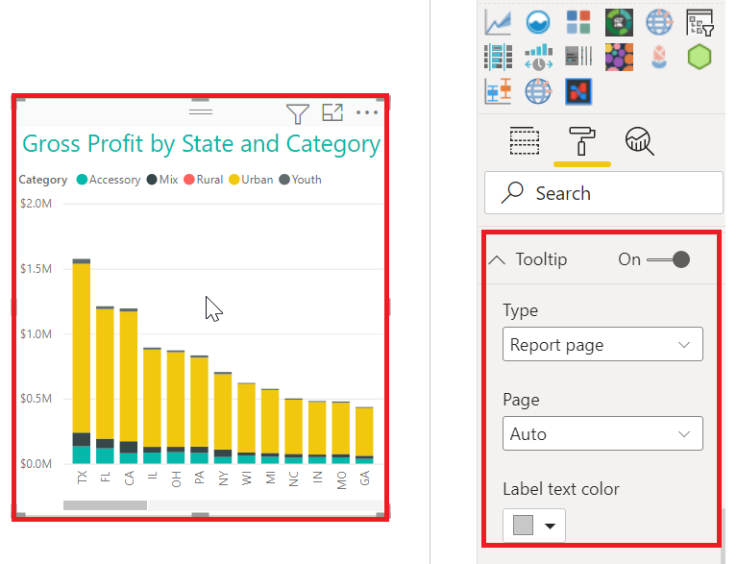
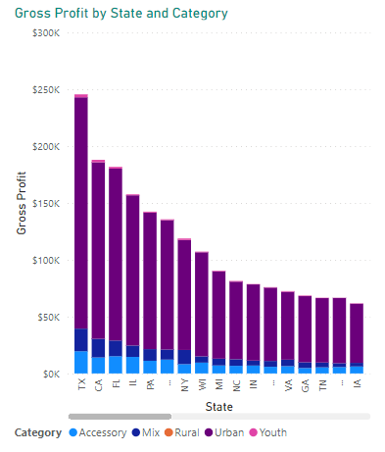
Create Custom Tooltip Report
Create a custom tooltip report for any field as a new page
Create the Tooltip Report
  Page Information – enable Tooltip
  Page Size – use Tooltip or set custom size
  View Ribbon, set Page View to Actual Size
  Place key Field in Tooltip Field Well
  Does not work with the Matrix or Table visual (yet)
Assign the Custom tooltip to each chart for which you want the tooltip to appear – the field must be visible on the chart
You can Hide the tooltip (or any other) report!
  Right click to hide
© 2021 Microsoft. All rights reserved.
Notes:
Big DEMO
Demo:
If Tooltips are still in PREVIEW – show class how to turn them on – and restart Desktop.
Hidden Report called Customer-ToolTip
The CustomerID field in the Tooltip well is what the report is based on
In ANY other chart with CustomerID displayed in the chart, you can set the Tooltip on the Format pane to the specific report.

Slide 24
Slicers vs Filters Pane
Slicers | Filters Pane
Visible on the report canvas | Does not take up room on the canvas
Can by synced across report pages | Good when list of values is large
Good for touch screens | More advanced options
Can edit interactions with slicers | Better for performance
Good when lists are limited | Good if the value is used infrequently
Good if the value is used frequently | Cannot be pinned to a dashboard
Good if value needs to be seen quickly
Can be pinned to a dashboard
© 2021 Microsoft. All rights reserved.
Notes:
Slicers
Display commonly-used or important filters on the report canvas for easier access.
Make it easier to see the current filtered state without having to open a drop-down list.
Filter out columns that are unneeded and hidden in the data tables.
Create more focused reports by putting slicers next to important visuals
Good when the list of values are limited
Can be pinned to a dashboard
Easy for the user to determine filters quickly
Good to use if the filter is used frequently
Filters
Does not take up valuable real estate on the report canvas
Good when list of values is large
More advanced options (Min, Max, TopN, etc.)
Better for performance
Good if filter is used infrequently
Cannot be pinned to a dashboard
https://guyinacube.com/2019/01/power-bi-slicers-vs-filters/

Slide 25
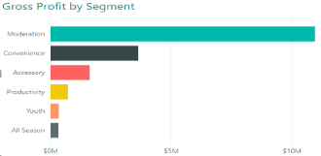
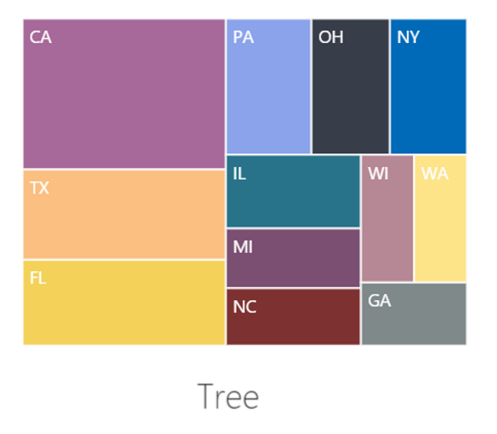
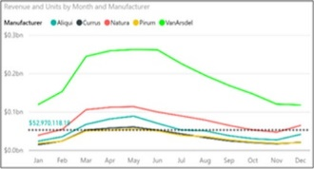
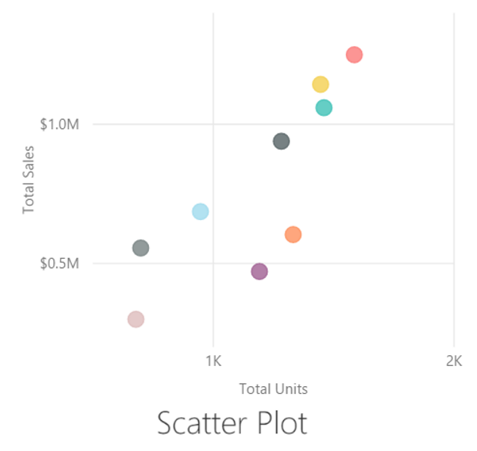

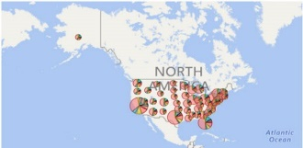
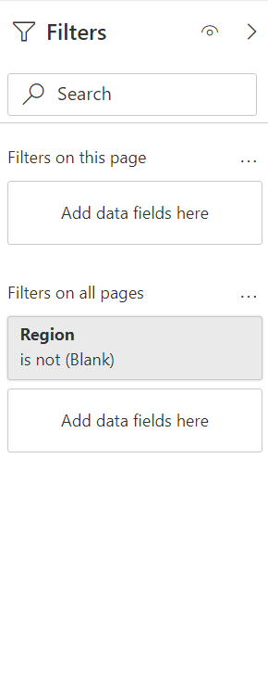
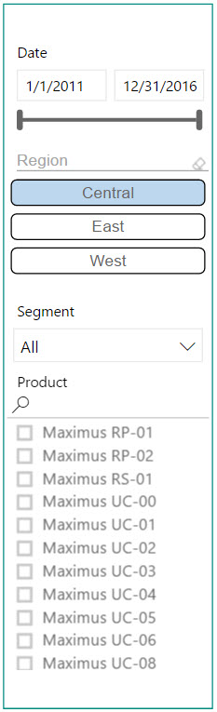
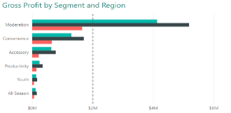
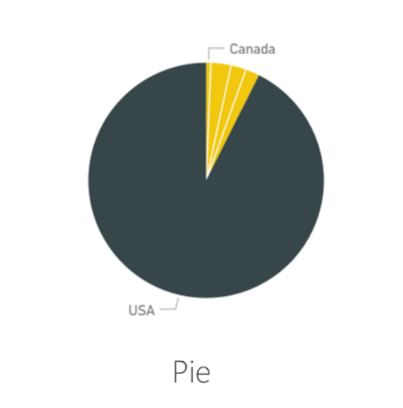
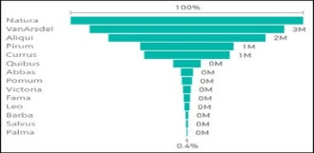
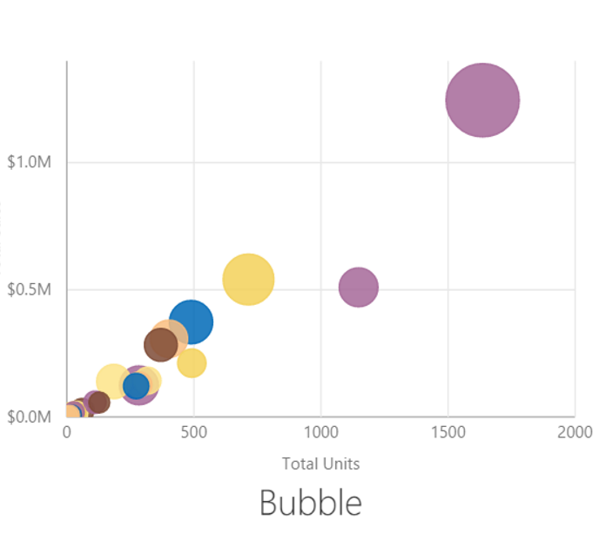

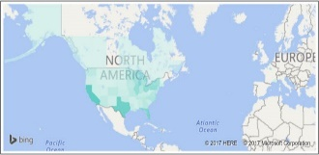

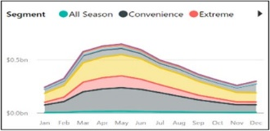
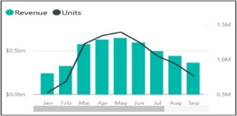

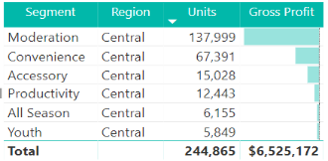
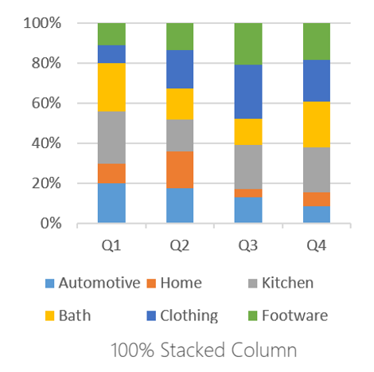
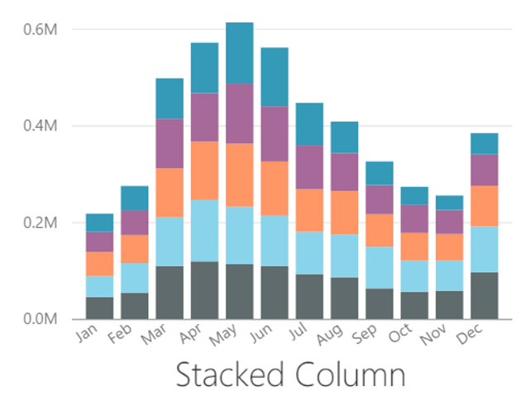
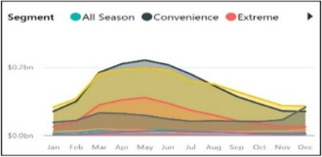
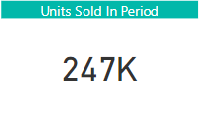
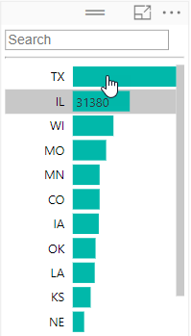


Choose the Right Charts for the Right Purpose
Comparison
Composition
Trend
Distribution
Status
Geographic
Relationships
Slicing/Filtering
Stacked Bar
Tree
Line
Scatter Plot
KPI
Map
Clustered Bar
Pie
Funnel
Bubble
Gauge
Filled Map
Clustered Column
Stacked Area
Line and Stacked Column
Map
Multi-row Card
Table
100% Stacked Column
Stacked Column
Area
Card
Matrix
Water Fall
Bubble
© 2021 Microsoft. All rights reserved.
Notes:
Optional for instructor to go through some scenarios and when to use which chart type.
(Image Source: Slalom under contract with Microsoft)

Slide 26








Column Charts for Comparison
Start Axis at 0
Sort Chart
Try to Have a Reference Line
Use colors to draw attention
© 2021 Microsoft. All rights reserved.
Notes:
Discuss the implications of each choice
1st column – adjust the height of the chart so min and max are closer together
2nd column – sort the bars asc or desc
3rd column – Add reference line or conditional formatting so it’s easier and quicker for the user to read

Slide 27


Column Chart vs Bar Chart for Comparison
When you have too many elements to display in a column, the bar chart can be easier to scroll.
© 2021 Microsoft. All rights reserved.
Notes:
Bar charts now have the ability to word wrap the Y axis which makes them even more powerful.

Slide 28


Line Charts
Start axis based on your “business scenario”
  Choose the right aspect ratio
  Try to have a reference line
  Use colors to draw attention strategically
Decide whether to “Show items with no data”
  Data can be misleading if the breaks are connected
  In the formatting pane, change the axis to categorical from continuous
© 2021 Microsoft. All rights reserved.
Notes:
One thing to keep in mind is the aspect ratio. If too short you exaggerate peaks too much, too long and the chart is too flat. Not too many lines or pieces of information otherwise the brain cannot really depict the different lines. If you want to Demo, in the Complete pbix go to the Traffic Channel tab, Toggle the Display Matrix so it shows the matrix and Drill thru on CustomerID 1 to see the No Data Line Chart

Slide 29



Area Chart vs Line Chart
Choose area charts sparingly (when # of series < 5)
Too many colors can be distracting
Often line charts are the better option
  Would a line chart better portray my meaning?
  Is the area the meaningful thing I am measuring?
© 2021 Microsoft. All rights reserved.
Notes:
Maybe a treemap might also be better than an area chart

Slide 30

Stacked Area Charts
Used to show how proportions and totals are changing
Choose this chart wisely
Can lead to misleading conclusions
The eye tends to interpret the trends using the top lines of each shaded region rather than using the area of each region
© 2021 Microsoft. All rights reserved.
Notes:
Showing how the burn down of certain goals is a good use of the Stacked Area Chart

Slide 31

One Use Case for Area Charts
To see when a trend goes above or below a reference line
© 2021 Microsoft. All rights reserved.
Notes:
Very similar to the burn down chart. This displays how a metric compares to a rolling trend.

Slide 32



Stacked vs Clustered Column (Bar) Chart Types
Shows totals
Shows part to whole relationship
Inter-category comparison
Intra-category comparison
Shows Mix% change
Ignore absolute numbers
© 2021 Microsoft. All rights reserved.
Notes:
Really important to be thinking about what the future of the report is? Will new categories be added later?
Know your story. If your overall totals of your data are the important item, then you want the stacked chart. If the breakdown itself is the most important thing, then a clustered chart might be better (but you lose the grand total).
The mixed ignores the absolute numbers. We wouldn’t use this if the East is better than the West because it will not show correctly.

Slide 33


Constructing Effective Tree Maps
Tree map is useful to visualize proportions
Use Drill down to allow navigation to detail
© 2021 Microsoft. All rights reserved.
Notes:
Top chart shows the details and then use a drill down when theY click into the details. Left most is the biggest and then smaller towards the bottom right corner.
Chart is on “Sales, Units Sold” tab

Slide 34



Constructing Effective Pie Charts
Do not have more than 3-5 categories (if you have more then put a slicer and choose a default)
Have data labels
Choose right sort order
Choose appropriate colors
Pie chart is widely used but is not a recommended visual because we can’t intuitively understand the segment size
Bad Pie chart
Good Pie chart
© 2021 Microsoft. All rights reserved.
Notes:
Top pie chart – Yeah…. Way too many categories. How can you differentiate and then the ratios are not in a continuous sort order.
The brain really enjoys the bottom pie chart better if you have to use a Pie Chart.

Slide 35



Constructing Effective Tables
Reduce precision
Use muted background color
Choose the right font size
Use white space for columns instead of borders
Highlight items using symbols
Sort table based on key KPIs
© 2021 Microsoft. All rights reserved.
Notes:
Talk about table best practices (no demo for this slide)
No distracting colors, borders, reduce precision
If you are showing numbers in the millions, you don’t need to show pennies
Don’t go crazy with too much formatting in the tile.

Slide 36



Constructing Effective Cards
Category labels can be renamed on each visual
Choose right precision levels
Use colors to draw attention to KPIs that matter most
Use KPIs in conjunction with symbols to draw attention
© 2021 Microsoft. All rights reserved.

Slide 37




Constructing Effective Slicers
Slicer
as List
Date slicer
Enclose slicers using a subtle box
Group slicers together and keep them on the same side of page
Conserve space by using dropdown slicers
Use “Chiclet Slicers” for a different look
When slicing dates, use the Date slicer
Numeric slicer
Chiclet
slicer
Chiclet
slicer
Slicers as
dropdown
© 2021 Microsoft. All rights reserved.
Notes:
Put all of your slicers together by overlaying a shape box with a clear fill. Usually a 1 point, and depending on your theme colors, maybe a light gray.
Key is to make sure to send it to the back so that all of your slicers are functional.
Chicklet Slicers are custom visuals that can be downloaded from the Custom Visual website.
Date range slicer is a great slicer as well
Home – Files, Options and Settings, Options, Preview Features – turn on Numeric Range Slicer
Drop the CustomerID field onto the canvas, change to Slicer
They cannot be used with Measures – only with numeric columns
In order to set a “default” value, make a selection in the Slicer

Slide 38

Constructing Scatterplot Charts
Used to see distributions of 2 or more variables
Use hierarchies
Helps to identify outliers
Useful for categorization or clustering
Time axis used to show changes over time
Choose colors wisely
© 2021 Microsoft. All rights reserved.

Slide 39
Colors
How do you pick a color scheme?
Check with your Marketing team for color/style guides
Use Cynthia Brewer’s Color Brewer or other sites to choose colorblind friendly colors
Use the Adobe Color Wheel to get custom complementary colors
Paletton.com is the color scheme generator that the Power BI product team uses
Colorblind Sensitive: Contrast Analyzer is a tool you can use that creates a “lens” to see how people with visual disabilities would view your reports: https://developer.paciellogroup.com/resources/contrastanalyser/
Use Power BI’s default color scheme
© 2021 Microsoft. All rights reserved.
Notes:
Demo these sites
There are some executives who are color blind and when presenting reports, they might be missing part of the story that other people are getting.

Slide 40



Things to Remember when Using Colors
Do not have more than 3-5 colors display on a single visual (think of Short-Term memory)
The eye cannot differentiate more than 5 colors of same hue
Try to have a semantic meaning for your colors (Red = Bad, Green = Good)
© 2021 Microsoft. All rights reserved.
Notes:
The chart on the left hand side looks like a wheel of fortune. It is too cluttered
The chart on the right hand side would be fine if the data was SEQUENTIAL, but it actually is QUALITATIVE, so the colors should be more distinct.
Also you don’t know the environment on which others will be viewing your visuals. In many training classes we host, the colors look great on our screens but through the LCD projector or the room size, the colors get washed out.

Slide 41



Make Your Own Theme
Theme files are simple JSON files
Import the theme into your PBIX to update styles in your report
  Color palette
  Font
  Visual formatting (and more…)
Check out pre-made themes in the Power BI Theme Gallery
Blog post on how to apply themes: https://powerbi.microsoft.com/en-us/blog/power-bi-community-report-theme-gallery/
Theme Generator: https://powerbi.tips/tools/report-theme-generator-v3/
© 2021 Microsoft. All rights reserved.
Notes:
Discuss the process to use a theme.
App to create Themes: this automatic theme generator
DEMO: Open Contrast Analyzer and then Theme Generator. Creating a Theme Generator lab.

Slide 42
Font
Two Font Types
Serif
Sans-Serif
Monospace
Informal
Monospace
Informal
Sans-Serif fonts most suited for digital media in a professional setting
Ex. Segoe, Calibri, Trebuchet
© 2021 Microsoft. All rights reserved.
Notes:
Serifs are the embellishments at the beginning or end of the stroke of a letter, like the “feet” on the I & F in Serif. A Sans-Serif (without serif) fond does not have these and are better for screens.
Monospace has to due with kerning (the left/right space a letter takes up). In the query editor, you can set the view to display in Monospace mode (all letters take up the same space) which can be helpful when parsing queries
What is the name of the Informal Font? (Comic Sans) When should you use it in a professional setting? (Never) Discuss use of proper formal fonts for Professional Dashboards and Reports

Slide 43
Changing Font Weight using three Techniques
Change font size
Hi Power BI - Segoe UI Light 28
Hi Power BI - Segoe UI Light 24
Choose different font with greater weight from same family
Hi Power BI - Segoe UI (Body) 24
Hi Power BI - Segoe UI Light 24
Bold an existing font
Hi Power BI - Segoe UI Light 24 (Bolded)
Hi Power BI - Segoe UI Light 24 (Non-Bolded)
Try all three techniques to see which one looks the best
© 2021 Microsoft. All rights reserved.
Notes:
Stephen Few showed us earlier that the thickness of a line can help spark short term memory so changing font to a thicker weight in the same family can help with emphasis.
Note, that italics are more for emphasis than size.

Slide 44
Font Recommendations
Choose at the most 2-3 font types/sizes on a report page/dashboard
  Choose a lighter weight font Ex. “Segoe UI Light” for
    Axis
  Non important Data Labels
  Text box
  Non-Titles
Use a higher weight font from same family for titles rather than (bold) Ex. Segoe UI Bold
© 2021 Microsoft. All rights reserved.

Slide 45

Use of Fonts
© 2021 Microsoft. All rights reserved.
Notes:
Discuss the use of consistent fonts and colors in this report
Continuity in the spacing helps naturally break up the visuals
(Image Source: Slalom under contract with Microsoft)

Slide 46

Icons
Effective use of icons can add to perceptual depth of a report
Don’t over use icons or misuse icons
© 2021 Microsoft. All rights reserved.
Notes:
In the picture above notice how the icon with chevrons stretches across multiple tiles. How do you do this?
Note to instructor: No need to actually build the big icon. Just drop hints
Step 1: Create the icons using Power Point
Step 2: For the icon to span across multiple tiles you need to know the right size in terms of pixels. How do you do this. In the next slide I have listed formulas that will help you calculate
(Image Source: Microsoft used with permission)

Slide 47

Dashboard Tile Art
Rectangle image size 1.81” by 2.66”
Add header text
Add subtitle text
Add circle shape for icon emphasis
Add icon from native Office 2016 Icon library
Change color of icon graphic
Snip out the box and save as PNG
Month to Date
MTD Actual vs MTD Goal
© 2021 Microsoft. All rights reserved.

Slide 48
Proportional Sizes for Custom Dashboard Tiles
1 x 1 Tile – 266:181 pixels
2 x 1 Tile – 540:181 pixels
3 x 1 Tile – 816:181 pixels
Rule of Thumb Formula:
Images Width = 266 * (Number of Tiles Wide)+ 8 (Number of Tiles Wide – 1)
Image Height = 181 * (Number of Tiles High)+ 8 (Number of Tiles High– 1)
Pro Tip: Tile sizes don’t have to be exact, just proportional (i.e. 2.66” by 1.81”)
© 2021 Microsoft. All rights reserved.
Notes:
Don’t worry about absolute pixels – each dashboard tile just needs to be proportional to the above.

Slide 49


Symbols
⇙
▼
⚠
➕
✔
⚐
★
◕
Different Ways to Use Symbols
  Unicode Symbols - You can find unicode symbols at Unicode-table.com or Unicode.org (need to convert hex to dec)
  (rendered in Black/White)
  Locate the web page for the desired symbol
  Scroll down to see the “Your Browser” section
  Highlight the symbol and copy ( Ctrl+C )
  Paste ( Ctrl+V ) into the formula bar of your DAX
© 2021 Microsoft. All rights reserved.
Notes:
Demo: Cards with MoM% calculation – add a second symbol to the > 0 (May & June 2016 show Neg)
If Unicode-table.com is down. Show the “Long way”: Open “Unicode.org/Charts” > Select Emoticon to see the chart. Open Excel and enter a Hex Code
Use formula =Hex2Dec(cell) to convert to Decimal then go into DAX and use =UNICHAR(128512) – for big smiley face

Slide 50

KPIs
Different Ways to Obtain/Use KPIs
  Use the KPI visualization in Power BI Desktop
  If you import an Excel data model with KPIs into Power BI Desktop, the KPIs will be maintained and render in color
  If you connect Power BI Desktop to either SSAS Multi-Dimensional or Tabular Model which contains KPIs, the KPIs will render in color in your visualizations
  In the Table Visual, use conditional formatting to set colors in a column then set the column width very small to only display the colors
© 2021 Microsoft. All rights reserved.
Notes:
DEMO: KPI Page – Show changing the Color Coding “High is Good” to “Low is Good”
Show Removing the goal/distance indicators

Slide 51

Report Layout Hacks
Can this be done in Power BI?
© 2021 Microsoft. All rights reserved.
Notes:
DEMO: Table with Sparks: Show in the product how all the visuals work together
There are actually multiple charts stacked onto of each other
Click on the matrix chart and move it down the page so it is no longer covering the other charts (students should start to understand the “stack hack”)
Hover your mouse over “VTB” to show how the column is very wide which creates white space
Hover over all of each chart that make up the Monthly VTB visuals to show that there are 6 visuals that make up this column (header and 5 column charts)
Each column chart has a “visual level filter” set to the corresponding segment value of the row in the matrix chart
Explain the VtB negative and VtB positive DAX Measures – and how they are mutually exclusive, and are based on the [VTB] Measure
Show Data Colors for the charts
Explain that you can make one chart, get it completely formatted then copy (CTRL+C) and paste (CTRL+V) to make the rest.
Explain the Daily Ave Sales column
Basically each is a line chart with three measures
Take the chart into “Focus Mode” to highlight that function
Explain the Avg Per Sale, MinPoint & MaxPoint DAX Measures (Explain how VAR sets the overall variable which is used in the RETURN)
Again, Each column chart has a “visual level filter” set to the corresponding segment value of the row in the matrix chart
Don’t forget to put a rectangle object from “Import Shapes” on top as a barrier which disallows sorting (set the line width to zero and turn off fill).

Slide 52


Bar Charts as KPIs
You can do the same with Pie Charts
© 2021 Microsoft. All rights reserved.
Notes:
Demo: KPIs Page

Slide 53



Spark Lines
Spark line with Min, Max
YoY growth with +/-
Win loss charts
How do you create these with Power BI?
© 2021 Microsoft. All rights reserved.
Notes:
Sparklines shown with Original Table (Table with Sparks)
To create the middle graph
Drop a vertical Stacked Bar Chart onto the canvas
Add MonthNo to the Axis
Now, let’s create new measures to use in the graph:
Search for the VTB Negative measure in the Fields list
Highlight and copy the formula from the Formula Bar
Create a new measure titled [VTB Negative$]
Paste the formula in the Formula Bar
Replace 1 with [VTB] and enter
Repeat steps 1 – 5 to create a new VTB Positive$ measure
Add VTB Negative$ and VTB Positive$ as values in the graph
Create a Chiclet Slice for Year
Select 2015 as the year since it contains a negative value
Turn off the X-axis
Turn off the Y-axis
Turn off the Legend
Set data colors

Slide 54


Hyperlinks and Images
Full path of the URL in a field
Modify the Data Category (modeling ribbon)
  ImageURL – to see image
  WebURL – to link symbol
Supports all link types displayed at left.
How do you create these with Power BI?
© 2021 Microsoft. All rights reserved.
Notes:
Demo: Cards Tab – Table with URL
For the Hyperlink, the field WebURL has the Data Category set to “WebURL”
For the Images, the field Full URL has the Data Category set to “ImageURL”

Slide 55
Power BI Reports - Design Thought Process
1. Empathize with your audience
1
2
3
4
5
Demographics - who are your users
Roles - what do the users want to achieve
Platforms - what is the consumption experience
Goals - what are the questions users want to answer
Experience - how do users explore the data
Pain points - what is the users main frustration

Slide 56
Power BI Reports - Design Thought Process
2. Define the platform environment
1
2
3
4
5
Service - Microsoft cloud-based app
Mobile – will users be accessing through mobile
Embedded - app development
Publish to web - blogs, websites, emails and social media
Paginated Reports - printing and electronic format
Mixed reality - augmented reality and mixed reality
2

Slide 57
Power BI Reports - Design Thought Process
3. Encompass the user experience
1
2
3
4
5
Information architecture - groups, labels and findability
Interaction design - what do you want the users to do next
Ethical design - accessibility and security
User journey - report navigation and visual interaction
Benchmarking - competitors and inspirational resources
3

Slide 58
Power BI Reports - Design Thought Process
4. Visualize your data
1
2
3
4
5
Data management - power query, SQL, PBI data flow
Measures – DAX
Data visualization - accurate, insightful, scalable
Interactivity - visual interactions, slicers and filters
Capabilities - conditional formatting, labels, axes, etc.
Features - bookmarks, tooltips, drill-mode, etc.
4

Slide 59
Power BI Reports - Design Thought Process
5. Test and implement
1
2
3
4
5
Functional testing - data, functionality, interactivity
System testing - performance, governance, platform
Acceptance testing - end to end, regression
Implementation
5

Slide 60
Original Report
© 2021 Microsoft. All rights reserved.
Notes:
Now that we have talked layout, charts, font, etc. let’s put everything together with this sample
This is how the original report looks with visuals that are not aligned. There is a report background that makes it hard to see a few visuals. Feels like there is no connection between visuals. There is no flow to the report.

Slide 61
Original Report
MAIN KPIs
KPIs DETAILS
SSA TIER 2
INDICATORS
PROPORTIONS
© 2021 Microsoft. All rights reserved.
Notes:
As discussed earlier, create a layout first

Slide 62







Chart Selection
© 2021 Microsoft. All rights reserved.
Notes:
Chart selection is key. We have already reviewed best practices for chart selection. Review the same.
If we start with blank report – update screenshot

Slide 63

Report Alignment
SSA TIER 2
MAIN KPIs
KPIs DETAILS
INDICATORS
PROPORTIONS
© 2021 Microsoft. All rights reserved.
Notes:
Make sure things align/line up. Various options available to achieve this – grid lines, smart lines.
You can use the X and Y coordinates for each visual to align visuals

Slide 64


Branding/Targeting
FLEXIBLE LOGO
MAIN COLOR
© 2021 Microsoft. All rights reserved.
Notes:
Next step is branding. Branding is not just the logo - make sure to pick your company colors
Reach out to marketing team – maybe there is gridlines available. Secondary colors, logos, where to add header

Slide 65

Color Selection
© 2021 Microsoft. All rights reserved.
Notes:
Pick your company colors and contrasting colors. Using themes feature is helpful here
When picking colors, think about accessibility (Color contrast)
Other things to consider for accessible reports – Alt tab

Slide 66

Background Color
© 2021 Microsoft. All rights reserved.
Notes:
Set the page background and wallpaper

Slide 67
Text Selection
Font
Segoe UI
8
9
14
30
Types
Normal
Bold
© 2021 Microsoft. All rights reserved.
Notes:
Format font type. This is usually ignored.
Headers a little bigger compared to visual headers. This is intentional

Slide 68
Report Optimization – High Level
Visuals generate queries against source data
Minimum of 1 query per visual
Queries are sent in parallel
Inappropriate use of visuals/slicers can generate a very large amount of queries and slow things down
Goals
Reduce number and complexity of queries
Reduce amount of data being returned to report
© 2021 Microsoft. All rights reserved.
Notes:
Use Performance Analyzer to understand impact of visuals and figure out which/how many visuals makes sense for your use case
Shapes/buttons/text boxes all take time to load and might impact report performance
Tooltip takes more time to load compared to drill down or drill through
Other features that might take time to load are – What If, Conditional Formatting. So make sure to use performance analyzer

Slide 69

Performance Analyzer
Using Performance Analyzer:
You will know how each of your report elements, such as visuals and DAX formulas, are performing
You can see and record logs that measure how each of your report elements performs when users interact with them, and which aspects of their performance are most (or least) resource intensive
© 2021 Microsoft. All rights reserved.
Notes:
https://docs.microsoft.com/en-us/power-bi/desktop-performance-analyzer

Slide 70
Be Careful with Custom Visuals, Test Performance
Scenario
Custom visuals can be poorly optimized
Why is it undesired?
Can be the slowest visuals, dragging down the user experience
Proposed solutions
Replace with built in visuals, or use certified custom visuals
Test custom visual performance in isolation then compare
© 2021 Microsoft. All rights reserved.
Notes:
*Custom visuals may not be easy to format – depends on the visual. Make sure to test it works for your use-case.
Some custom visuals may not work in service
Themes may not work with all custom visuals
Make sure custom visuals meet your use-case and adds value to your report
Organizational custom visuals are visuals approved by your organization. These should be the visuals you can look at before look at market place
https://charticulator.com/ - let’s you build a custom visual

Slide 71
Filters vs Slicers
Scenario
Slicers in a report contains thousands of values
Why is it undesired?
High memory load, especially with multiple interacting slicers. Slicers issue two queries (populate, fetch selection details)
Proposed solutions
Use filter instead of slicer, or to force context and limit values
Restructure to provide drillthrough to detail
© 2021 Microsoft. All rights reserved.
Notes:
Favor using filters over slicers. Filters provide better performance

Slide 72
Use Slicer Selection Defaults
Scenario
Unfiltered visuals contain a high number of values
Why is it undesired?
High memory load, more data to fetch and process
Proposed solutions
Set default value and set the single/multi-select property
Restructure to provide drillthrough to detail
© 2021 Microsoft. All rights reserved.

Slide 73
Use Synced Slicers with Care
Scenario
Report with many pages, many visuals and synced slicers
Why is it undesired?
Higher memory load and more queries
Proposed solutions
Use filter instead of slicer, or to force context and limit values
Restructure to provide drillthrough to detail
© 2021 Microsoft. All rights reserved.

Slide 74

Use Query Reduction Features
Scenario
Previously discussed high number of visuals/slicers
Why is it desired?
Lower memory load, less data to fetch and process
Proposed solutions
Consider no cross-highlighting
and adding Apply buttons to
slicers and filers
© 2021 Microsoft. All rights reserved.

Slide 75

Avoid Intensive Data Export
Scenario
Table visual containing many fields and complex measures
Users export detail data
Why is it undesired?
Leaf level queries are expensive and can consume a lot of memory, especially for large models
Proposed solution
Limit export at design time
© 2021 Microsoft. All rights reserved.
Notes:
Think about optimizing DAX or reducing the number of measures in the visual (table/matrix)
By default user can export summarized or default.
If data point is derived from a large fact table and if user exports detailed data, it leads to performance issues. Especially if multiple users are downloading at the same time. E.g. month end reporting
This is more of an issue in Premium, Typically is Shared there is back up capacity so may not happen often

