Slide 1
Power BI
Innovators in Accessibility
Cyrus Christian
Intelligence Technical Specialist – State and Local Government cychrist@microsoft.com
Danni Olson
Intelligence Technical Specialist – State and Local Government dannio@microsoft.com
Making our world more inclusive
Notes:
We at Microsoft have learned a lot on our accessibility journey and would like to help with yours. Building accessibility into everything we do helps us empower people of all abilities to achieve and do more. We have an opportunity and responsibility to create inclusive technology, including Power BI.

Slide 2

Accessibility is a responsibility
1+ billion
But only
1in10
have access to the
products needed
people have disabilities, many of whom need assistive technology
and
disability can affect any
of us at any time
of disabilities are invisible, so you don’t always know what maybe a challenge for those around you
70%
“We will focus on designing and building products that our customers love and that are accessible to everyone and built for each of us.” - Satya Nadella
Notes:
A few stats to share of why this is so important and why it’s so important to Microsoft to build products that are accessible to everyone. There over are 1 billion people in the world who have disabilities, many of whom need assistive technology. But only 1 in 10 have access to the products needed, and this means many of them can't fully participate. Accessible technology can allow them to fully participate whether that be a temporary or permanent disability such as vision impairment or arm injury. Also, it's important to know that 70% of disability is invisible, so you don't always know what may be a challenge for those around you.
In a 2004 Forrester study, they found that 57% of current working-age computer users may benefit from accessible technology because of mild to severe vision, hearing, dexterity, speech and cognitive difficulties. As the U.S. population continues to age, the number of people who experience these impairments will increase, and more people will likely turn to accessible technology to mitigate the effects of their changing physical abilities.
In the U.S., the unemployment rate for people with disabilities is double that of people without. And this has not substantially changed in the last 30 years since the establishment of the Americans with Disabilities Act (ADA). And the unemployment rate for with an Autism Spectrum Disorder is around 80 percent. This is a huge untapped talent pool.
And finally, remember that disability – whether temporary, situational, or permanent - is something that can affect any of us, or someone we love, at any time.
-------------------------------------------------------------------------------------------
Source: World Health Organization
http://www.who.int/phi/implementation/assistive_technology/2206_infographic.pdf?ua=1
https://news.microsoft.com/2004/02/02/new-research-study-shows-57-percent-of-adult-computer-users-can-benefit-from-accessible-technology/
https://invisibledisabilities.org/what-is-an-invisible-disability/

Slide 3
Accessibility standards
Web Content Accessibility Guidelines (WCAG) 2.1 help make web content accessible to people with disabilities. The following are key principles of the guidelines:
  Perceivable. Information and user interface components must be presentable to users in ways they can perceive.
  Operable. User interface components and navigation must be operable.
  Understandable. Information and the operation of user interface must be understandable.
US Section 508 - standard that requires governments and federal agencies to make their electronic and information technology accessible to people with disabilities.
Microsoft Accessibility Conformance Reports - Microsoft Industry Blogs

Slide 4
ADA vs Section 508 vs WCAG
ACCESSIBILITY STANDARDS
SUMMARY | ADA | 508 | WCAG
What Is It? | A civil rights law that prohibits the discrimination of people with disabilities in all areas of life, including when using electronic and information technology. | A federal law that requires federal agencies to maintain and use information and communications technology that people with disabilities can use. | An ISO standard set of guidelines for creating an accessible website for people with disabilities.
Who Is Affected? | Local governments, State governments, Nonprofits, Businesses | Federal agencies, Federal departments | N/A
How Is Non-Compliance Handled? | $55,000-$75,000 for first-time violation, $150,000 for repeat violations, Revoked funding if federally funded | Formal complaints, Civil lawsuits | N/A
How Are They Different? | Applies to the public and private sector | Applies only to federal agencies and departments | Serves as a reference for ADA or 508 website compliance
How Do I Make My Website Compliant? | Create an ADA-compliant website using WCAG guidelines in-house, Use ADA-compliant web design services, Install an ADA compliance plugin (if using a WordPress site) | Use WCAG to build a 508-compliant website in-house, Hire a web design agency to create a 508-compliant website | N/A
ADA protects the civil rights of persons with disabilities participating in interstate commerce; whereas Section 508 is a set of regulations related to access to Government ICT.
508 compliance provides accessibility for digitally published material within government agencies and entities.
ADA standards apply broadly to society, commerce, and government as a whole.
Table taken from https://www.webfx.com/web-design/learn/ada-vs-508-compliance

Slide 5
Types of Accessibility Features
Built-in accessibility features (no configuration required)
Keyboard navigation
Screen-reader compatibility
High contrast color view
Focus mode
Show data table
Built-in accessibility features (configuration required)
Alt text
Tab order
Titles & labels
Markers
Report themes

Slide 6
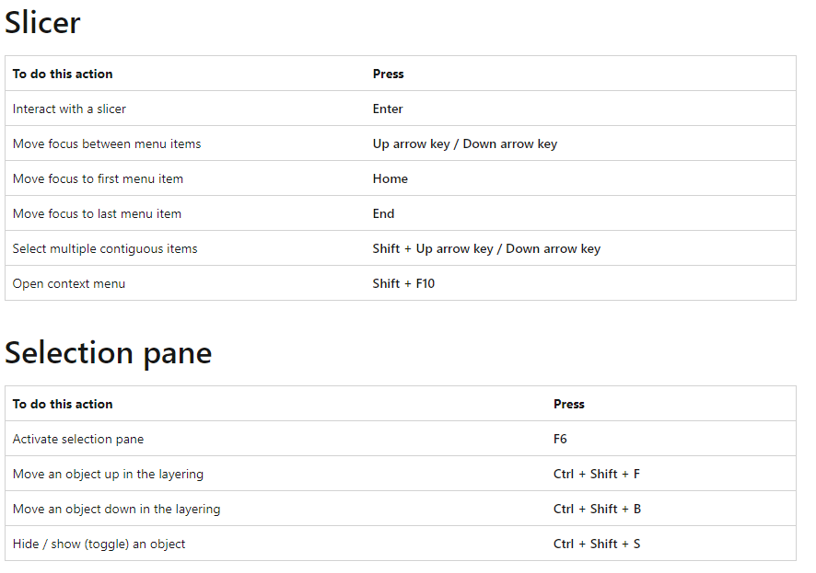
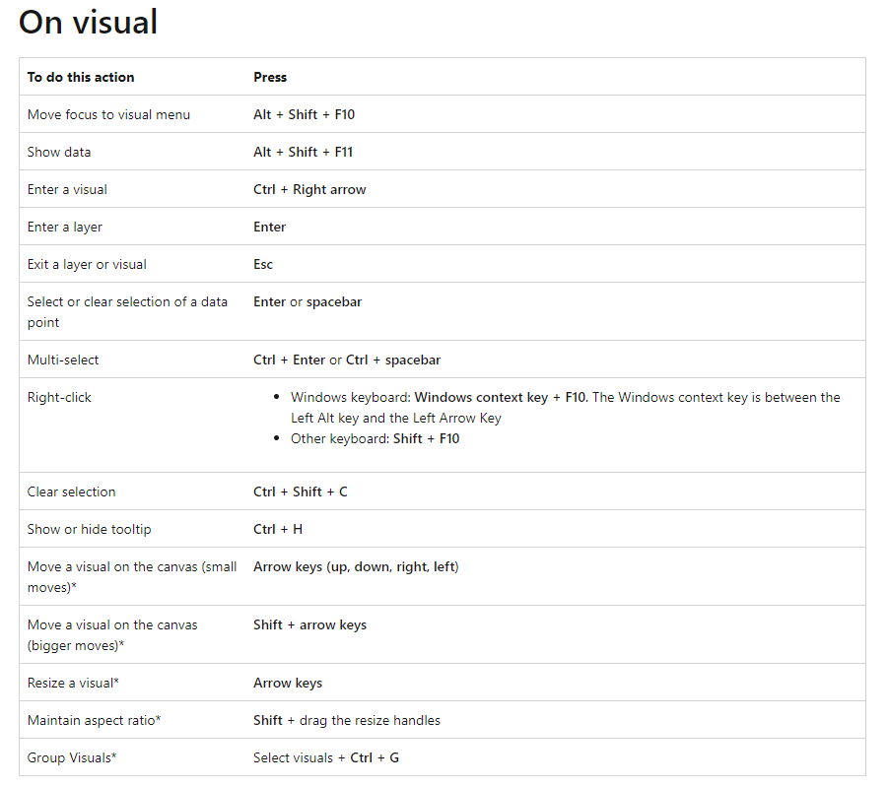
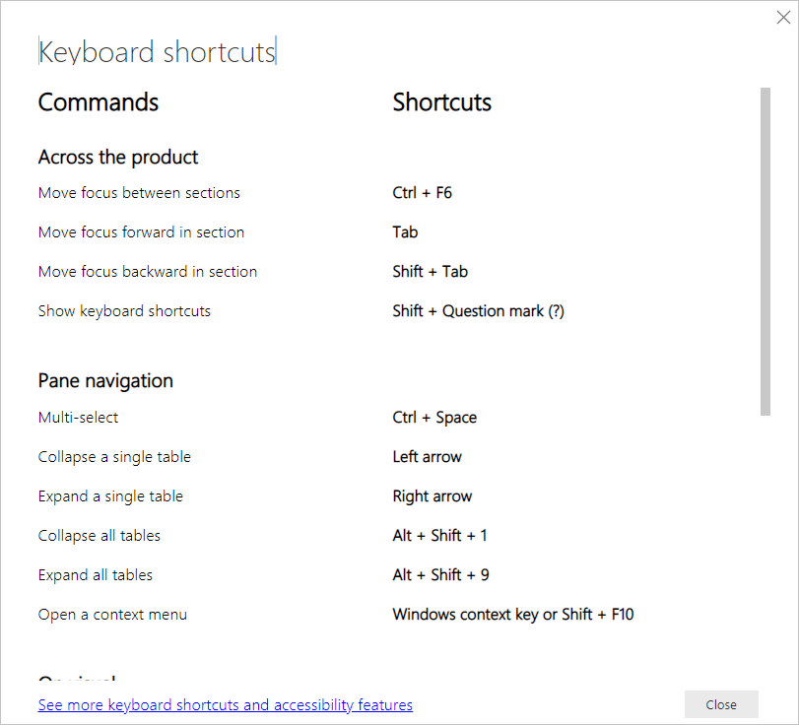
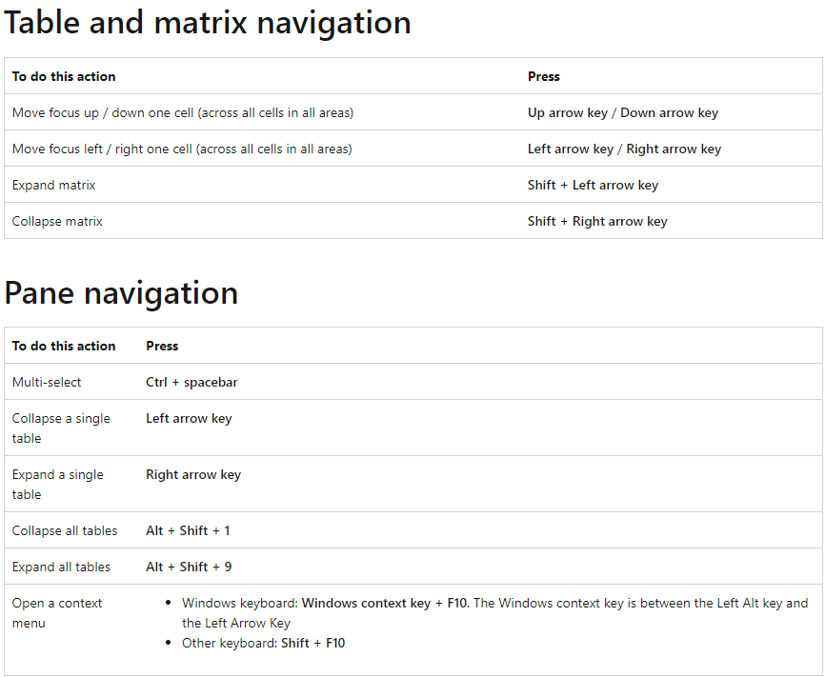
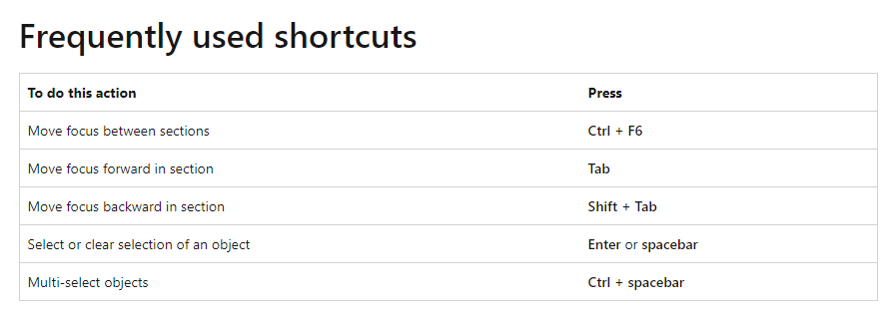
Keyboard navigation

Slide 7
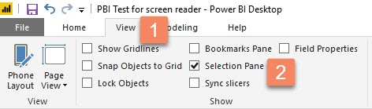
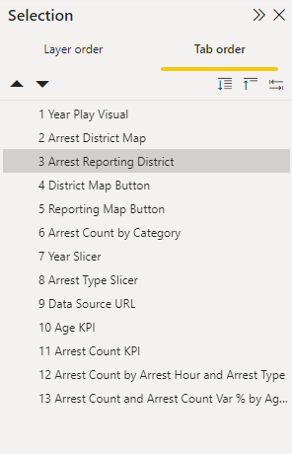
Tab Order
Accessibility Tip!
It only takes a minute to set the tab order, but it greatly increases usability for keyboard users.

Slide 8
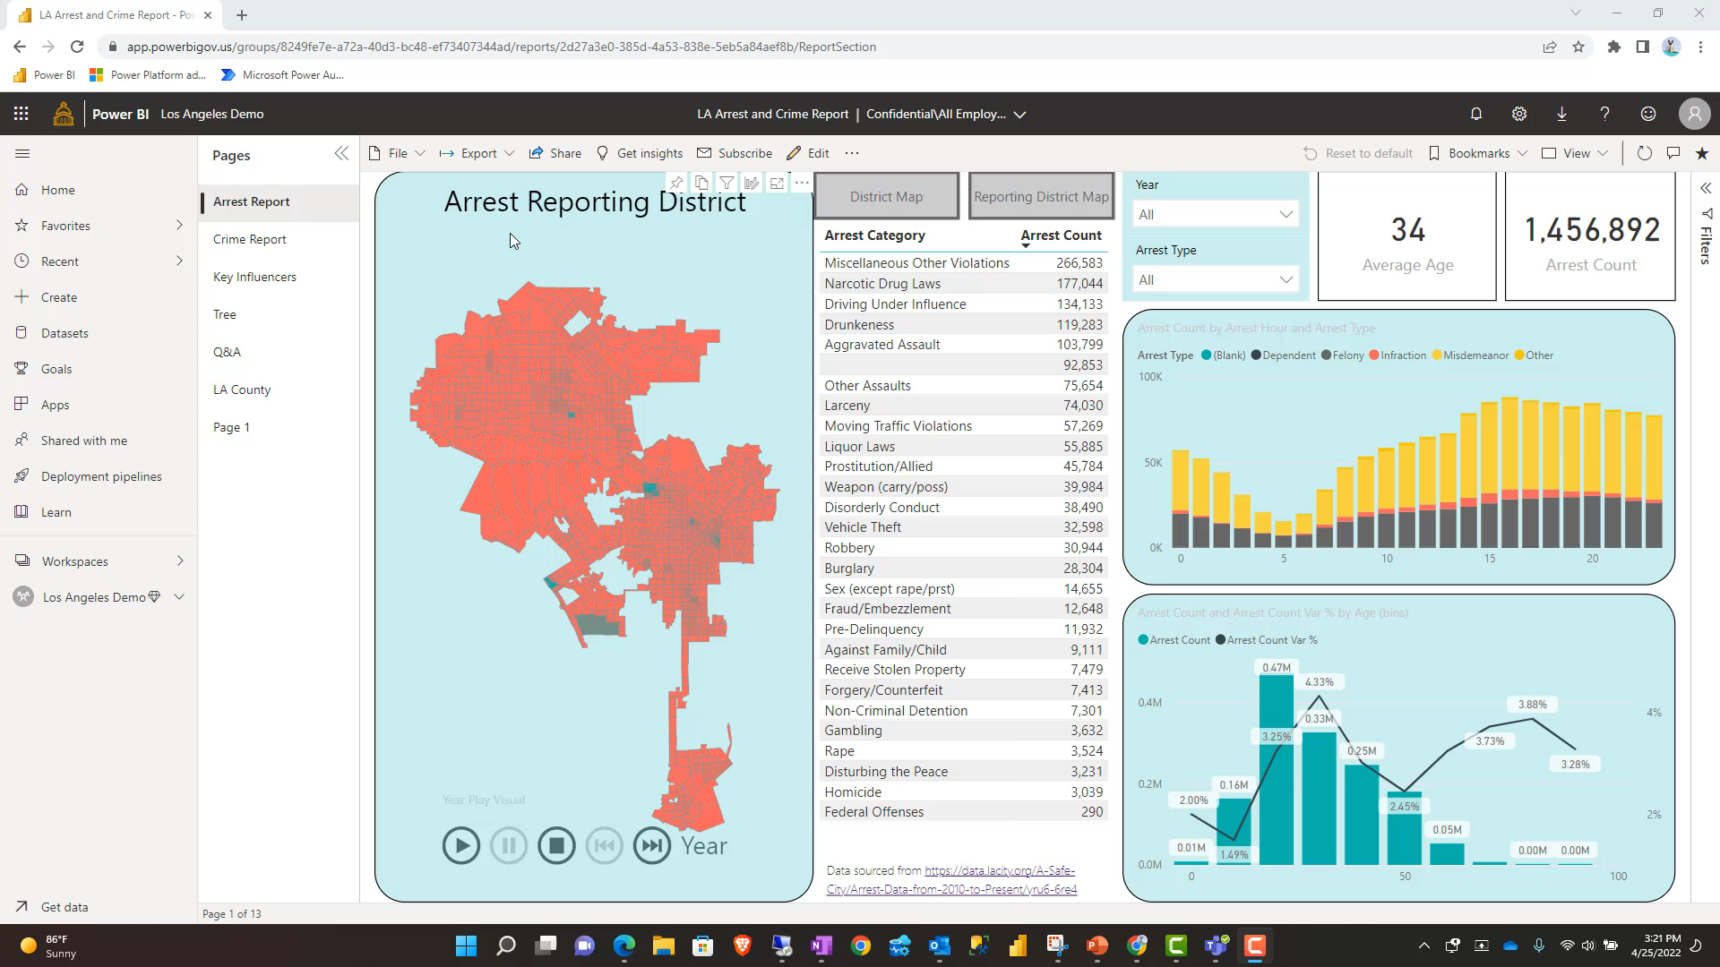
Screen-reader compatibility
Narrator app included with Windows operating system
Accessibility Tip!
Alt Text will be read by screen Narrator.

Slide 9
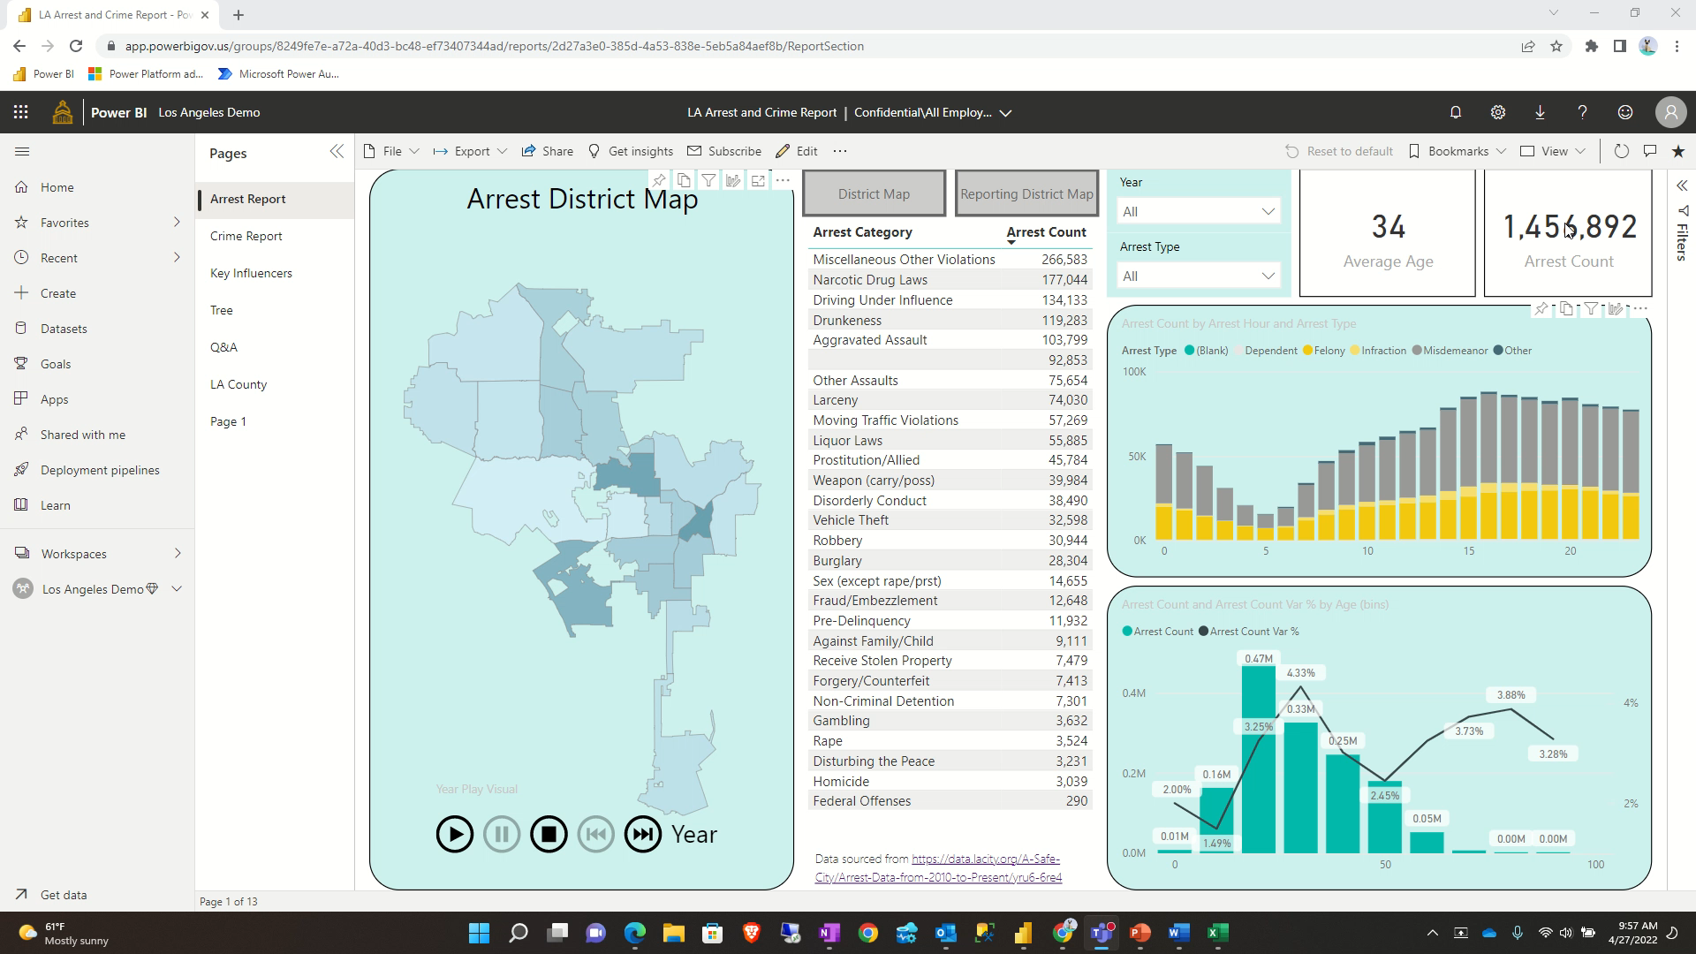
High contrast color view
Power BI has high contrast support for reports. The Power BI service also attempts to detect the high contrast settings selected for Windows, but how effective and accurate that detection is depends on the browser being used for the Power BI service.

Slide 10
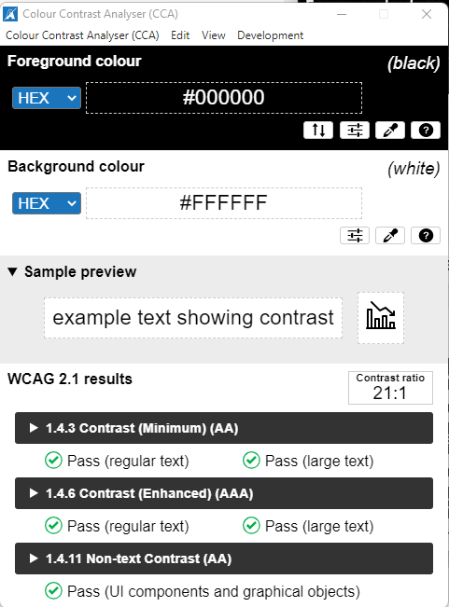
Color Contrastor
Color Contrast Checker - TPGi

Slide 11
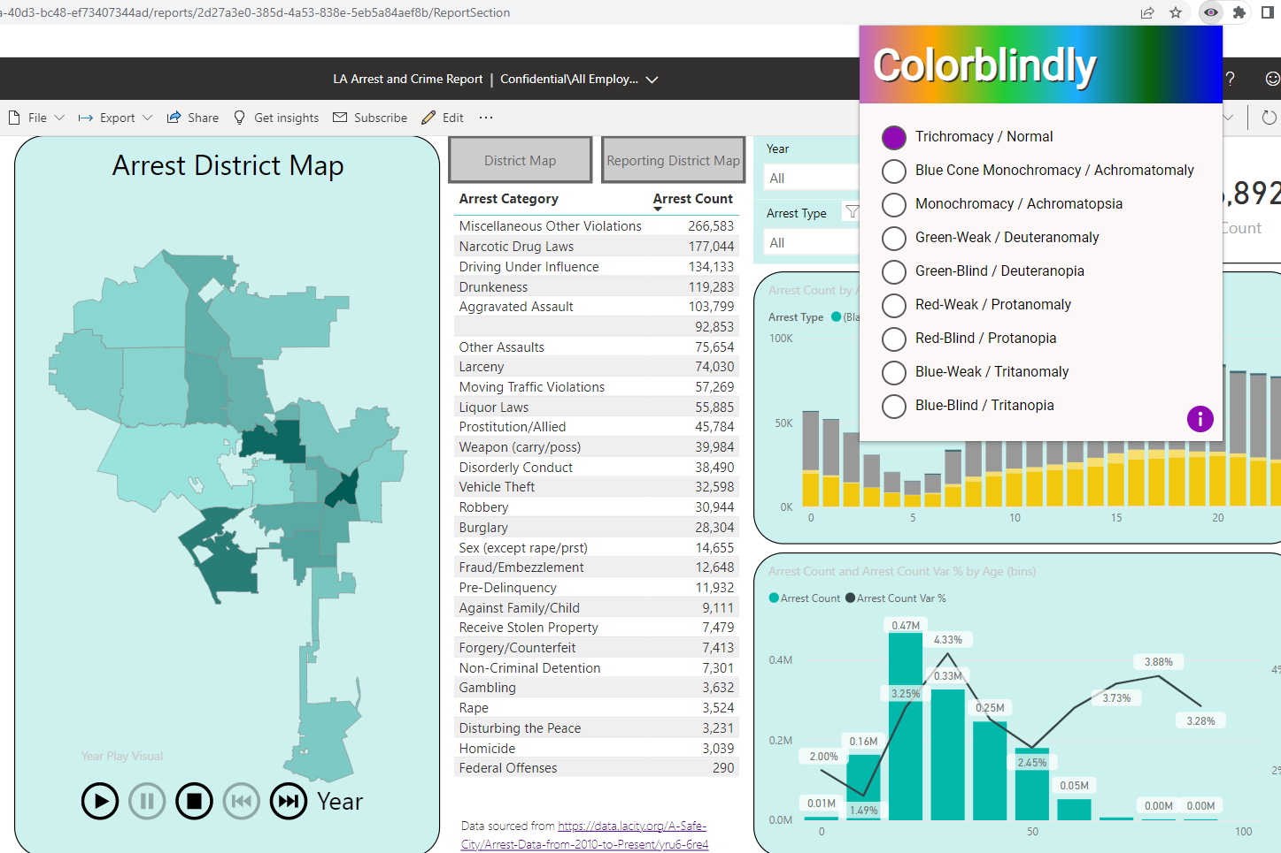
Colorblindness Checker
https://chrome.google.com/webstore/detail/colorblindly/floniaahmccleoclneebhhmnjgdfijgg?hl=en

Slide 12
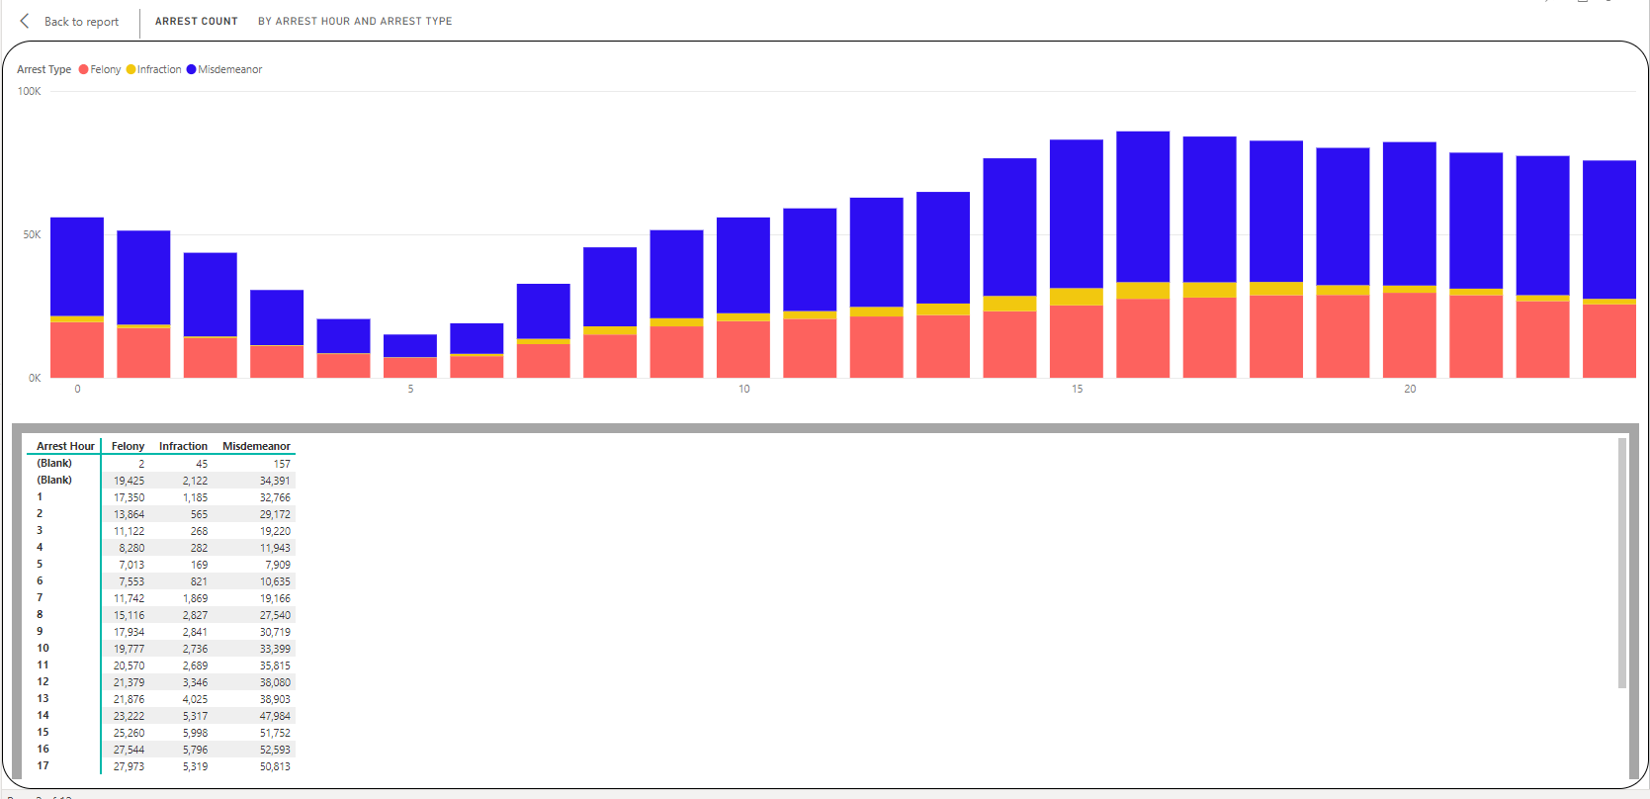
Show data table and Focus Mode
Alt + Shift + F11

Slide 13
Accessibility Checklist
All visuals
  Include a title, axis labels, and data labels in all visuals. Use meaningful titles for all report pages.
  Ensure color contrast between title, axis label, and data label text and the background are at least 4.5:1
  Avoid using color as the only means of conveying information. Use text or icons to supplement or replace the color.
  Ensure alt text is added to all non-decorative visuals on the page.
  Avoid unnecessary jargon or acronyms to help all readers understand full context of information. Tip: Glossary page
  Check that your report page works for users with color vision deficiency.
Slicers
  If you have a collection of several slicers on your report pages, ensure your design is consistent across pages. Use the same font, colors, and spatial position as much as possible.
Visual Interactions
  If using bookmarks for navigation, try navigating your report with a keyboard to ensure the experience is acceptable for keyboard-only users
Tooltips
  Don't use tooltips to convey important information. Users with motor issues and users who do not use a mouse will have difficulties accessing them.
  Do add tooltips to charts as ancillary information. It is included in the accessible Show Data table for each visual.
Power BI Visuals
  Check the accessible Show Data table for Power BI visuals – if information is not enough, look for another visual.

Slide 14
Roadmap 2022
RELEASED: Slicer improvements https://powerbi.microsoft.com/en-us/blog/power-bi-march-2022-feature-summary/#post-18792-_Toc98245391
Improved table navigation https://docs.microsoft.com/en-us/power-platform-release-plan/2022wave1/power-bi/accessibility--improved-table-navigation
Reflow to support 400x zoom https://docs.microsoft.com/en-us/power-platform-release-plan/2022wave1/power-bi/accessibility--reflow-support-400-zoom
Show visuals as tables https://docs.microsoft.com/en-us/power-platform-release-plan/2022wave1/power-bi/accessibility--show-as-all-tables
Smart narrative descriptions https://docs.microsoft.com/en-us/power-platform-release-plan/2022wave1/power-bi/accessibility--smart-narrative-descriptions

Slide 15

Start your Accessibility journey at https://www.youtube.com/user/MSFTEnable
Enable your organization to complete the free Accessibility training at https://docs.microsoft.com/en-us/learn/paths/accessibility-fundamentals/
Enabling Accessibility in your Organization

