Slide 1
Power BI Data Driven Reports
Power BI Data Driven Subscriptions using
Dataverse for Teams, Cloud Flow and Power Apps
Cyrus Christian
Intelligence Technical Specialist – State and Local Government [Western Region]
cychrist@microsoft.com

Slide 2
What is a Data Driven Subscription?
A data-driven subscription provides a way to use dynamic subscription data that is retrieved from an external data source at run time. A data-driven subscription can also use static text and default values that you specify when the subscription is defined. You can use data-driven subscriptions to do the following:
Distribute a report to a fluctuating list of subscribers. For example, you can use data-driven subscriptions to distribute a report throughout a large organization where subscribers vary from one month to the next, or use other criteria that determines group membership from an existing set of users.
Filter the report output using report parameter values that are retrieved at run time.
Vary report output formats and delivery options for each report delivery.

Slide 3
Power Platform to the rescue!
Dataverse in Teams – Store the user email, report details and conditional element
Power Apps in Teams – Allow users to self register for subscriptions
Cloud Flow – Automate a process that will email a Power BI report when data condition is met

Slide 4
What licensing is required?
Power BI capacity Export and email a report with Power Automate - Power BI | Microsoft Docs
Concurrent report pages Export Power BI embedded analytics reports API - Power BI | Microsoft Docs
Office 365 with Teams FAQs for Dataverse for Teams - Power Apps | Microsoft Docs

Slide 5
Dataverse for Teams
Dataverse for Teams offers a suite of embedded Microsoft Power Platform tools in Teams, including Power Automate. With Dataverse for Teams, organizations can easily build low-code apps, automate processes, and deploy chatbots without leaving Teams. All of this creative capability comes with rich administration, security, and governance.

Slide 6
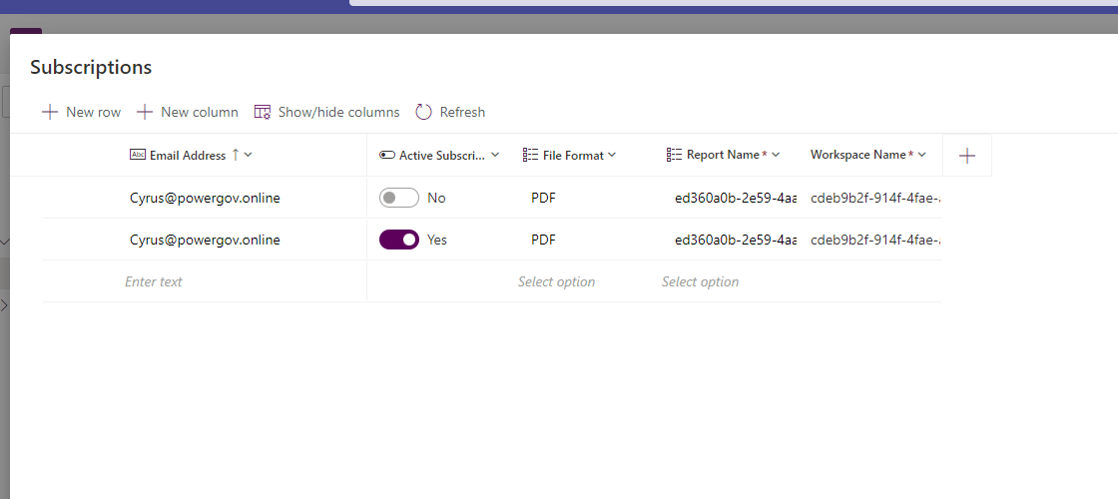
Create a Table
Create a table and add columns
Choice values make it easier for users to pick reports than manually enter names/guids
Add a conditional value for the report trigger

Slide 7
Dataverse in Teams: Table Demo

Slide 8
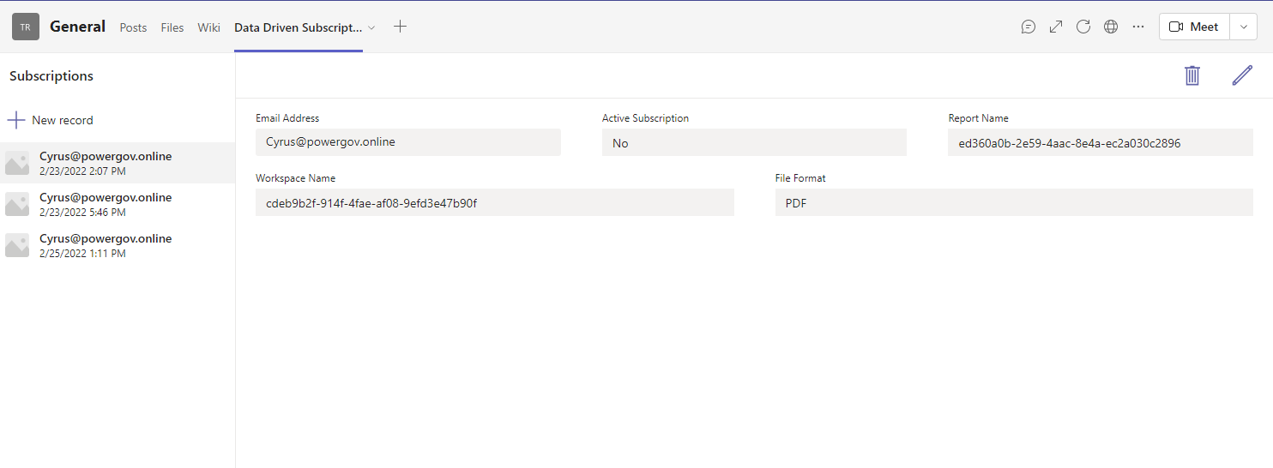
Create Power App
Integrated into Team is now a Power App design experience
Deploy App to Teams Channel
Users can self service subscriptions by adding an entry for report delivery

Slide 9
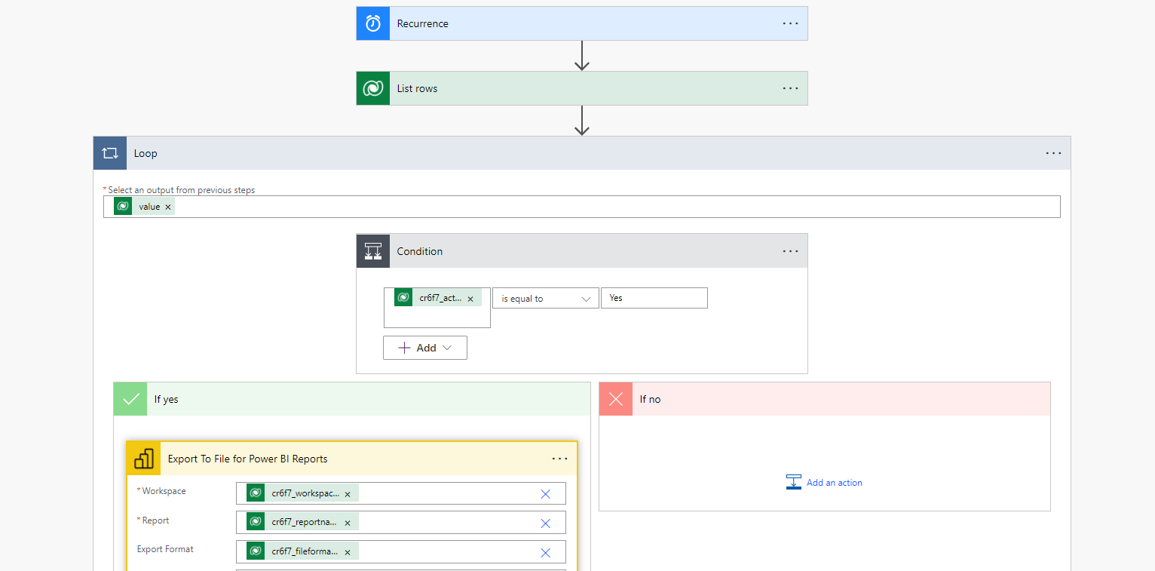
Build Cloud Flow
Create reoccurring flow that Lists Rows from Dataverse and conditionally sends Power BI export files.
On Export update Last Sent with current time

Slide 10
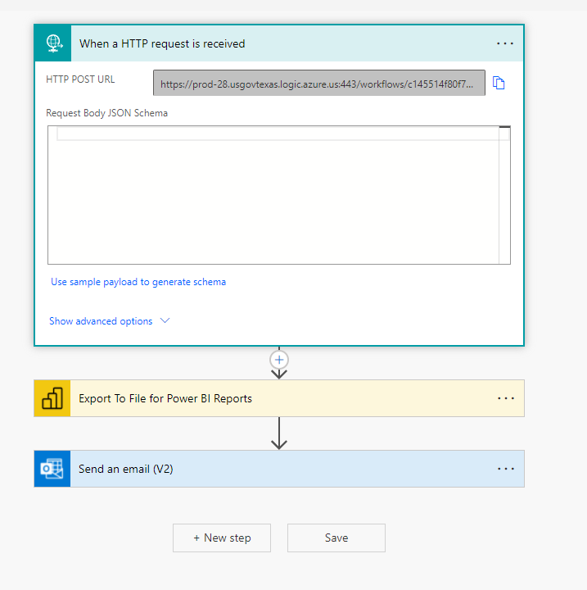
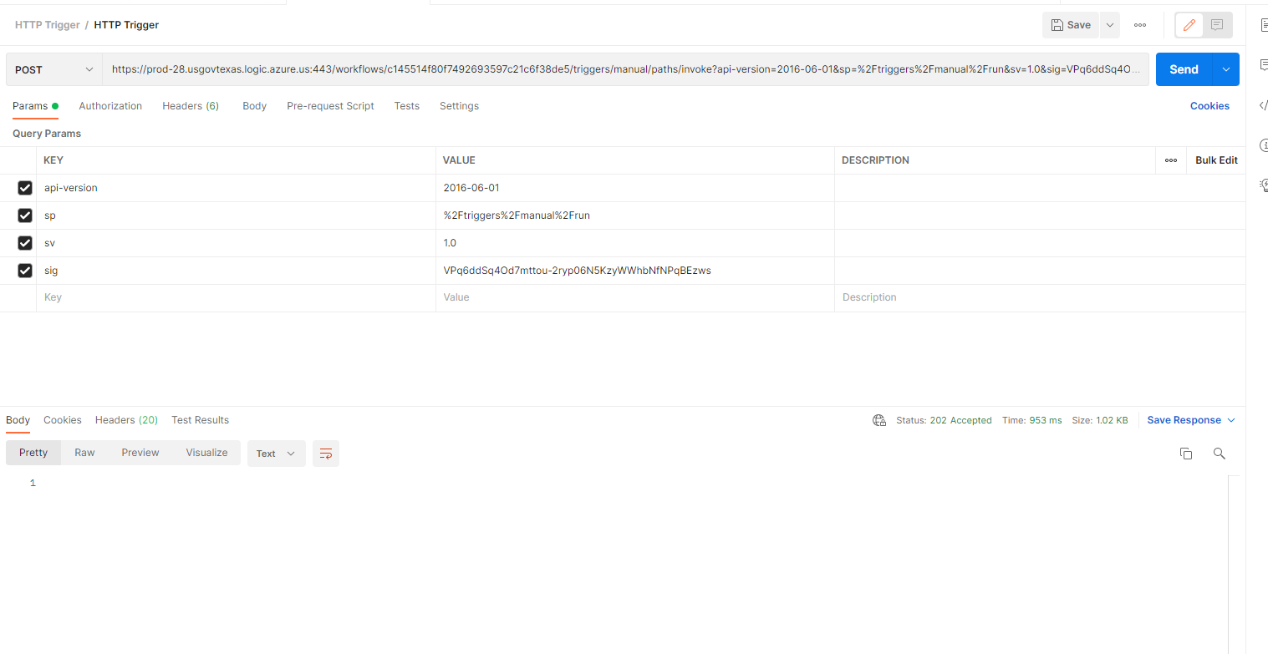
HTTP Post Trigger

Slide 11
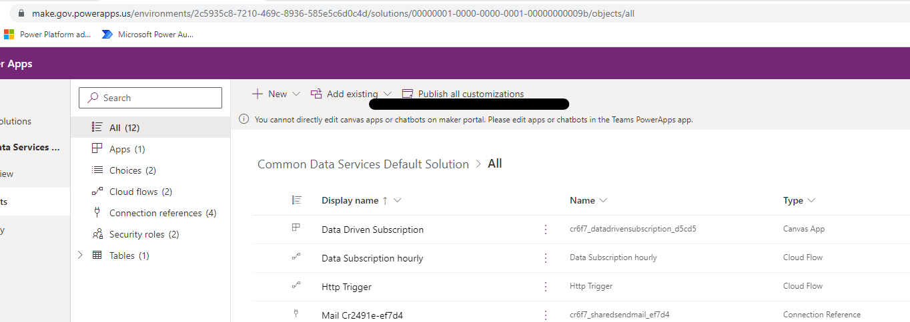
Publish your work!

Slide 12
Power App and Cloud Flow Demo

Slide 13
Build Power BI Report
Optionally, create a report in Power BI that pulls form the table in the Dataverse.
Currently there are a few bugs in GCC that are soon to be fixed.
  Need to manually add M Code for connecting to Dataverse (GCC Only – Fixed in March Desktop)
  Data Sources in service cannot be updated with credentials (GCC Only – Fix Rolling out to Service)

Slide 14
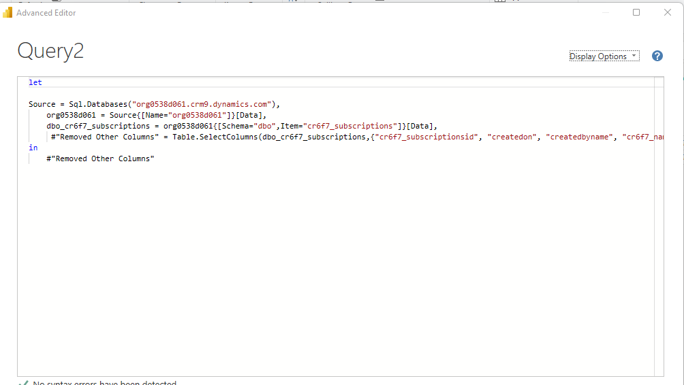
SQL M Code for Import/Direct Query

Slide 15
Power BI Demo

Slide 16
Thank You!
Please fill out this survey with your feedback for future events https://forms.office.com/r/79pa33niDq
Next Community Call will be showcasing Power Bi administrative monitoring with a Product Team member

