Slide 1
Power BI Community Call
January 6th
As another year comes to an end, we will review the new features of Power BI released during 2021. This presentation will have links to all features as we highlight/demo our favorites. Examples of favorites to demo: Small Multiples, Personalize Visuals Experience, Sparklines, Premium per User, and Bookmark Page Navigator.
https://slgcommunitycall.blob.core.windows.net/communitydownloads/SLGCommunityCall.ics
Danni (Ortman) Olson | LinkedIn
Cyrus Christian | LinkedIn

Slide 2
Power BI December 2021 Feature Summary
Power BI December 2021 Feature Summary
Demo: Sparklines (Create and Format)
  Sparklines
Power BI Developer in a Day Content updated
  Power BI Developer in a Day – YouTube
New Format Pane
  The new Format pane in Power BI Desktop (preview)

Slide 3
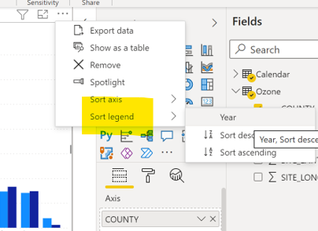
Power BI November 2021 Feature Summary
Power BI November 2021 Feature Summary
Page and Bookmark Navigation plus Format
  Create page and button navigators
Sort Legend

Slide 4
Power BI October 2021 Feature Summary
Power BI October 2021 Feature Summary
New Beta DAX Training
  PBI Training Content

Slide 5
Power BI September 2021 Feature Summary
Power BI September 2021 Feature Summary
Report Builder – For Paginated Reports
  New version of Power BI Report Builder

Slide 6
Power BI August 2021 Feature Summary
Power BI August 2021 Feature Summary
Share Q/A Synonyms (modeling)
  Intro to Q&A tooling (preview)

Slide 7
Power BI July 2021 Feature Summary
Power BI July 2021 Feature Summary
Small Multiples
  Small Multiples
Power Automate
  Create a Power Automate visual
Microsoft Information Protection (MIP) sensitivity labels
  Power BI Security Overview, Community Call

Slide 8
Power BI April, May, June
Power BI June 2021 Feature Summary
Power BI May 2021 Feature Summary
Smart Narratives
Power BI April 2021 Feature Summary
Share Teams - Link

Slide 9
Power BI February 2021 Feature Summary
Power BI February 2021 Feature Summary
Is Empty Filter
Email subscription attachment
We heard your feedback and are excited to share that you can now create a subscription from a premium upgraded workspace or with PPU for yourself and others and include a copy of all pages in your reports. This eliminates the need to subscribe separately to each section and in many ways is the same as generating an export of the report. Attachments may be generated in either PDF or PPT.

Slide 10
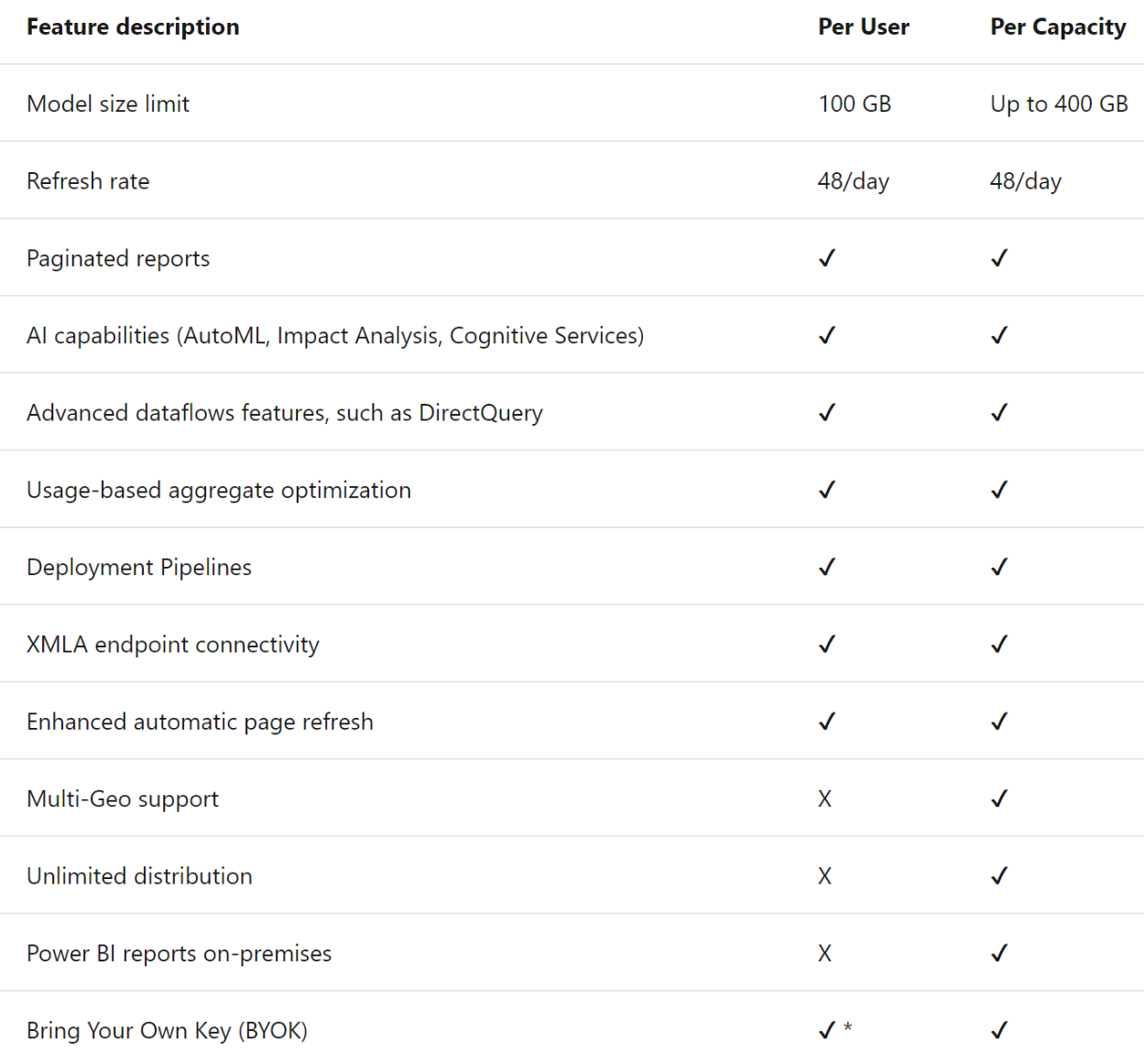
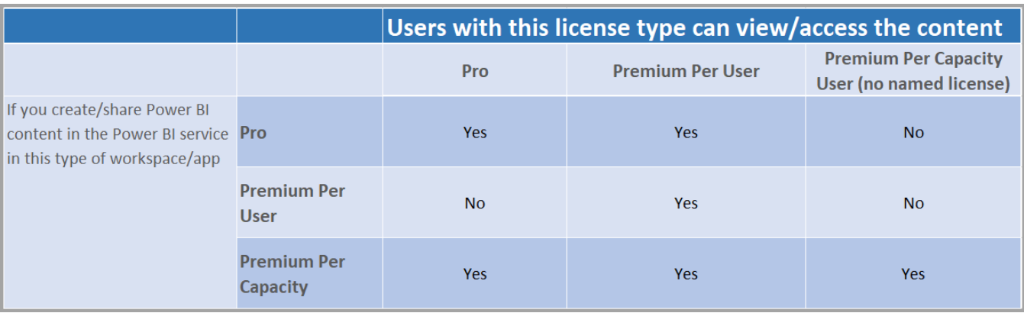
Power BI Premium Per User
Premium features at user level
Microsoft manages tenant
Full license includes Pro
Can buy step-up for existing Pro or G5

Slide 11
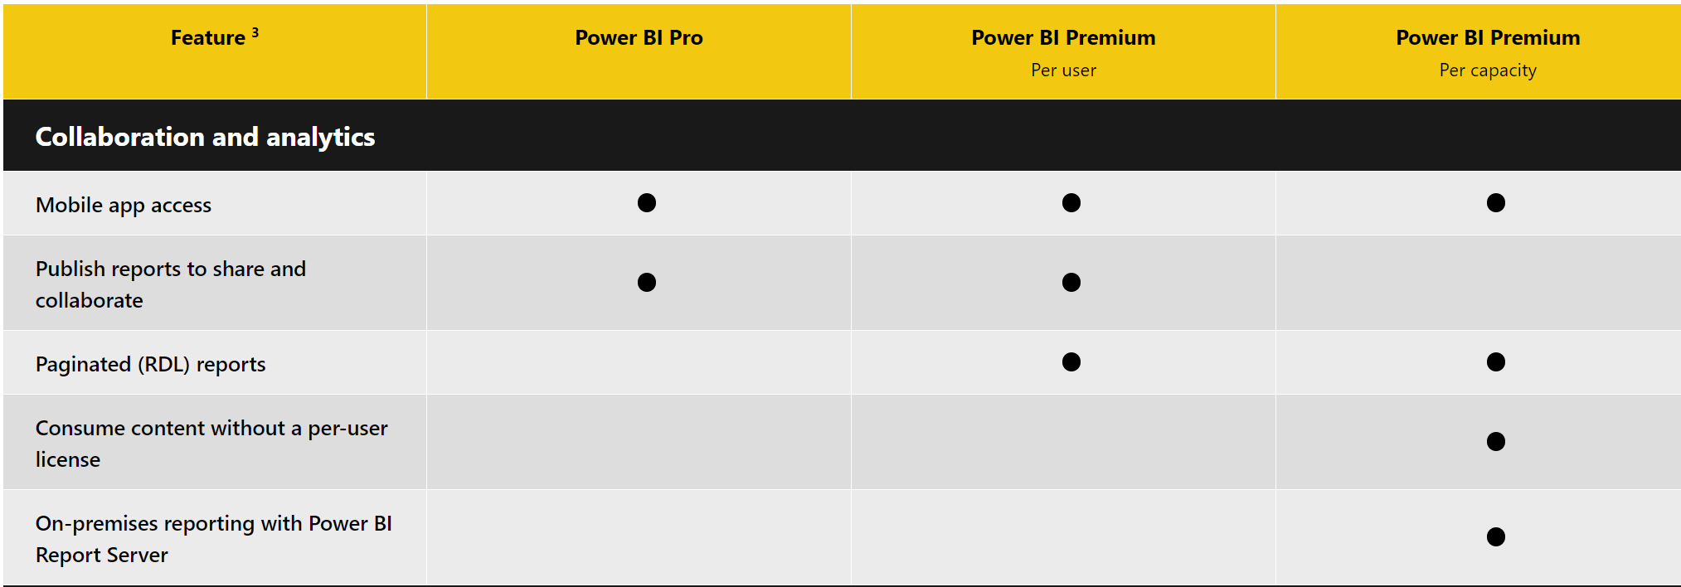
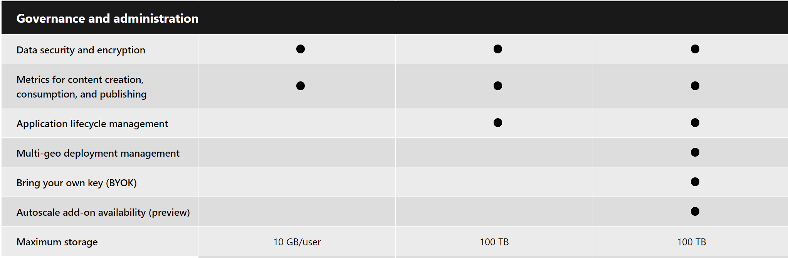
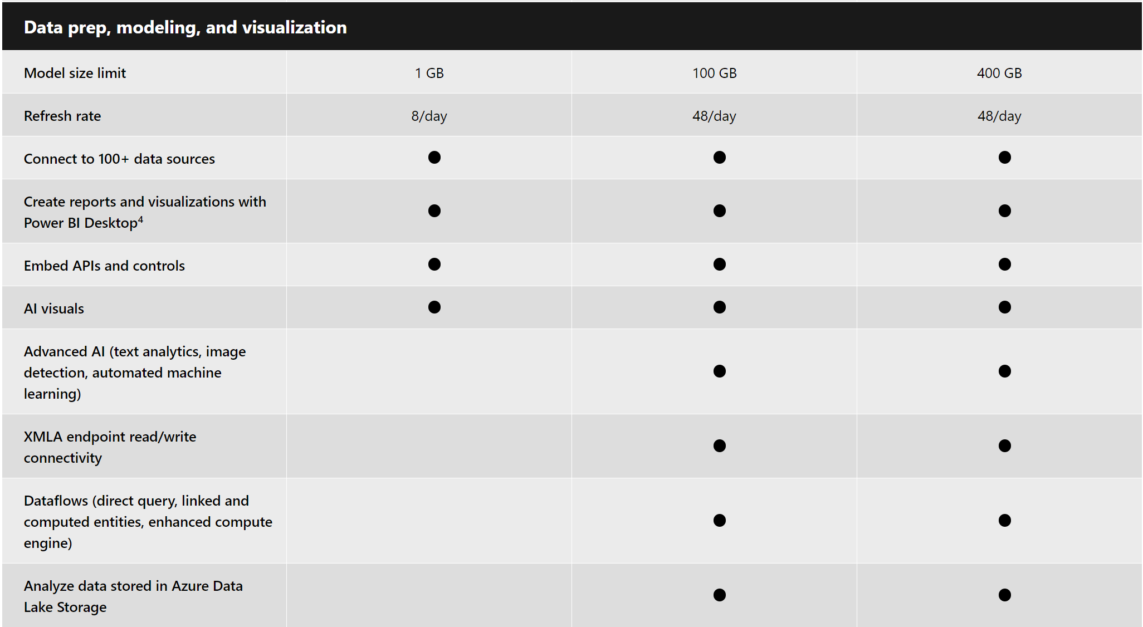
Pricing & Product Comparison | Microsoft Power BI

Slide 12
Please Do
Complete Survey
  Jan 6th Survey
Did you put a recurring meeting on your calendar for every other Thursday at 10 pst / 1 est
  https://powergi.blog/state-and-local-government-community-calls
All past recordings and PowerPoints decks stored

Slide 13
Increase your Knowledge
Attend a daylong PowerBI instructor led hands-on session
  Register for Dashboard in a day
  https://aka.ms/nextdiad
Instructor Led 60 min Presentation:
  Online Professional Training from Microsoft Store
Explore MS Learning – Self Pace
  https://docs.microsoft.com/en-us/learn/browse/?products=power-bi
Instructor Led 4 days - Enterprise Skilling from MSFT:
  Course DA-100T00-A: Analyzing Data with Power BI - Learn | Microsoft Docs
GCC Community Calls (Danni and Cyrus):
  State and Local Government Community Calls – Power BI in Government (powergi.blog)
  https://slgcommunitycall.blob.core.windows.net/communitydownloads/SLGCommunityCall.ics

