Slide 1
Power BI Open Data
State and Local Government
Examples of Customer created reports for transparency

Slide 2
Transportation
Ridership
Bridges, tunnels and Highway Maintenance
Motor Vehicle Collisions
Transit on time performance
Traffic Fatalties

Slide 3

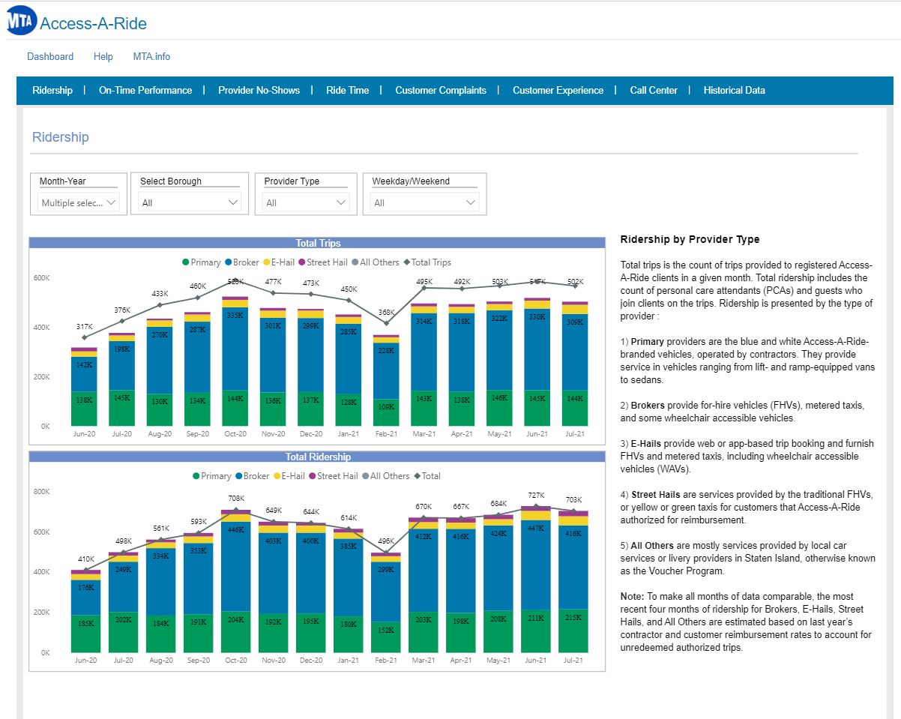
New York City MTA
Ridership Analysis
http://aardashboard.mta.info/

Slide 4
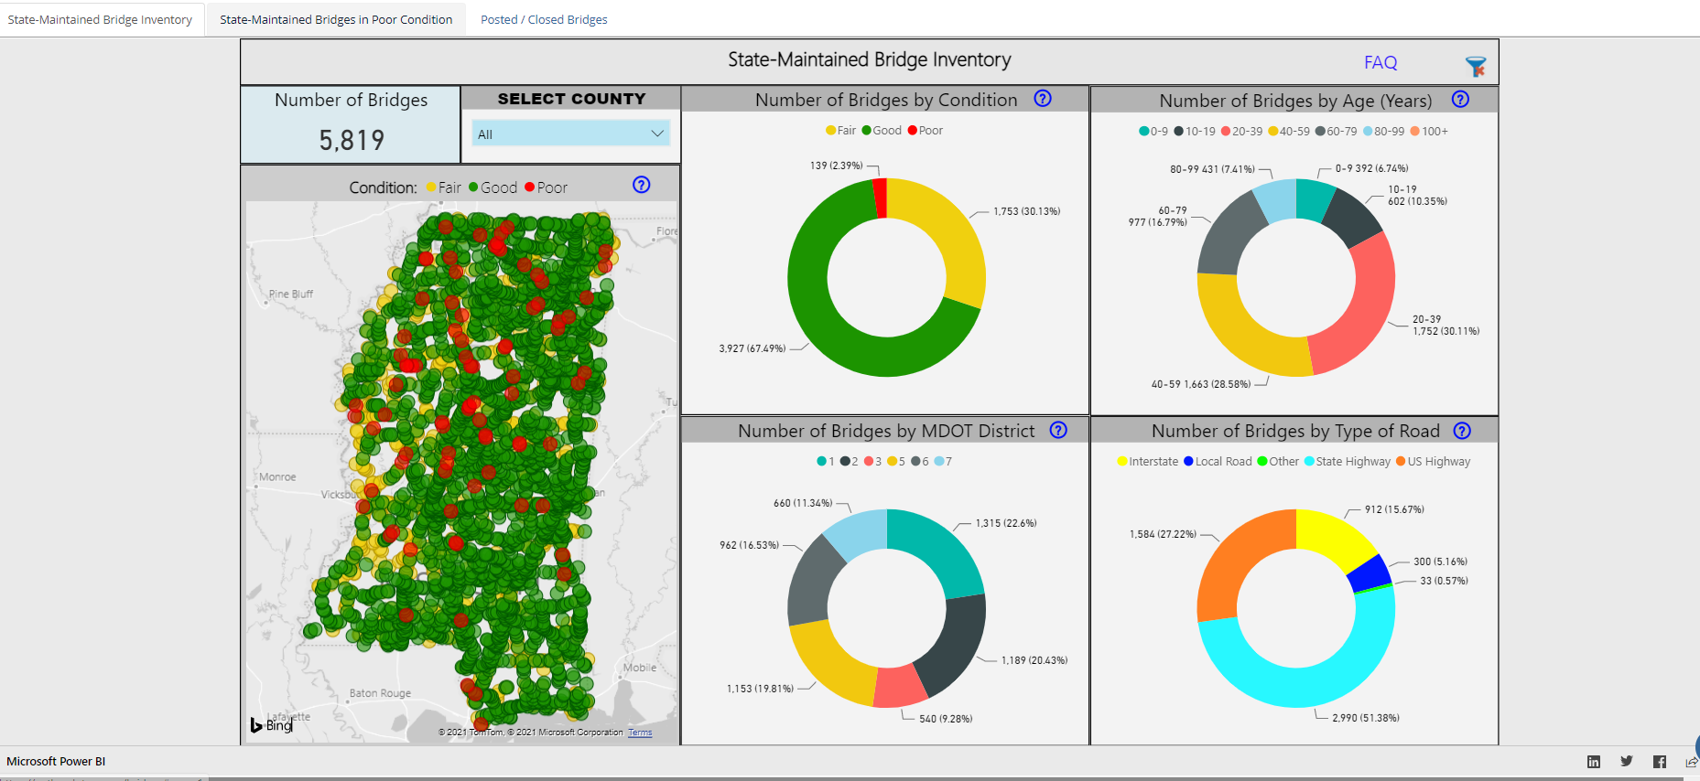
Misissipi Department of Transportation
Bridge Conditions Scorecard
https://path.mdot.ms.gov/bridges

Slide 5
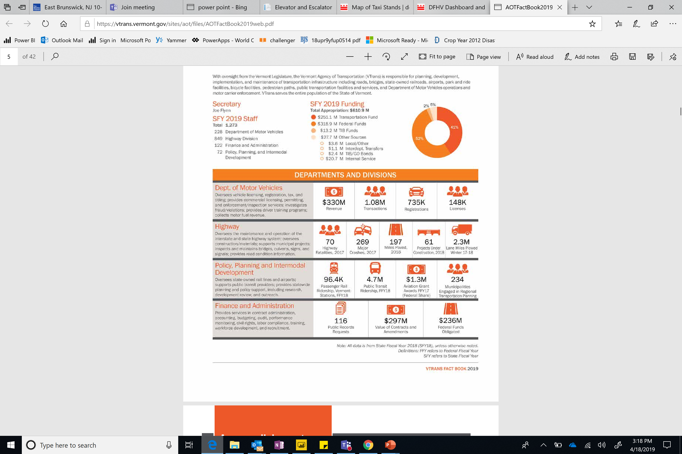
Vermont Department of Transportation
Planning, Projects and Safety Annual Report
https://vtrans.vermont.gov/sites/aot/files/AOTFactBook2019web.pdf

Slide 6
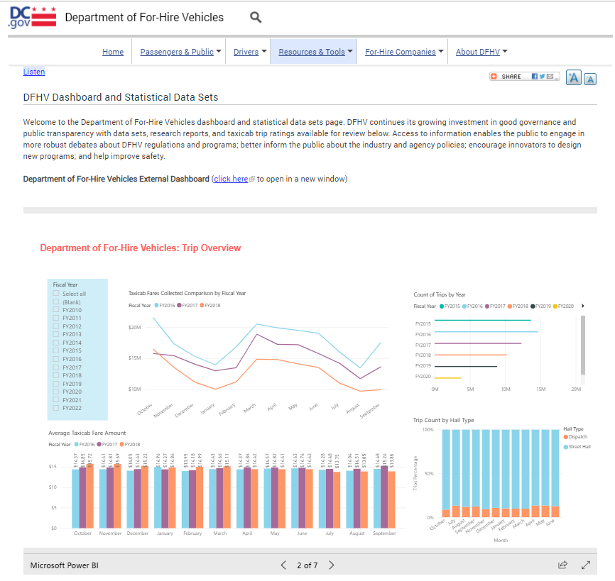
DC Department for-Hire Vehicles
Taxi Trip analysis
https://dfhv.dc.gov/page/dfhv-dashboard-and-statistical-data-sets

Slide 7
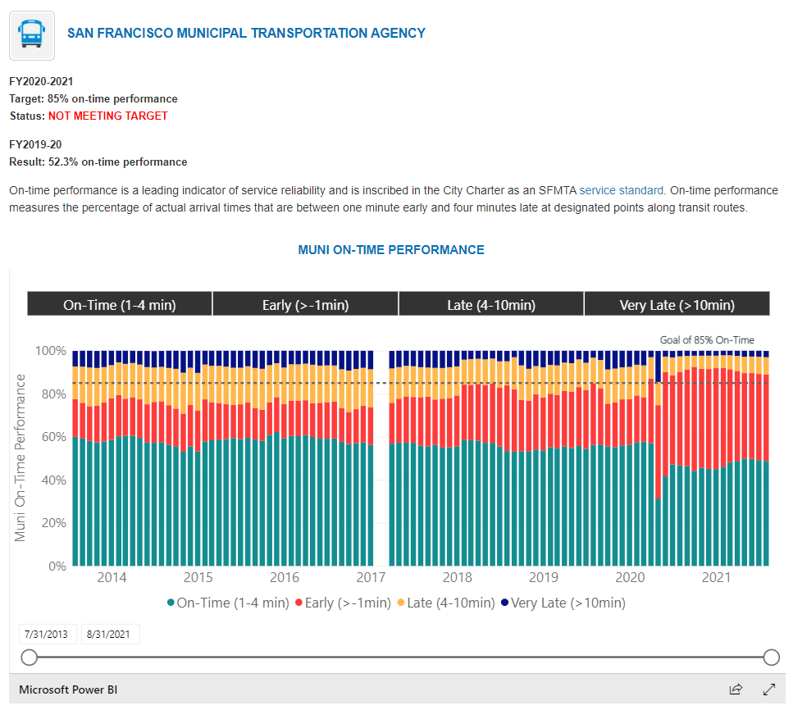
City of San Francisco
Transit on time performance
https://sfgov.org/scorecards/transportation/transit-time-performance

Slide 8




Public Health
Health Insurance Coverage
Urgent Care Access
Health Spending
COVID-19 Infections and vaccinations

Slide 9
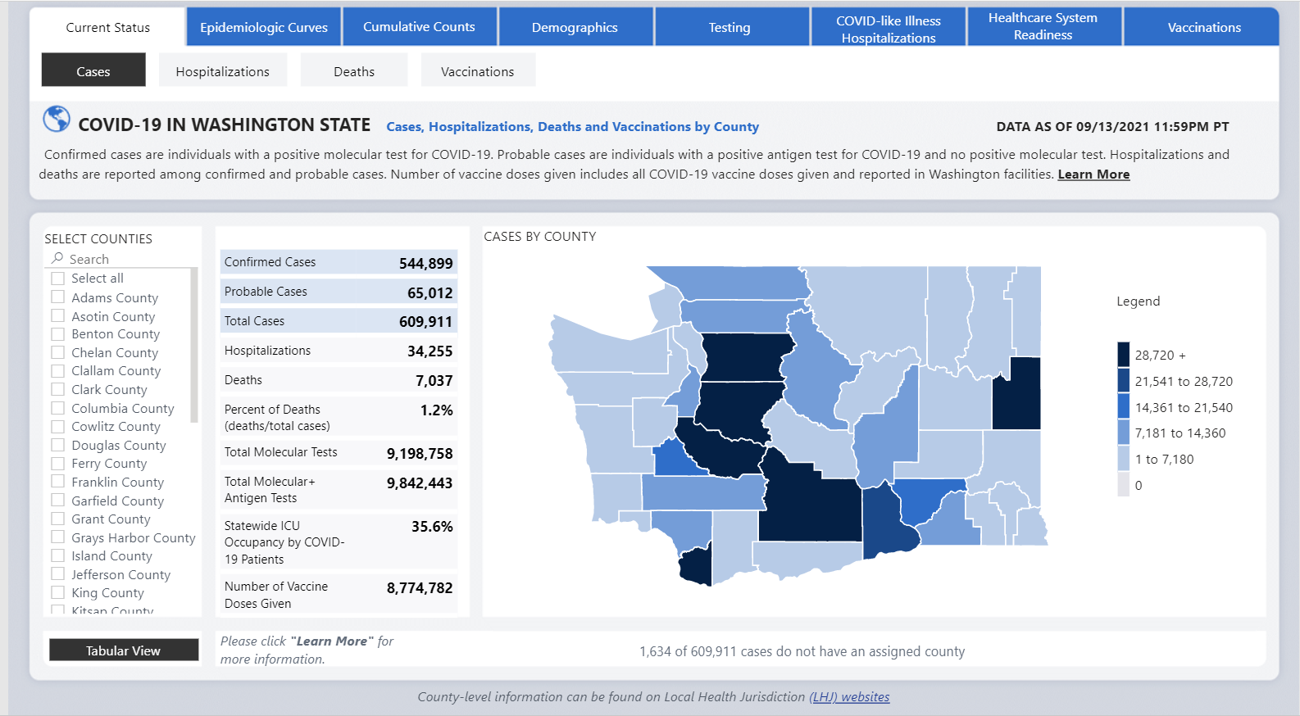
State of Washington
COVID-19 Case Dashboard
https://www.doh.wa.gov/Emergencies/COVID19/DataDashboard

Slide 10
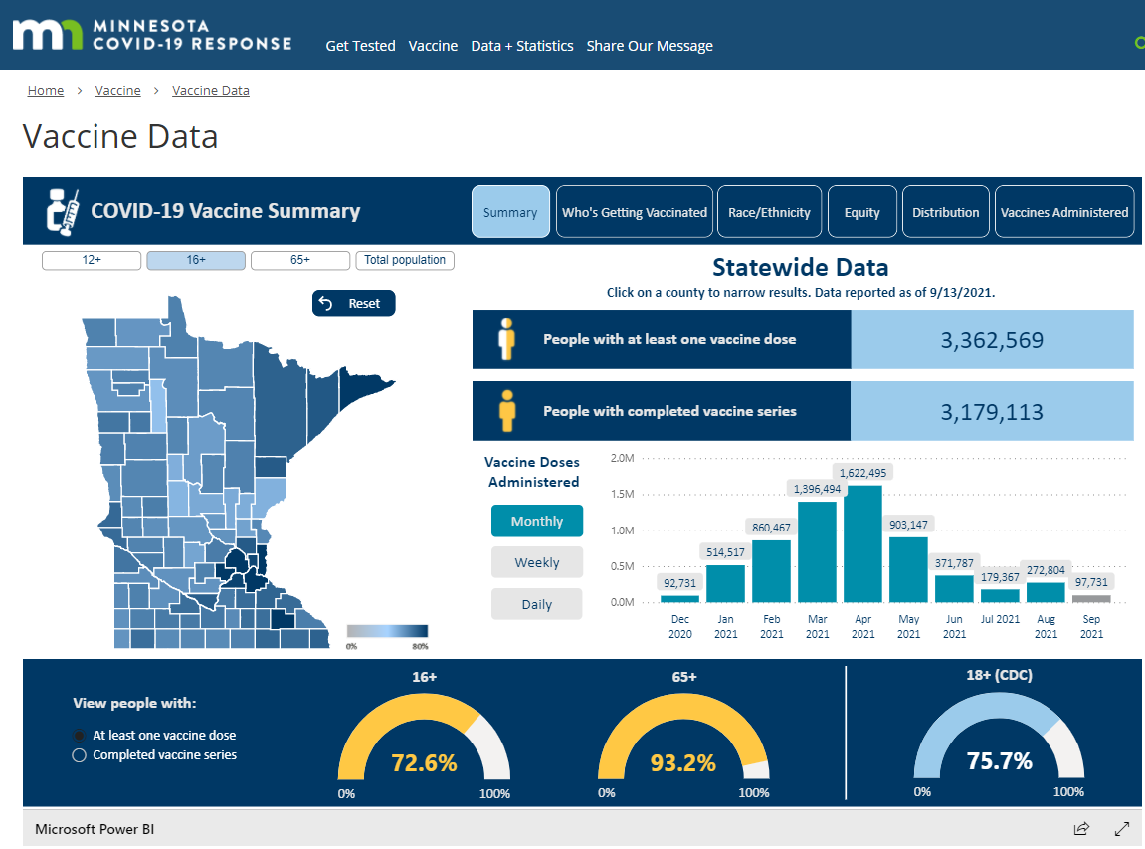
State of Minnesota
COVID-19 Vaccination Summary
https://mn.gov/covid19/vaccine/data/index.jsp

Slide 11
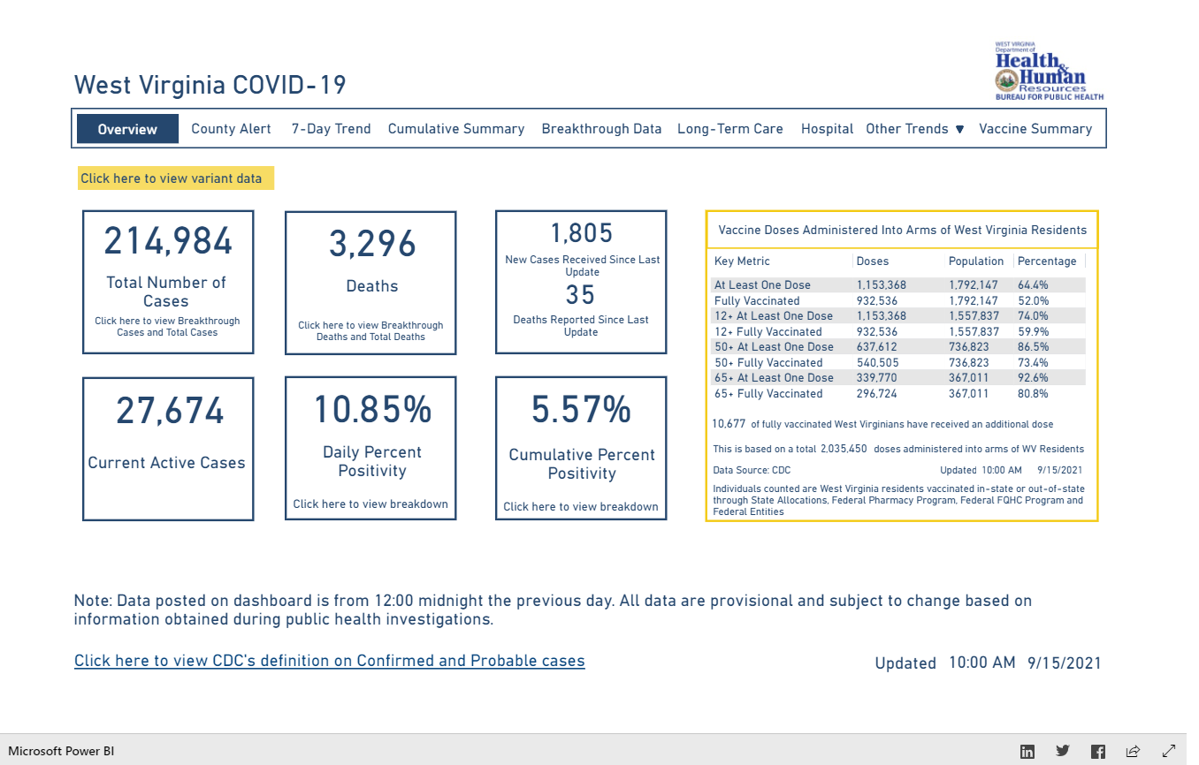
State of West Virginia
COVID-19 Infection Summary
https://dhhr.wv.gov/COVID-19/Pages/default.aspx

Slide 12
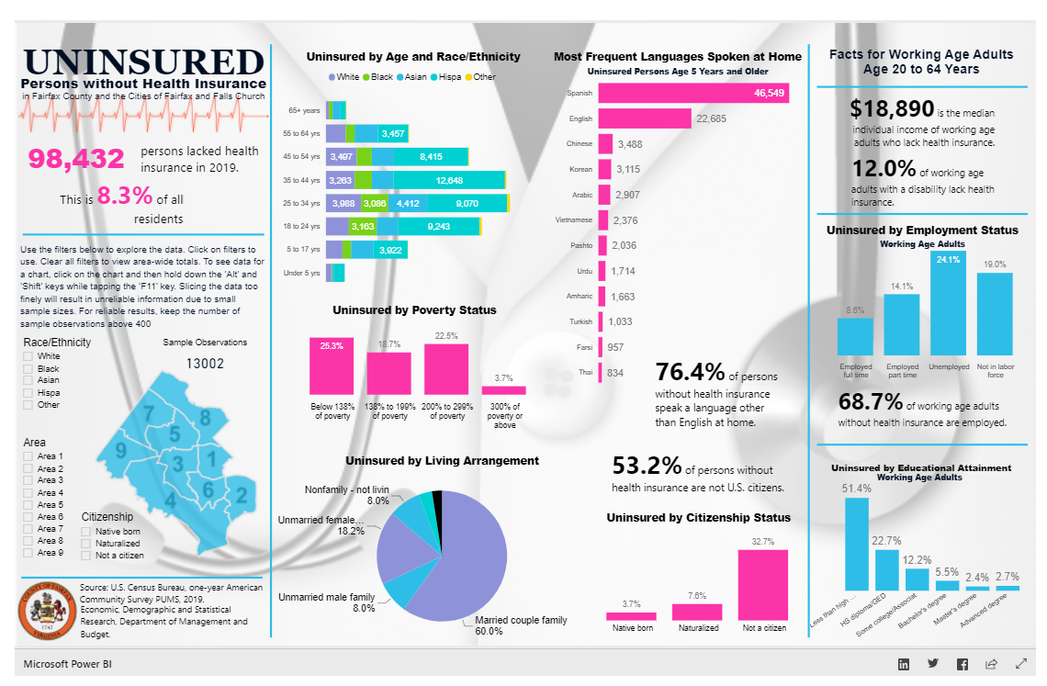
Fairfax County
Health Insurance Coverage
https://www.fairfaxcounty.gov/demographics/health-insurance

Slide 13
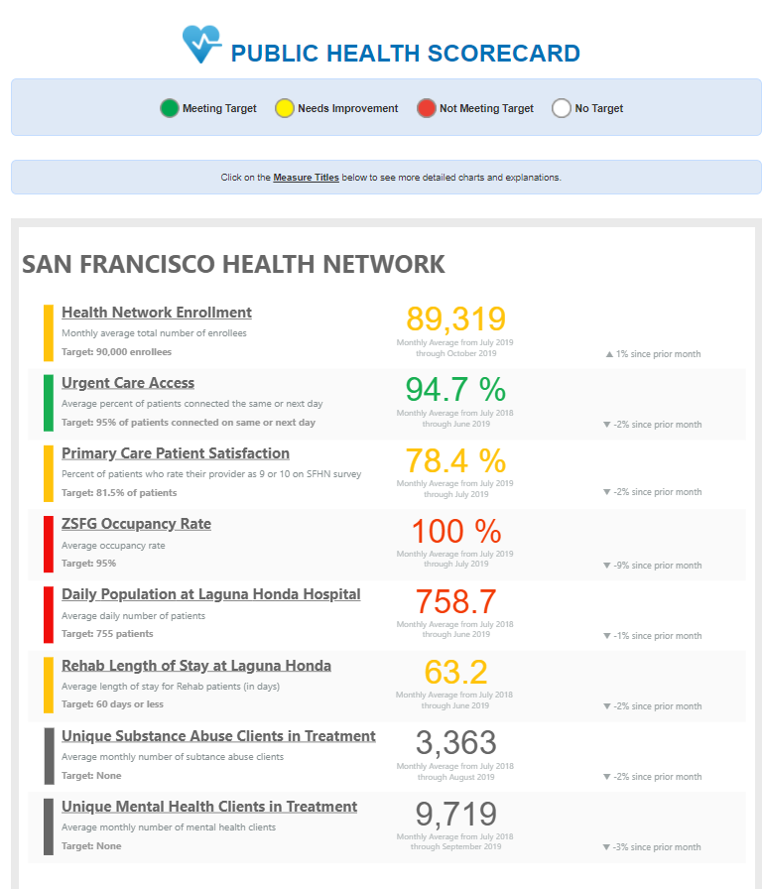
City of San Francisco
Public Health Scorecard
https://sfgov.org/scorecards/public-health/public-health

Slide 14
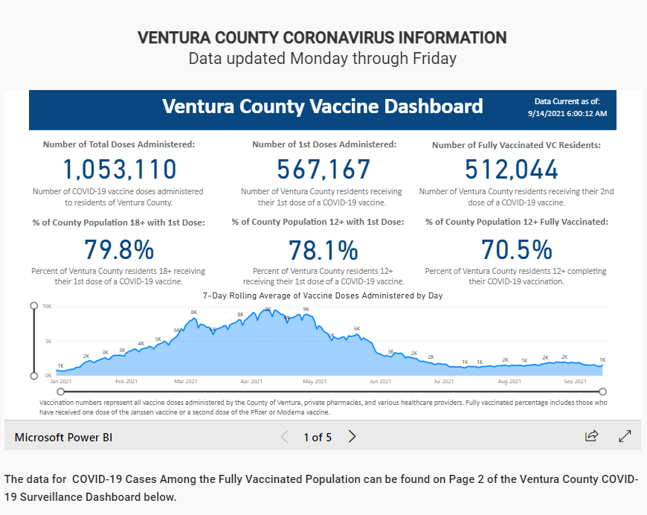
Ventura County
VENTURA COUNTY CORONAVIRUS INFORMATION
https://www.venturacountyrecovers.org/

Slide 15
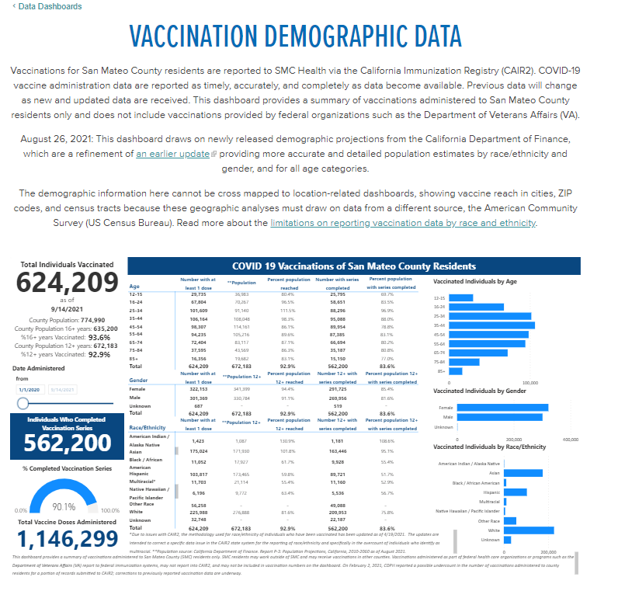
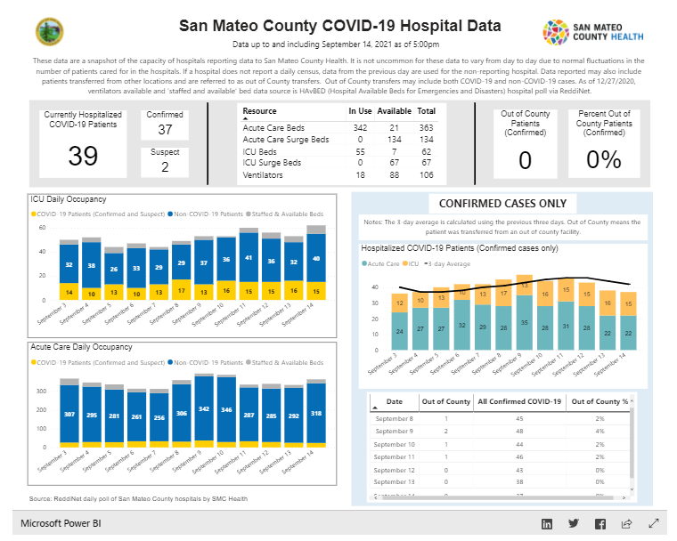
San Mateo County
Vaccination Demographic Data
https://www.smchealth.org/data-dashboard/vaccination-demographic-data
COVID-19 Hospital Data
https://www.smchealth.org/data-dashboard/hospital-data

Slide 16
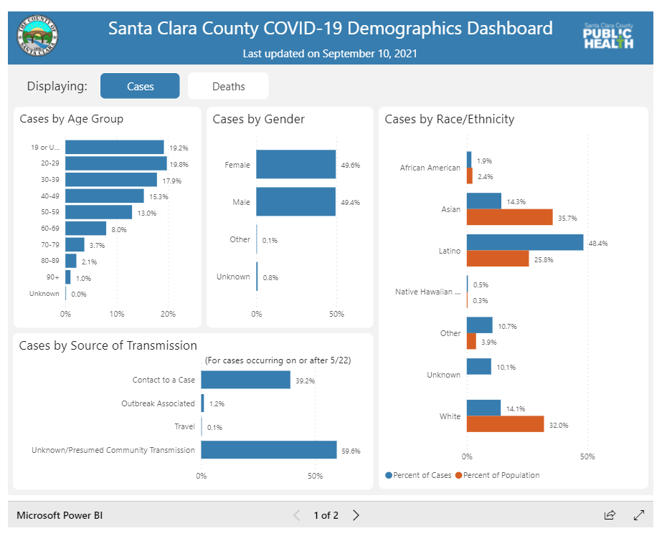
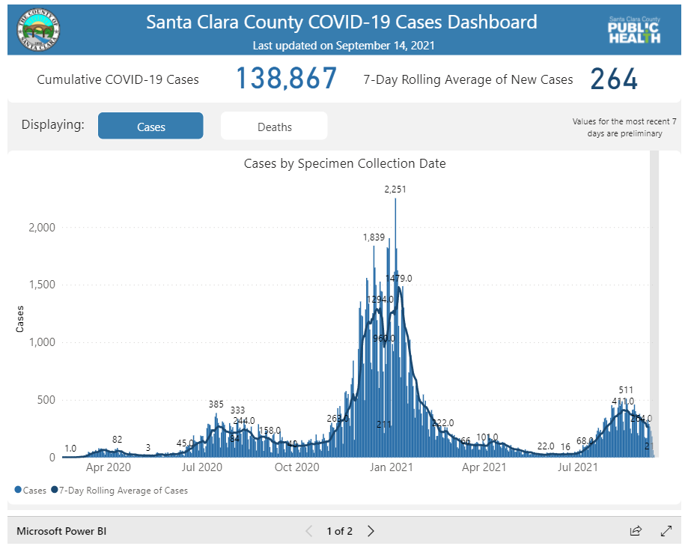
Santa Clara County
Vaccination Demographic Data
https://covid19.sccgov.org/dashboard-demographics-of-cases-and-deaths
COVID-19 Case Dashboard
https://covid19.sccgov.org/dashboard-cases-and-deaths

Slide 17
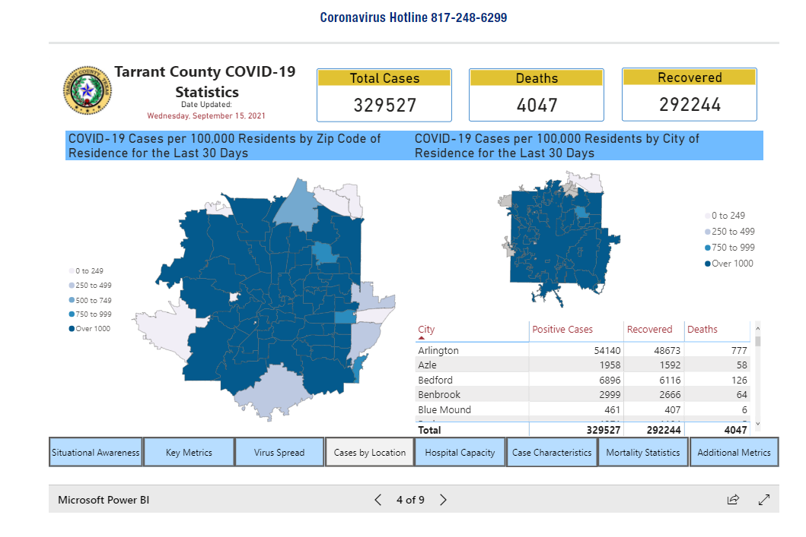
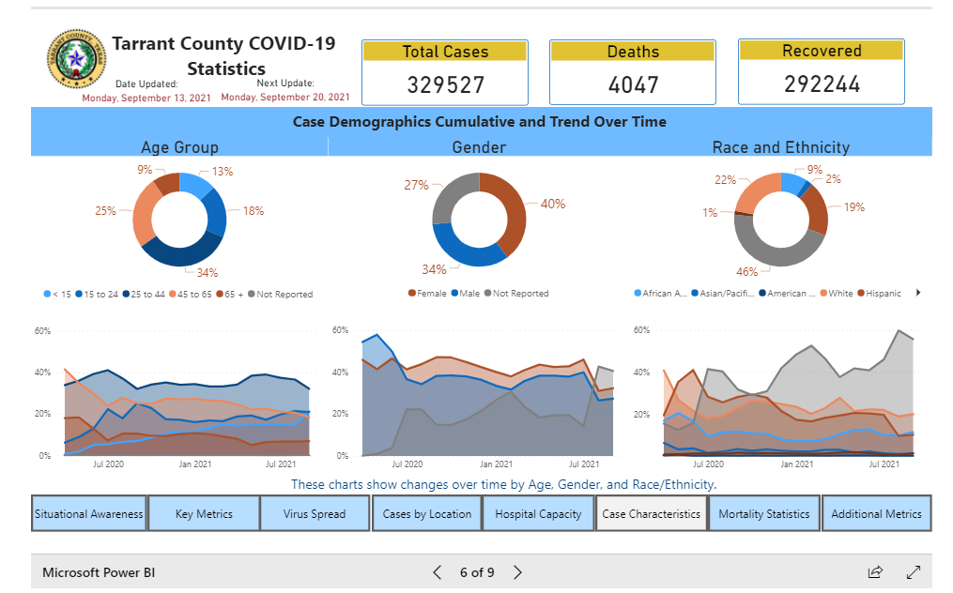
Tarrant County
COVID-19 Statistics
https://www.tarrantcounty.com/en/public-health/disease-control---prevention/COVID-19.html

Slide 18
Energy
Energy Consumption
Renewable Energy

Slide 19
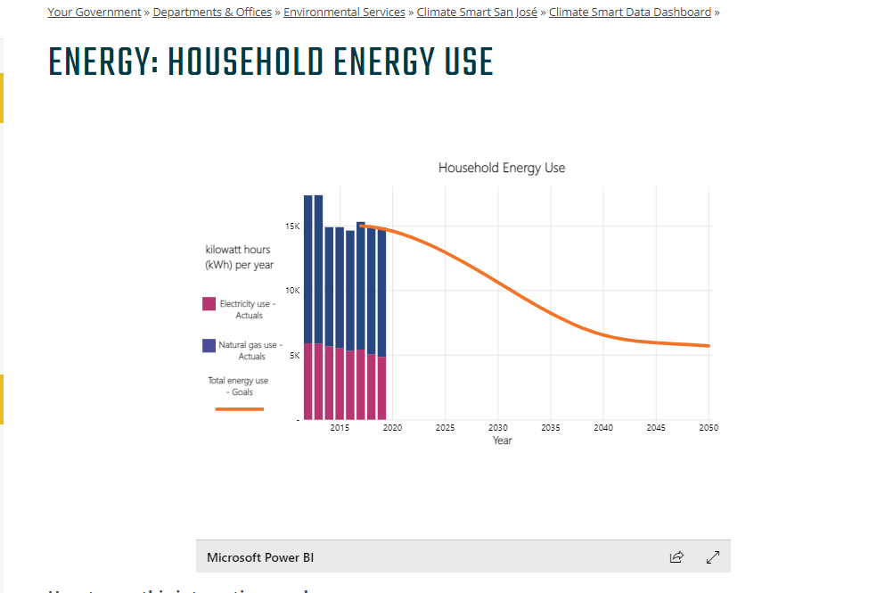
City of San Jose
Household Energy Use
https://www.sanjoseca.gov/your-government/departments-offices/environmental-services/climate-smart-san-jos/climate-smart-data-dashboard/energy-local-renewables/energy-household-energy-use

Slide 20

Finance
Financial Performance Scorecard
Tax Assessments Analysis
STORM FUNDING TRACKER

Slide 21
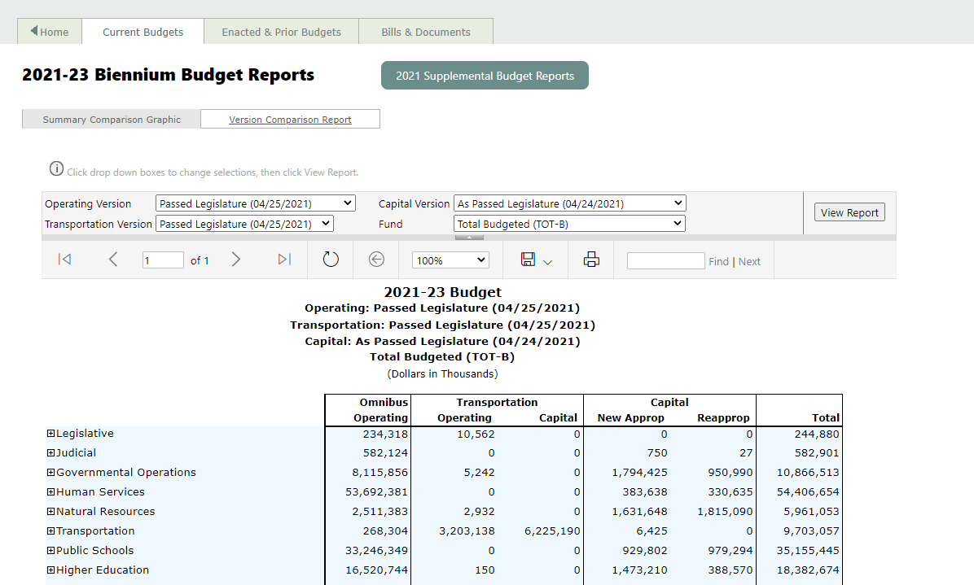
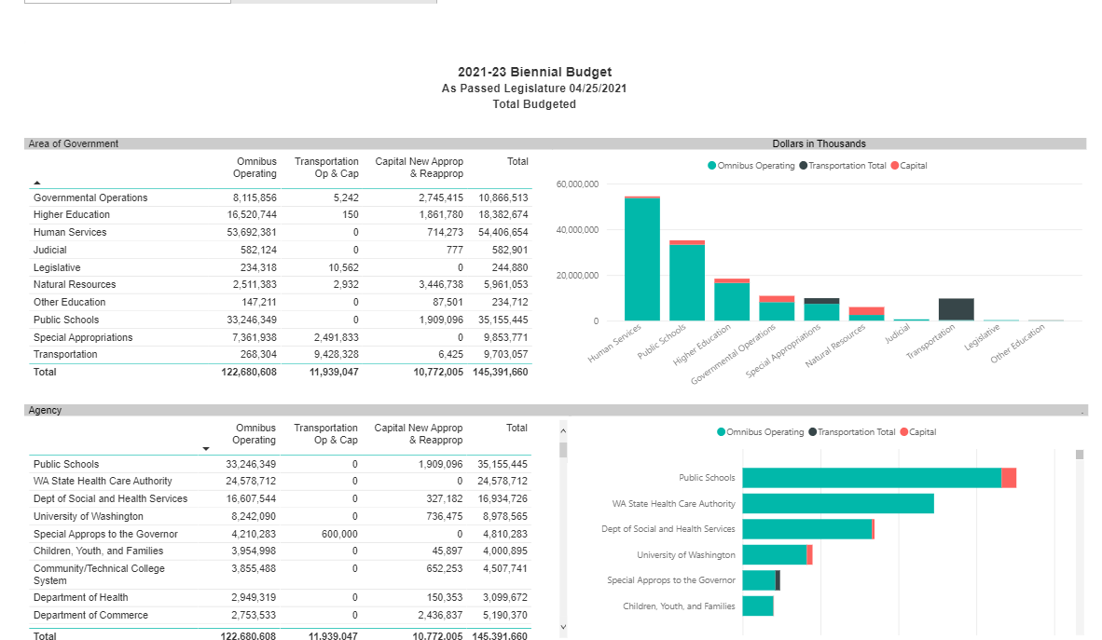
Washington State Fiscal
Operating, Capital and Transportation Budgets
http://fiscal.wa.gov/AllBudgetsVersionCompareBien.aspx

Slide 22
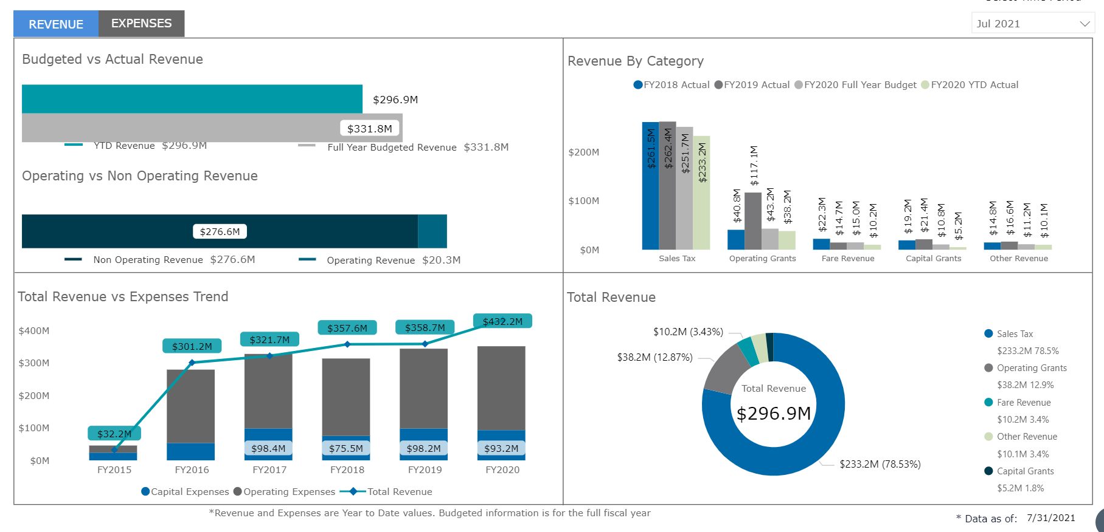
Austin Cap Metro
Financial Performance Dashboard
https://www.capmetro.org/financial-stats/

Slide 23
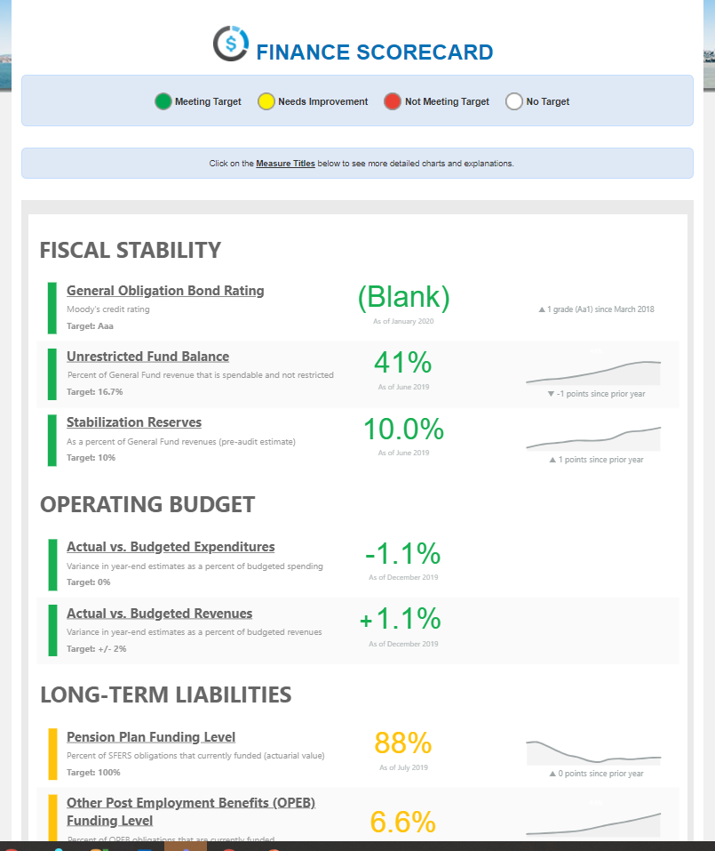
City of San Francisco
Financial Scorecard
https://sfgov.org/scorecards/finance

Slide 24
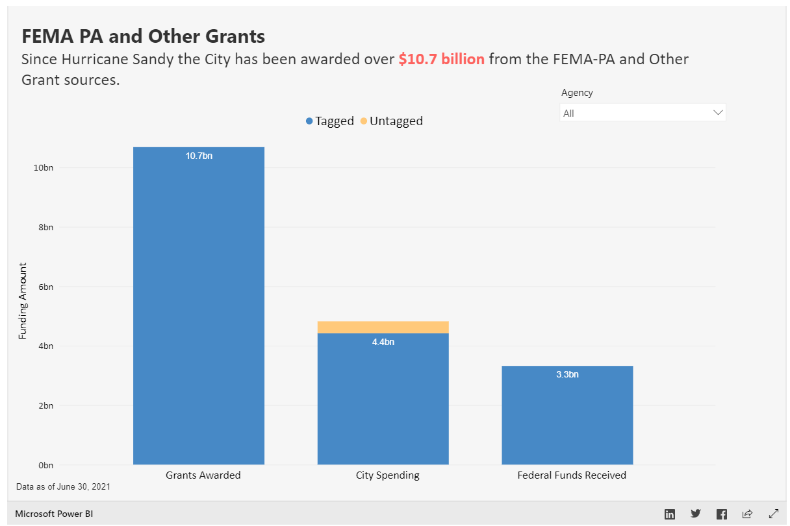
New York City Office of Management and Budget
Sandy Funding Tracker
https://www1.nyc.gov/content/sandytracker/pages/fema-pa-and-other-grants

Slide 25
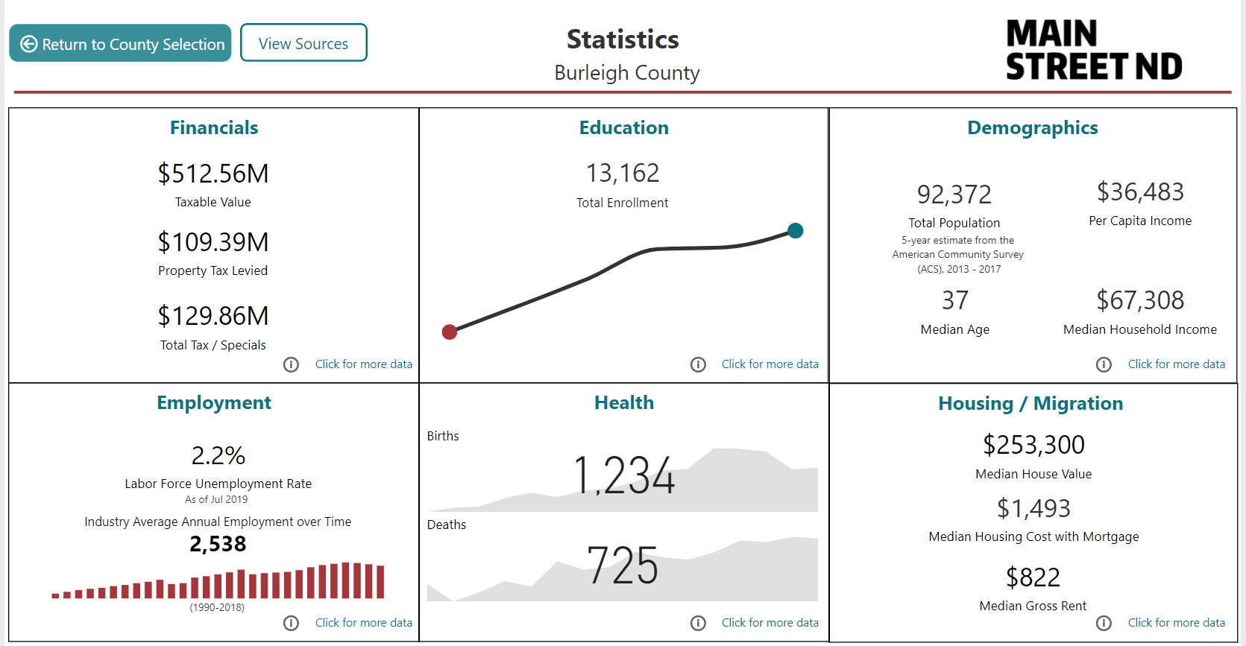
Main Street North Dakota
Property Taxes and Assessments
https://www.nd.gov/living-nd/main-street-nd/main-street-dashboard

Slide 26

Housing
Housing Recovery Projects
Housing Pipeline
HOUSING DIVERSITY AND DEMOGRAPHICS

Slide 27
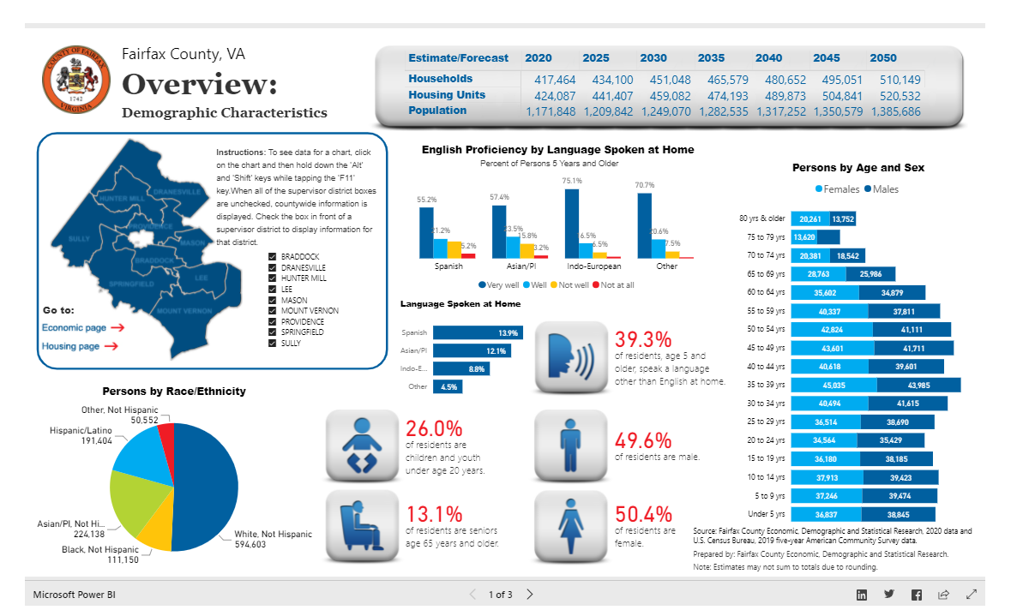
Fairfax County
Diversity and Demographics
https://www.fairfaxcounty.gov/demographics/fairfax-county-general-overview

Slide 28
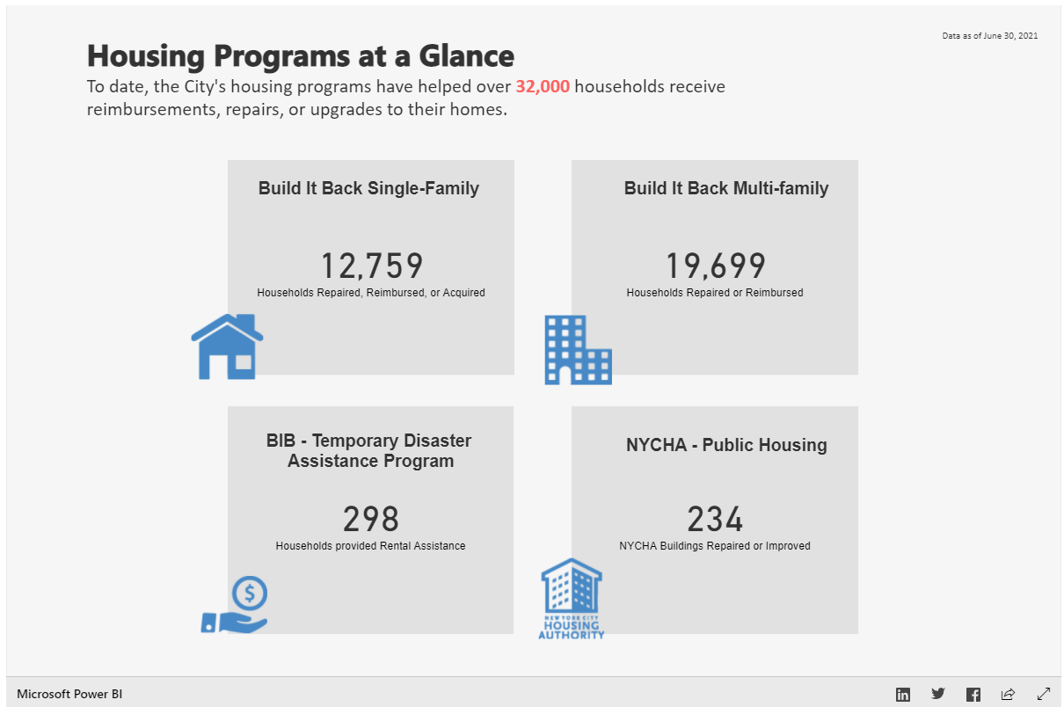
New York Sandy Funding Tracker
Housing Recovery Projects
https://www1.nyc.gov/content/sandytracker/pages/housing

Slide 29
Public Safety
Crime Analysis
Public Safety Scorecard
Jail population
Police Response rate

Slide 30
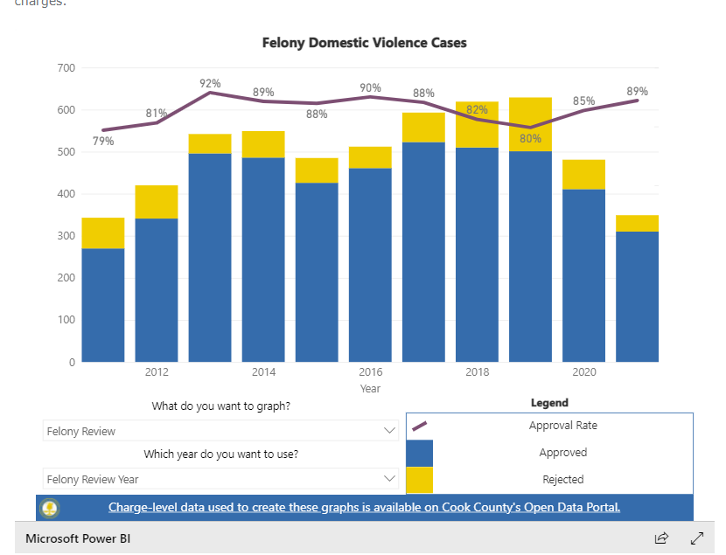
Cook County
Domestic Violence Dashboard
https://www.cookcountystatesattorney.org/resources/domestic-violence

Slide 31
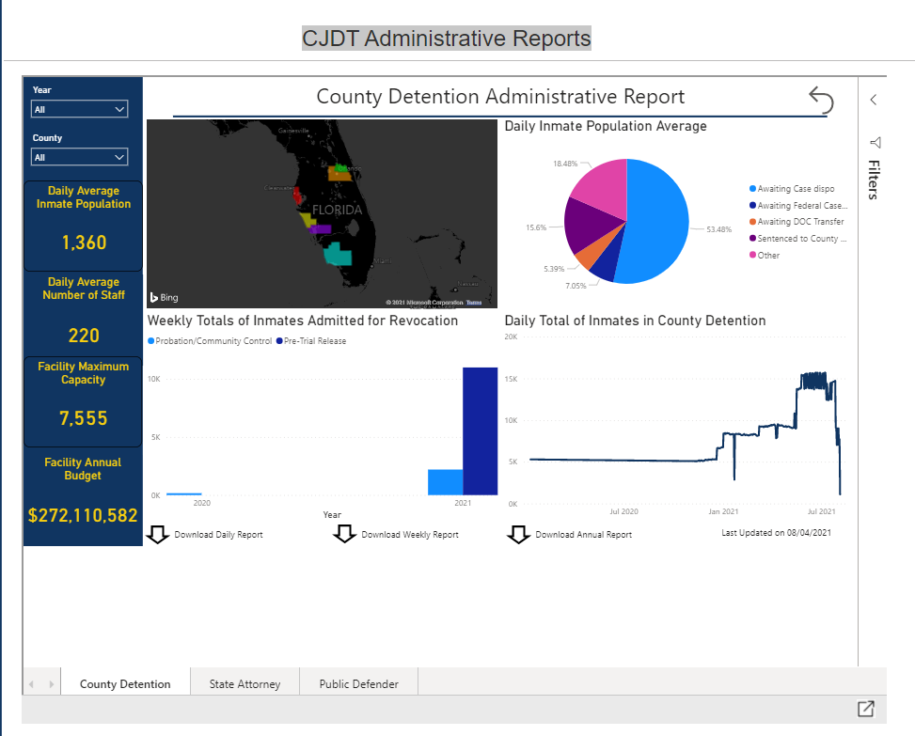
State of Florida
County Detention Administrative Report
http://www.fdle.state.fl.us/FSAC/CJAB-Home/FSAC/CJDT-Home/Admin-Reports-Presentation.aspx

Slide 32
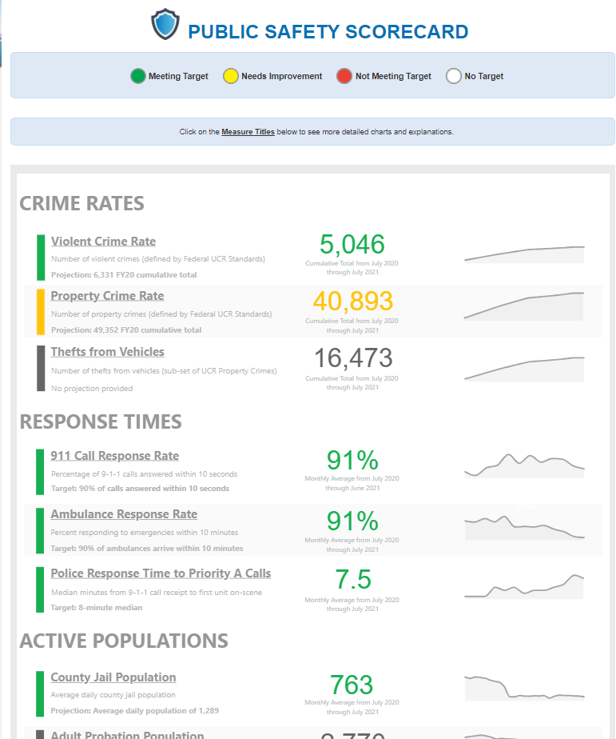
City of San Francisco
Public Safety Scorecard
https://sfgov.org/scorecards/public-safety

Slide 33
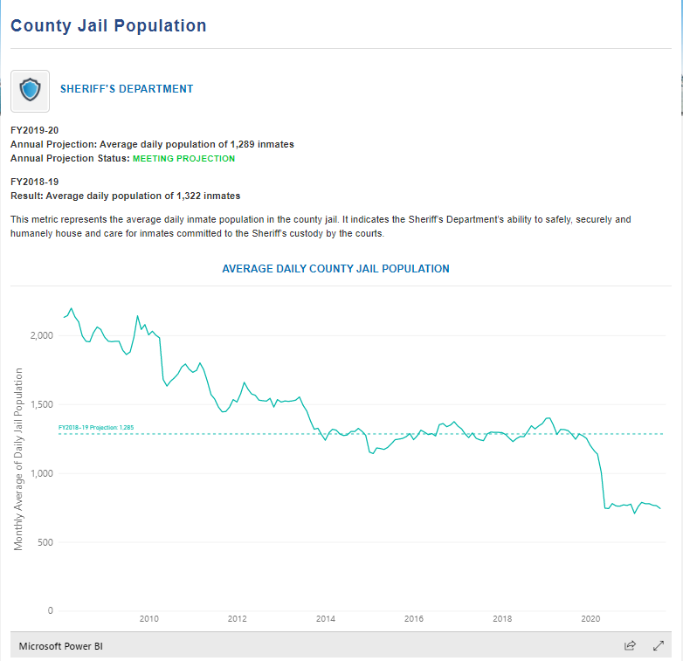
City of San Francisco
Jail Population
https://sfgov.org/scorecards/public-safety/county-jail-population

Slide 34
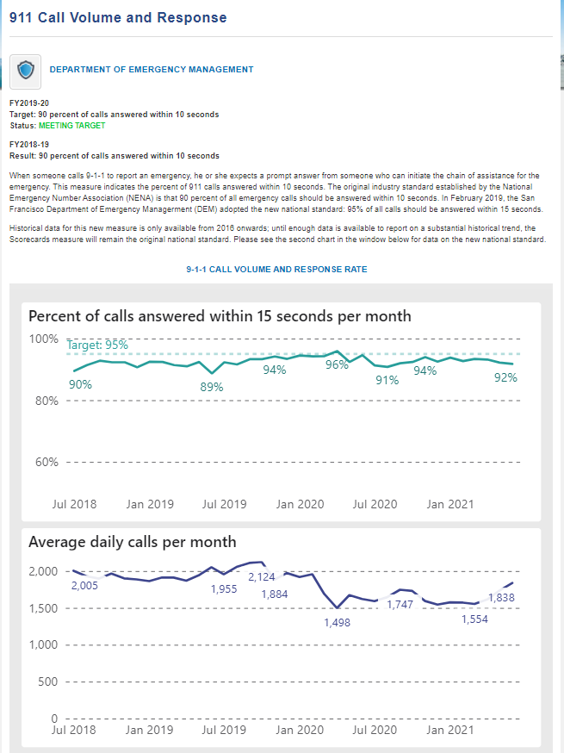
City of San Francisco
Police Response Rate
https://sfgov.org/scorecards/public-safety/911-call-volume-and-response

Slide 35
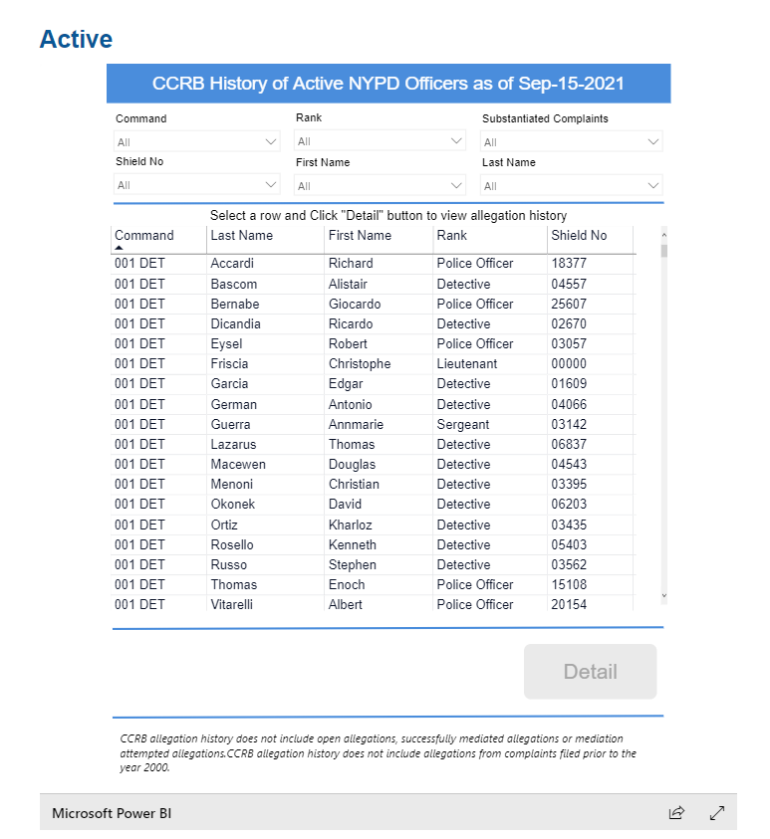
New York City PD
Civilian Complaint Review Board
https://www1.nyc.gov/site/ccrb/policy/MOS-records.page

Slide 36

Environment
Greenhouse Gas Emissions
Landfill Diversion
Air Quality Analysis
Water and Sewer Cost Tracking

Slide 37
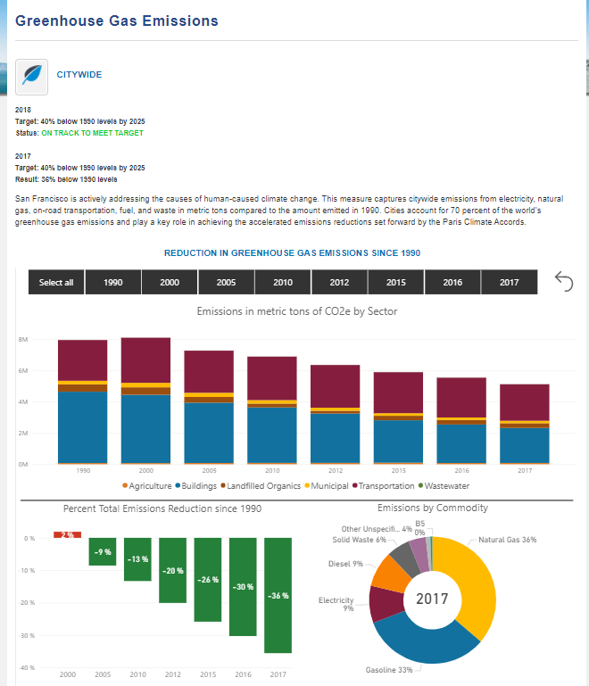
City of San Francisco
Greenshouse Gas Emissions
https://sfgov.org/scorecards/environment/greenhouse-gas-emissions

Slide 38
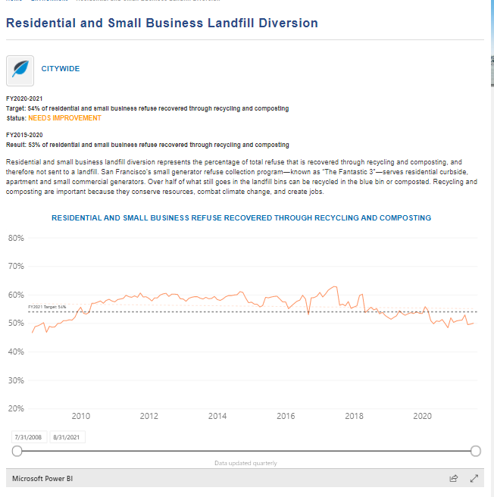
City of San Francisco
Landfill Diversion
https://sfgov.org/scorecards/environment/residential-and-small-business-landfill-diversion

Slide 39
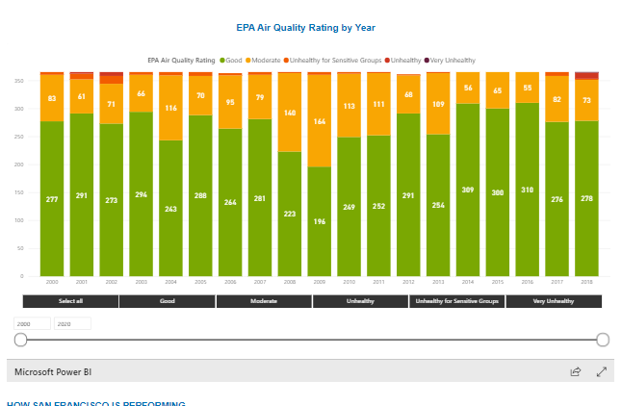
City of San Francisco
Air Quality Rating Analysis
https://sfgov.org/scorecards/environment/days-epa-air-quality-index-rating-good

Slide 40
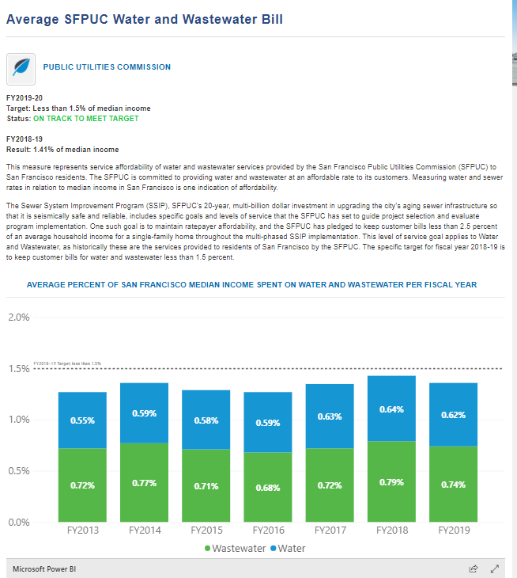
City of San Francisco
Water and Sewer Spending
https://sfgov.org/scorecards/environment/average-sfpuc-water-and-sewer-bill

Slide 41
Custom Demos
Reports built using public data for Power BI demonstrations

Slide 42
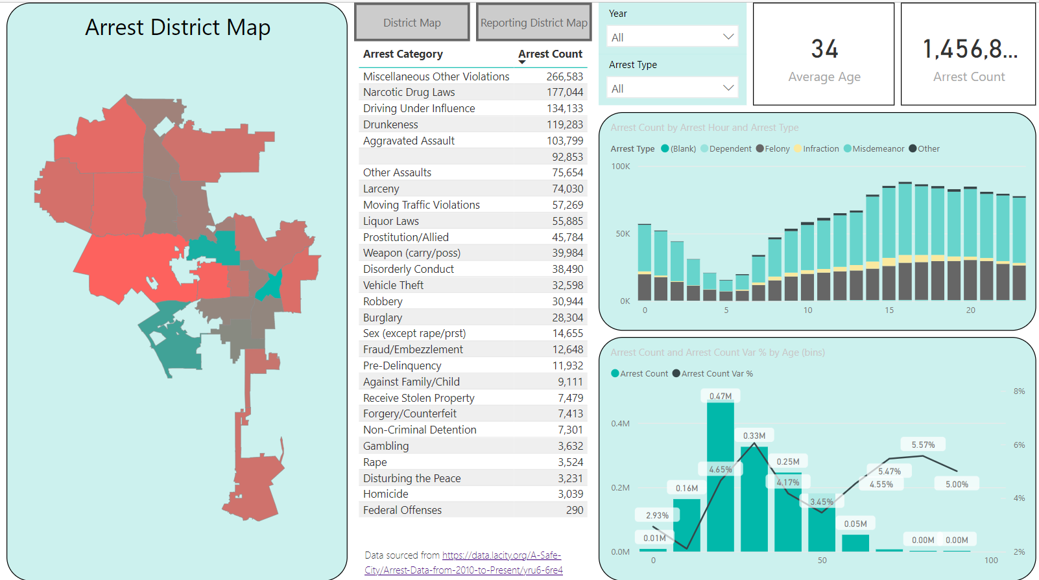
City of Los Angeles
LAPD Arrest and Crime Maps
https://aka.ms/LACityArrestAndCrime

Slide 43
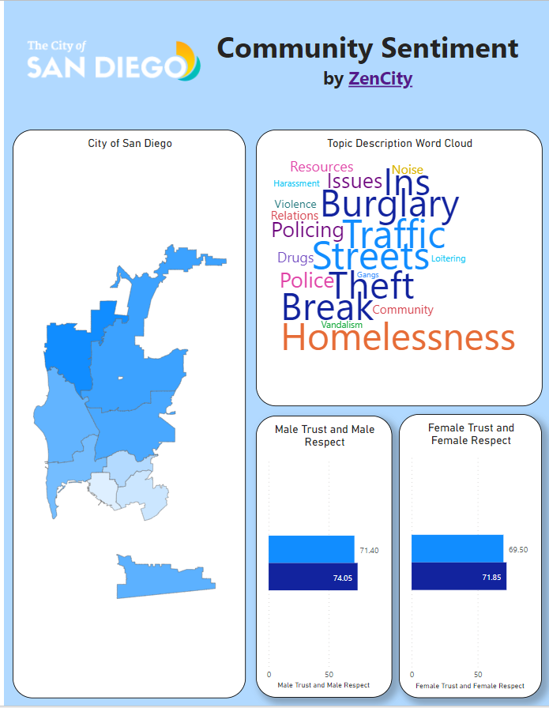
City of San Diego
Community Sentiment by ZenCity
https://aka.ms/CitySanDiegoZenCity

Slide 44
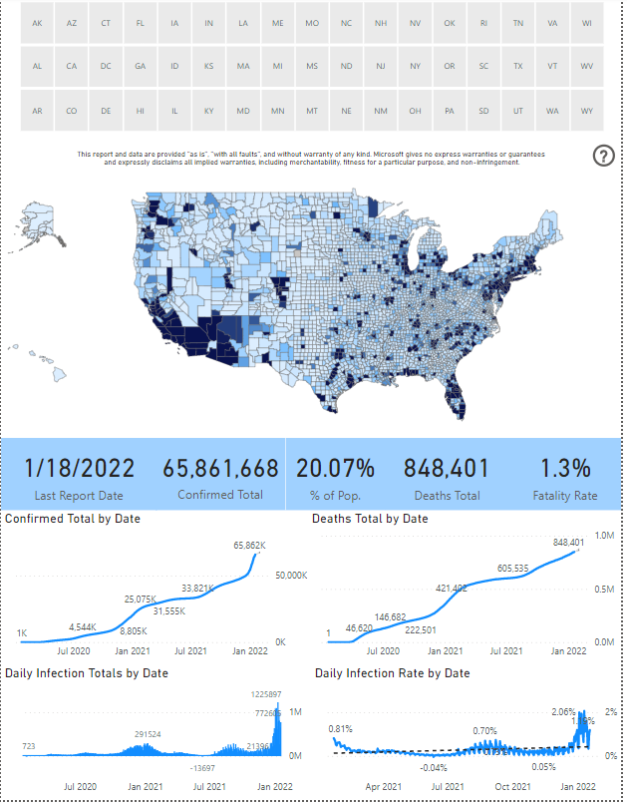
COVID 19 Report
COVID 19 Cases and Deaths USA Facts Data
https://aka.ms/COVID19Report

