Slide 1
Power BI Dynamic Row Level Security
Danni Olson
dannio@microsoft.com

Slide 2
We will review - ynamic RLS
Only certain people/groups can access report
Certain people/groups are filtered, but everyone else can see the report unfiltered
Row-level security won’t take affect for any user who has edit permissions on the content in a workspace.

Slide 3
Dynamic RLS Steps
Power BI Desktop: (Dynamic Row Level Security with Organizational Hierarchy Power BI - RADACAD)
  Create report
  Have/Create a link between email address (userprincipalname()) and fields to filter
  Create Roles
  Optional Step - Test
  Save Desktop File
Power BI Service: (Row-level security (RLS) with Power BI - Power BI | Microsoft Docs)
  Create a Workspace
  Connect Roles created in Desktop to AD people/groups
  Share/Give Workspace Access to people/groups

Slide 4
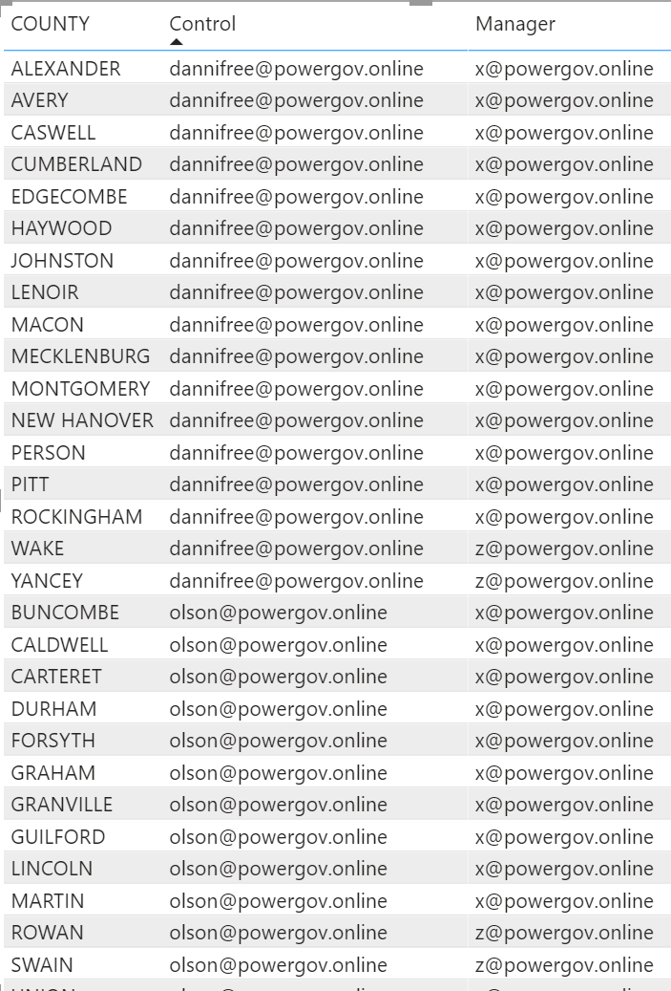


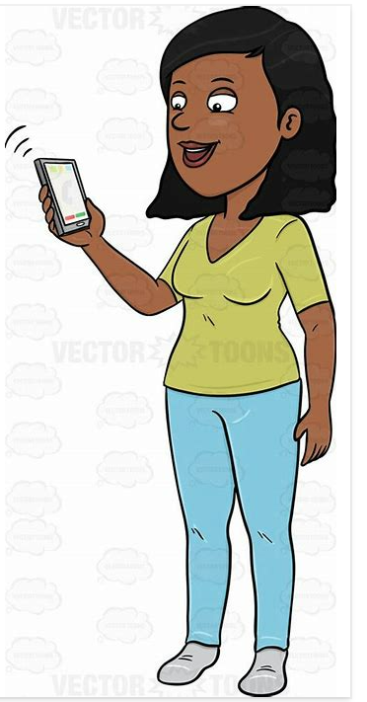

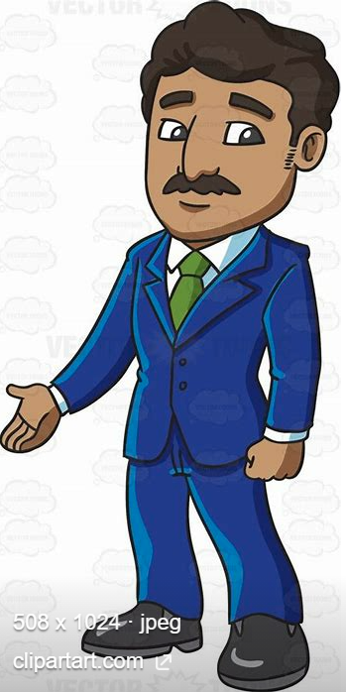
Only certain people/groups can access report
dannifree
X
Sally
olson
Z

Slide 5
Dynamic RLS Steps
Power BI Desktop: (Dynamic Row Level Security with Organizational Hierarchy Power BI - RADACAD)
  Create report
  Have/Create a link between email address (userprincipalname()) and fields to filter
  Create Roles
  Optional Step - Test
  Save Desktop File
Power BI Service: (Row-level security (RLS) with Power BI - Power BI | Microsoft Docs)
  Create a Workspace
  Connect Roles created in Desktop to AD people/groups
  Share/Give Workspace Access to people/groups

Slide 6
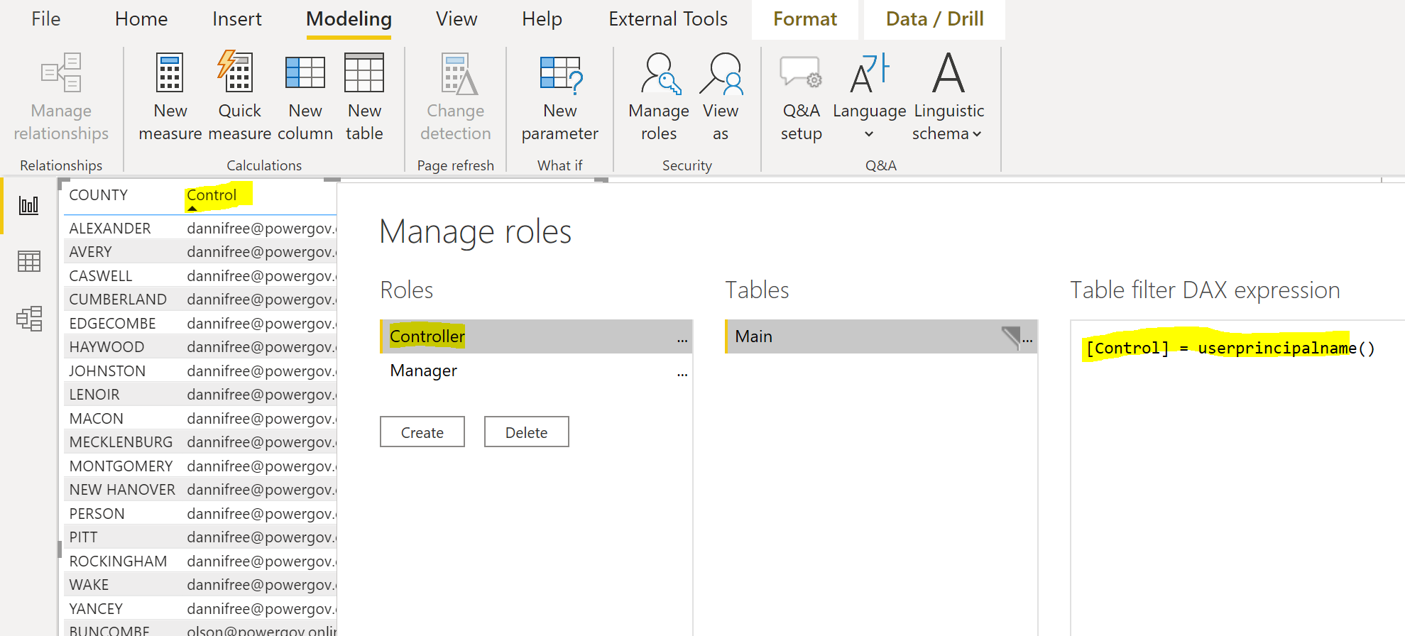
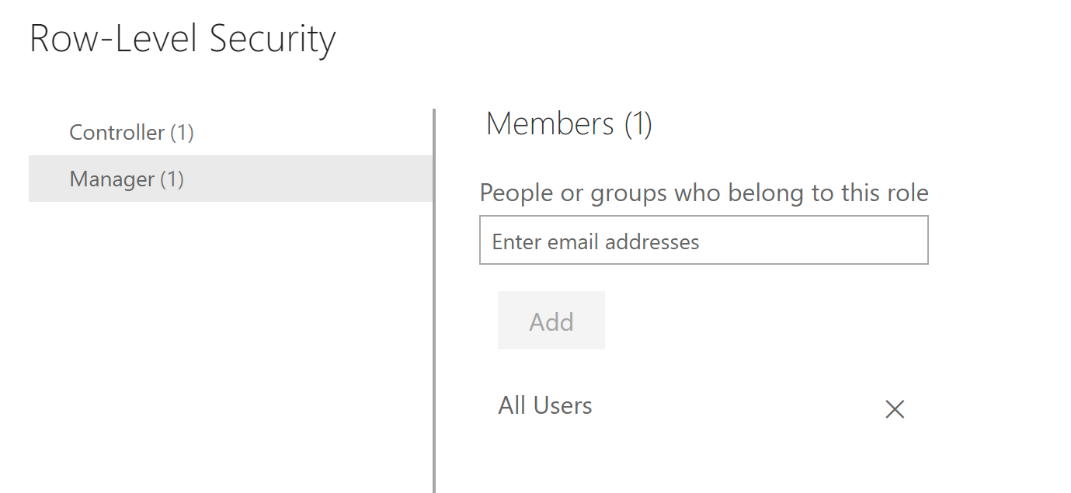
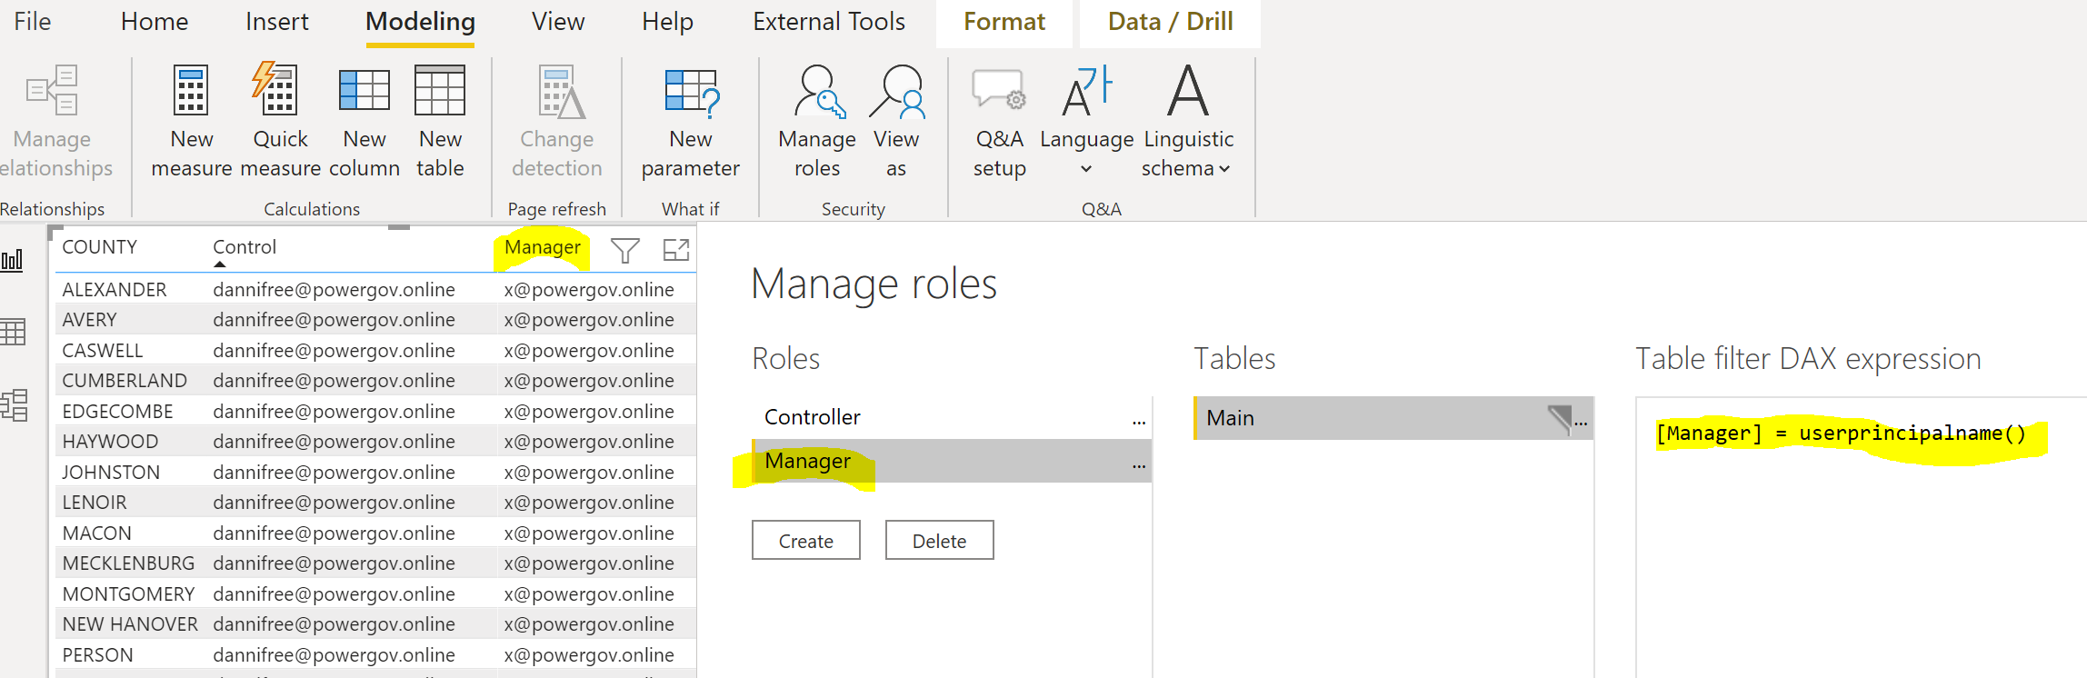
Only certain people/groups can access report
=userprincipalname())

Slide 7
Dynamic RLS Steps
Only certain people/groups can access report
Power BI Desktop: (Dynamic Row Level Security with Organizational Hierarchy Power BI - RADACAD)
  Create report
  Have/Create a link between email address (userprincipalname()) and fields to filter
  Create Roles
  Optional Step - Test
  Save Desktop File
Power BI Service: (Row-level security (RLS) with Power BI - Power BI | Microsoft Docs)
  Create a Workspace
  Upload Power BI Desktop file to Workspace
  Connect Roles created in Desktop to AD people/groups
  Share/Give Workspace Access to people/groups

Slide 8
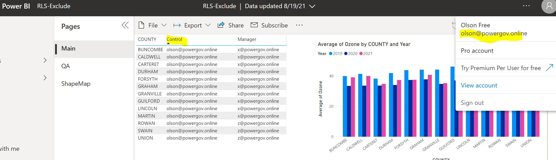
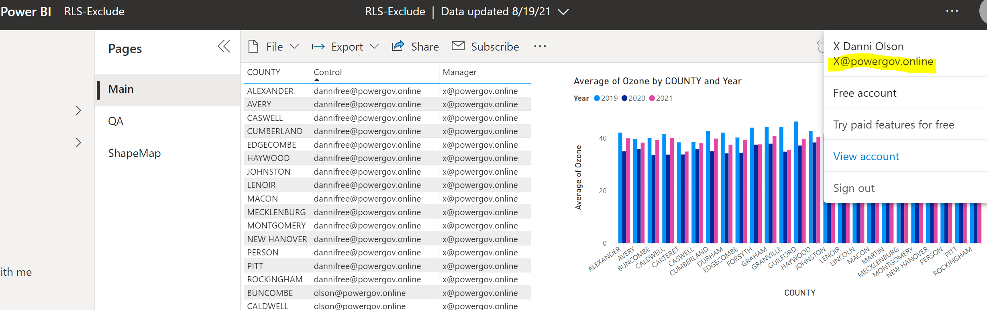
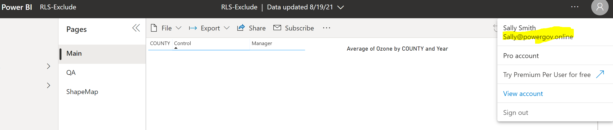
Only certain people/groups can access report
olson
X
Sally

Slide 9
Dynamic RLS Steps
Certain people/groups are filtered, but everyone else can see the report unfiltered
Power BI Desktop: (Dynamic Row Level Security with Organizational Hierarchy Power BI - RADACAD)
  Create report
  Have/Create a link between email address (userprincipalname()) and fields to filter
  Create Roles
  Optional Step - Test
  Save Desktop File
Power BI Service: (Row-level security (RLS) with Power BI - Power BI | Microsoft Docs)
  Create a Workspace
  Connect Roles created in Desktop to AD people/groups
  Share/Give Workspace Access to people/groups

Slide 10
Certain people/groups are filtered, but everyone else can see the report unfiltered
dannifree
X
SEE ALL
Sally
olson
Z

Slide 11
Dynamic RLS Steps
Certain people/groups are filtered, but everyone else can see the report unfiltered
Power BI Desktop: (Dynamic Row Level Security with Organizational Hierarchy Power BI - RADACAD)
  Create report
  Have/Create a link between email address (userprincipalname()) and fields to filter
  Create Roles
  Optional Step - Test
  Save Desktop File
Power BI Service: (Row-level security (RLS) with Power BI - Power BI | Microsoft Docs)
  Create a Workspace
  Connect Roles created in Desktop to AD people/groups
  Share/Give Workspace Access to people/groups

Slide 12
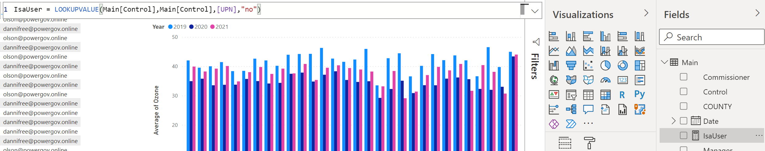
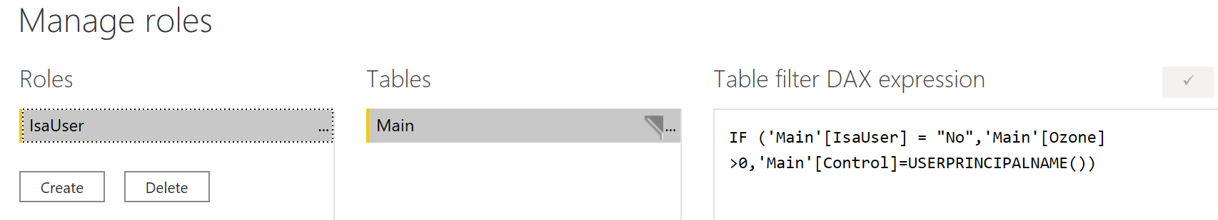
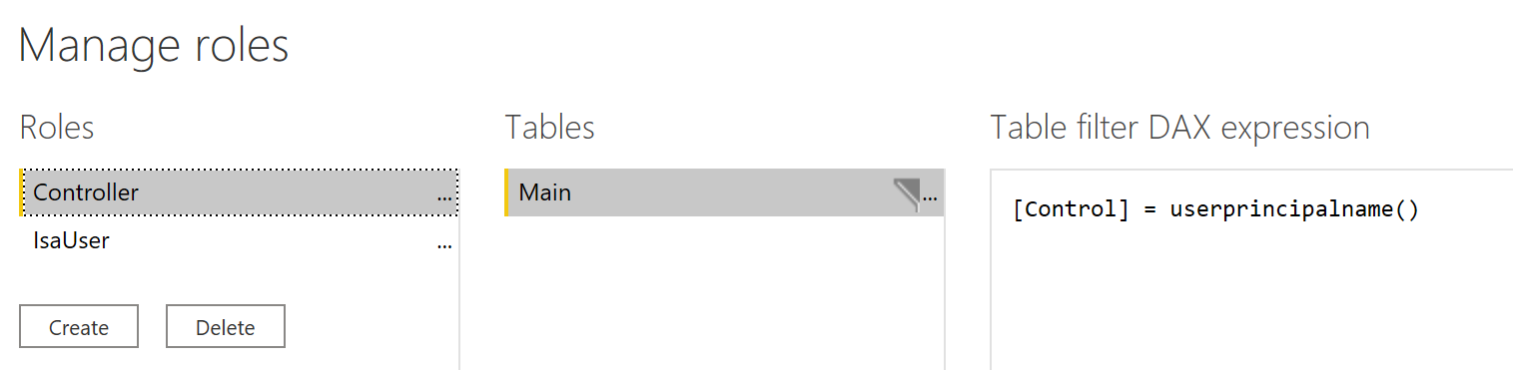
Certain people/groups are filtered, but everyone else can see the report unfiltered
Create a measure to look-up if a person is a user
IsaUser = LOOKUPVALUE(Main[Control],Main[Control],[UPN],"no")
Create Roles inside of PowerBI Desktop
IF ('Main'[IsaUser] = "No",'Main'[Ozone]>0,'Main'[Control]=USERPRINCIPALNAME())
[Control] = userprincipalname()

Slide 13
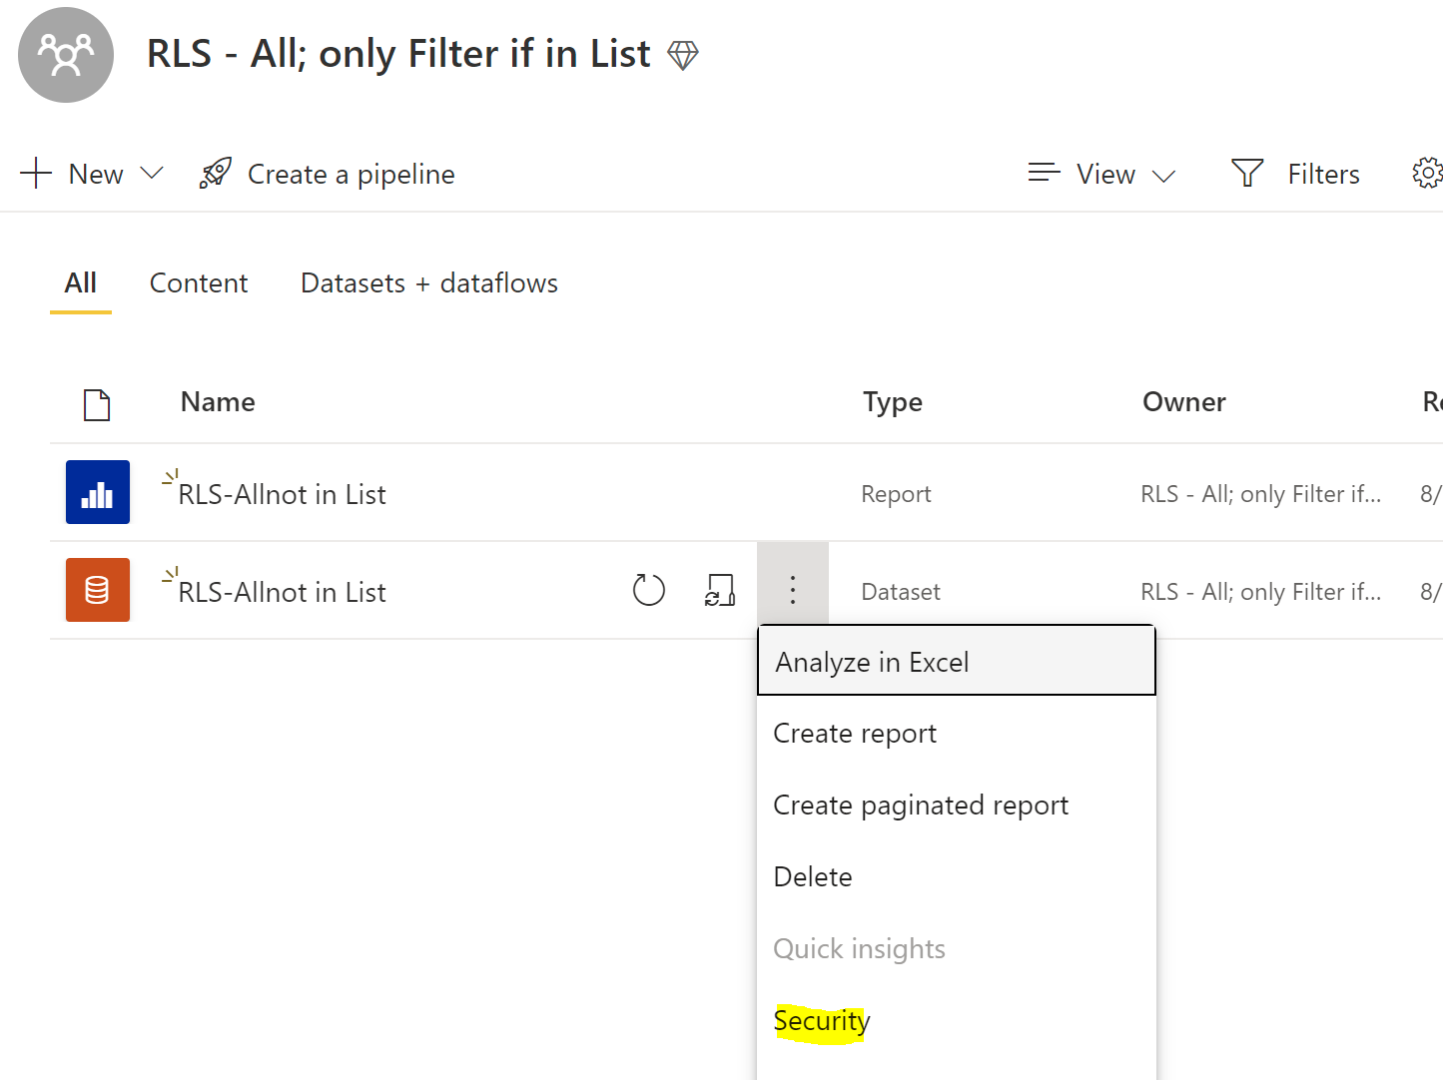
Certain people/groups are filtered, but everyone else can see the report unfiltered
Assign Roles created in PowerBI Desktop to AD Groups in Power BI Service

Slide 14
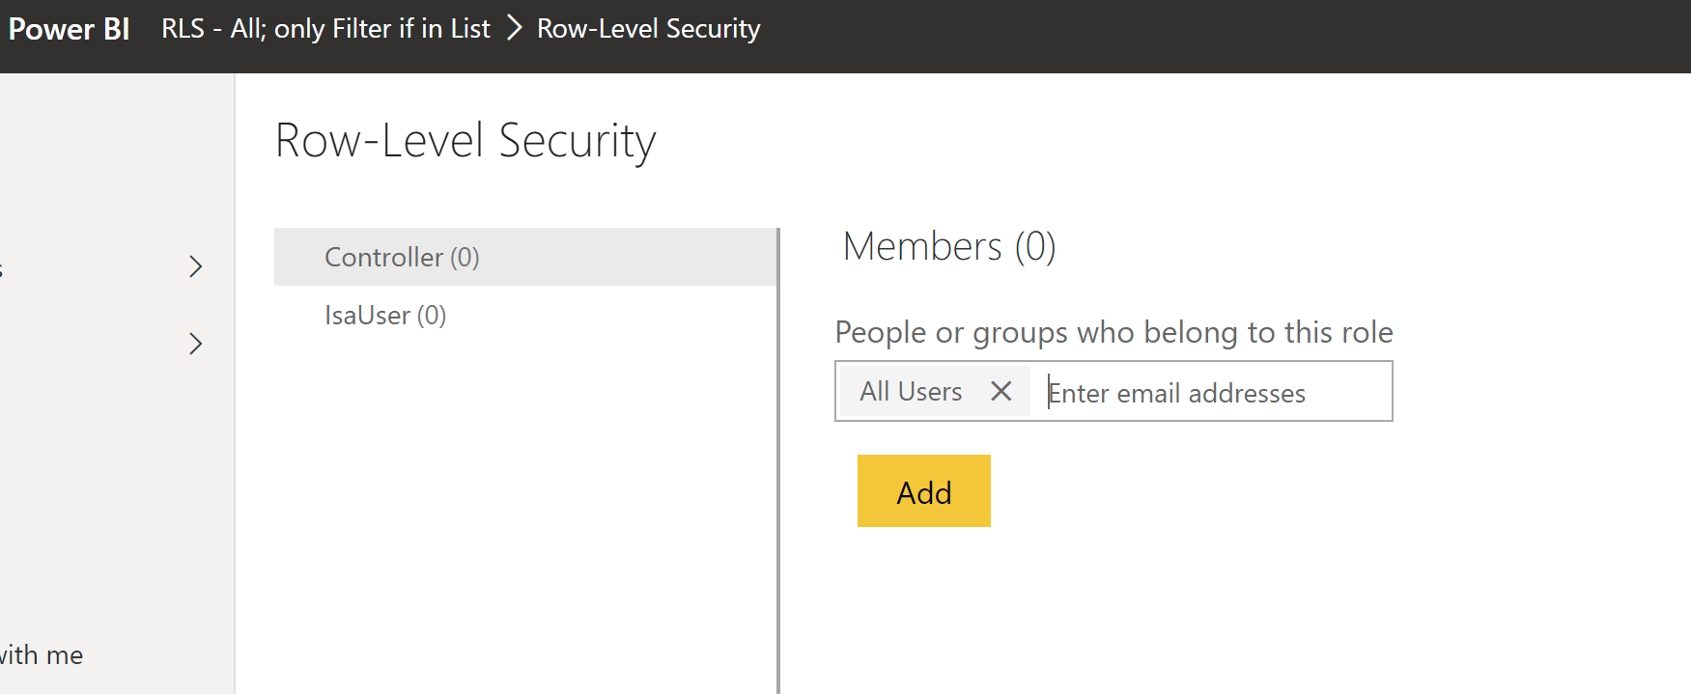
Certain people/groups are filtered, but everyone else can see the report unfiltered
Assign Roles created in PowerBI Desktop to AD Groups in Power BI Service

Slide 15
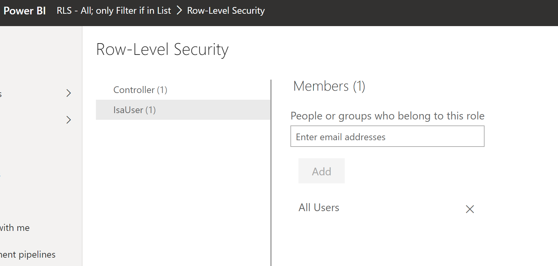
Certain people/groups are filtered, but everyone else can see the report unfiltered
Assign Roles created in PowerBI Desktop to AD Groups in Power BI Service

Slide 16
Dynamic RLS Steps
Certain people/groups are filtered, but everyone else can see the report unfiltered
Power BI Desktop: (Dynamic Row Level Security with Organizational Hierarchy Power BI - RADACAD)
  Create report
  Have/Create a link between email address (userprincipalname()) and fields to filter
  Create Roles
  Optional Step - Test
  Save Desktop File
Power BI Service: (Row-level security (RLS) with Power BI - Power BI | Microsoft Docs)
  Create a Workspace
  Connect Roles created in Desktop to AD people/groups
  Share/Give Workspace Access to people/groups

Slide 17
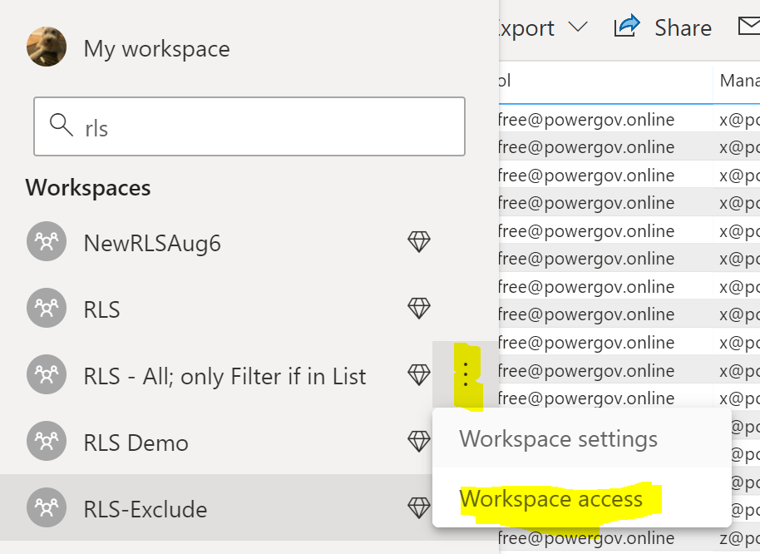
Certain people/groups are filtered, but everyone else can see the report unfiltered
Give Access to Workspace to Users

Slide 18
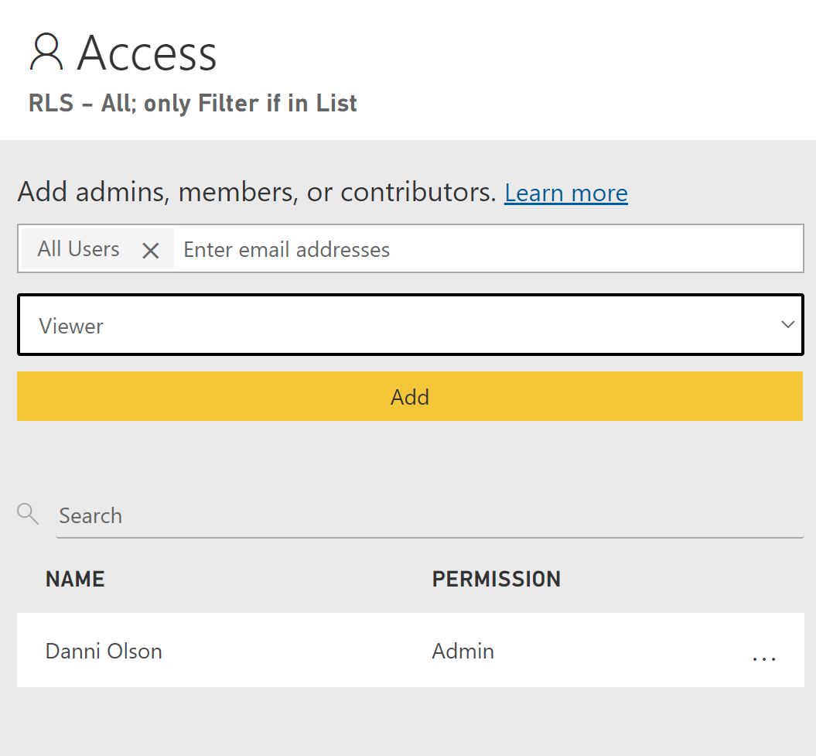
Certain people/groups are filtered, but everyone else can see the report unfiltered
Give Access to Workspace to Users

Slide 19
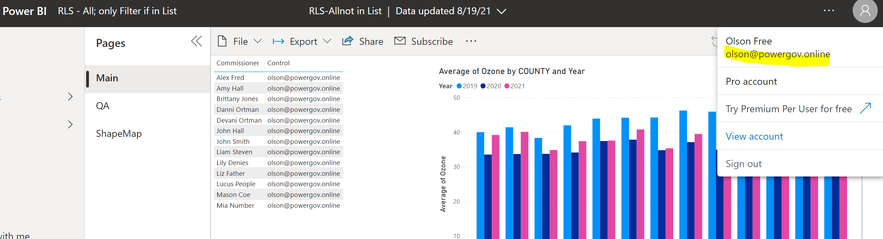
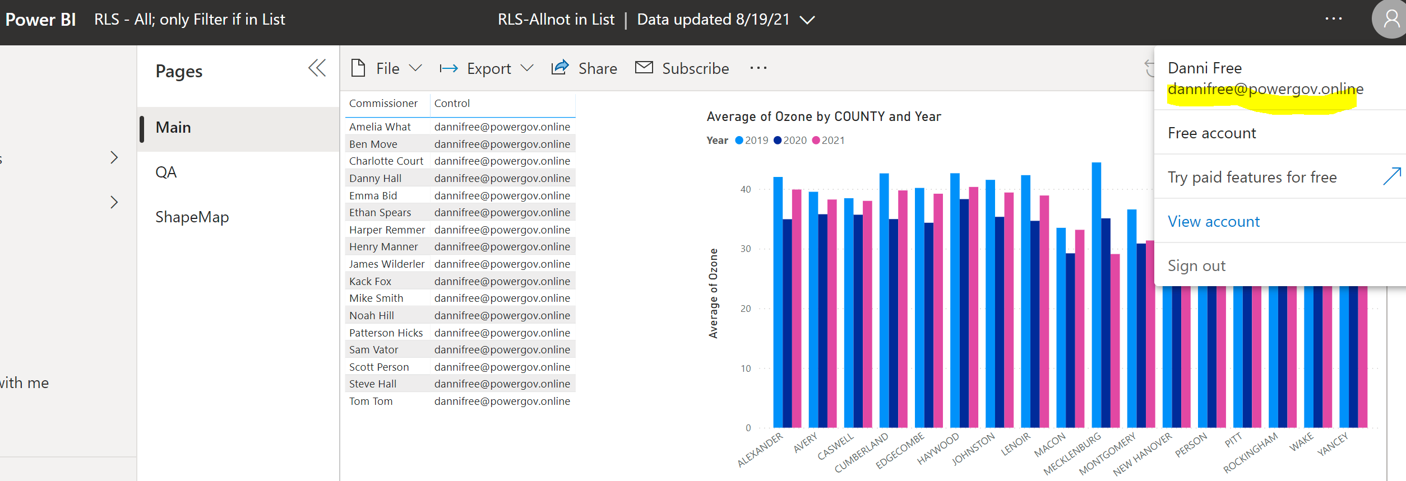
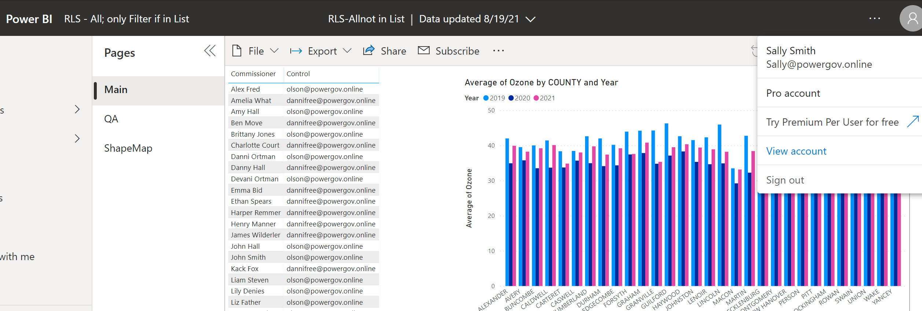
Certain people/groups are filtered, but everyone else can see the report unfiltered
olson
dannifree
Sally

Slide 20
Dynamic RLS Steps
Power BI Desktop: (Dynamic Row Level Security with Organizational Hierarchy Power BI - RADACAD)
  Create report
  Have/Create a link between email address (userprincipalname()) and fields to filter
  Create Roles
  Optional Step - Test
  Save Desktop File
Power BI Service: (Row-level security (RLS) with Power BI - Power BI | Microsoft Docs)
  Create a Workspace
  Connect Roles created in Desktop to AD people/groups
  Share/Give Workspace Access to people/groups

Slide 21
Sharing Content Internally

Slide 22
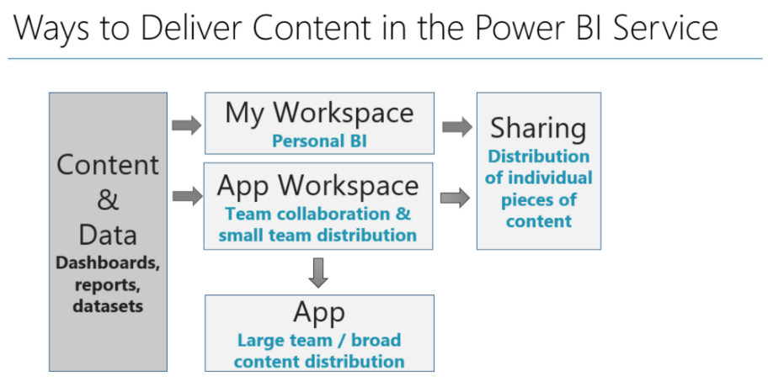
How to Deliver Content
Excluding subscriptions and embedding scenarios, there are three main ways to distribute content once it’s been published to the Power BI Service:
  Sharing
  Workspaces
  Apps

Slide 23
Sharing one report
Sharing can be used effectively when a user or group needs access to one piece of content but has no need to view everything in a workspace or everything in an app.
Sharing is best suited to informal scenarios where content is shared with just one person, or a few people who work closely together.
Sharing should be the exception rather than the rule (I recommend looking at using workspaces or apps first). Since sharing permissions are set per report and per dashboard, it can become a good bit of maintenance and error-prone if overused.
Sharing should rarely be used from My Workspace, and definitely not for mission-critical content, since only one person can maintain the original content in My Workspace.

Slide 24
Sharing Workspace
Workspaces are where we publish content to. They serve as not only a content organization boundary, but also a security boundary.
For small teams who work together closely, it might be very practical to use the workspace for not only content creation and testing but also for content distribution. For instance, perhaps there is a manager or a colleague who only needs viewer rights only to the content.

Slide 25
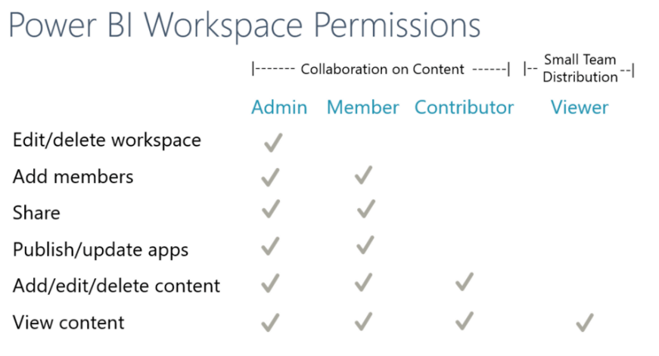
Permission Levels
The workspace permissions always apply to all content within a workspace.
Row-level security won’t take affect for any user who has edit permissions on the content in a workspace.
Any report/dashboard changes are viewable to recipients of the share immediately after the changes are saved in the Power BI Service.
Viewers filters are saved
Members of a workspace with at least a Contributor role automatically have Build permission for datasets in that workspace, and permission to copy a report
Roles in the new workspaces in Power BI - Power BI | Microsoft Docs

Slide 26
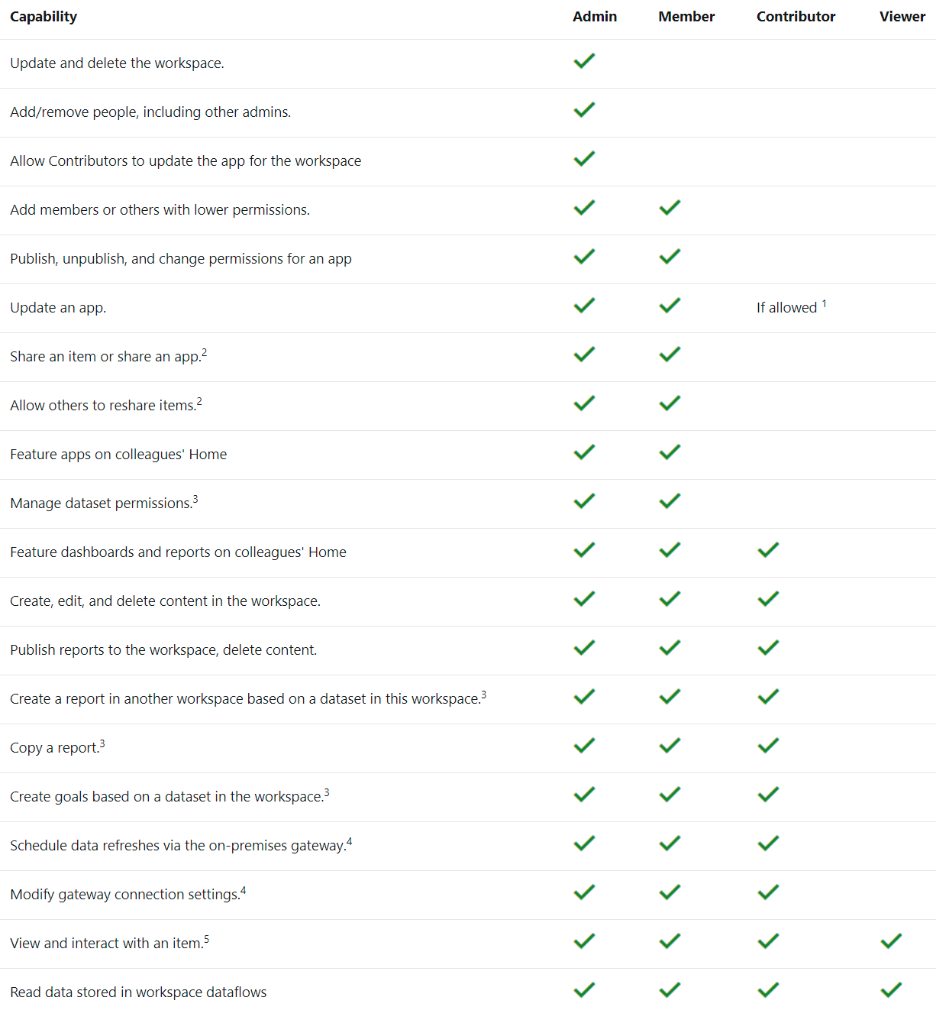
Permission Levels
Members of a workspace with at least a Contributor role automatically have Build permission for datasets in that workspace, and permission to copy a report
Roles in the new workspaces in Power BI - Power BI | Microsoft Docs

Slide 27
Test Workspace Permissions
olson
X
Sally

Slide 28
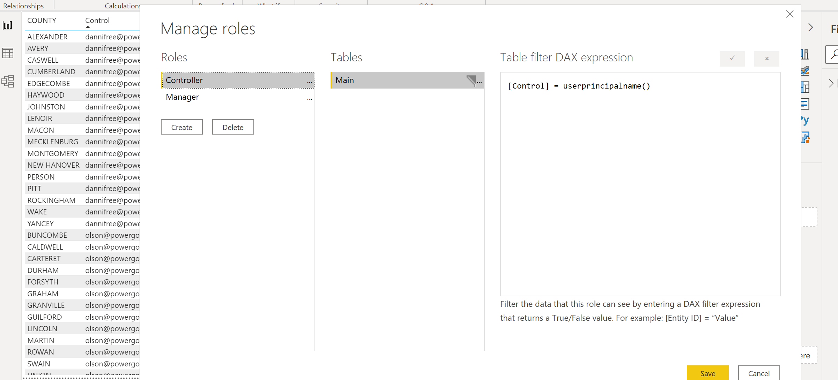
Test Workspace Permissions
Same Roles as our first example

Slide 29
olson
X
Sally

Slide 30
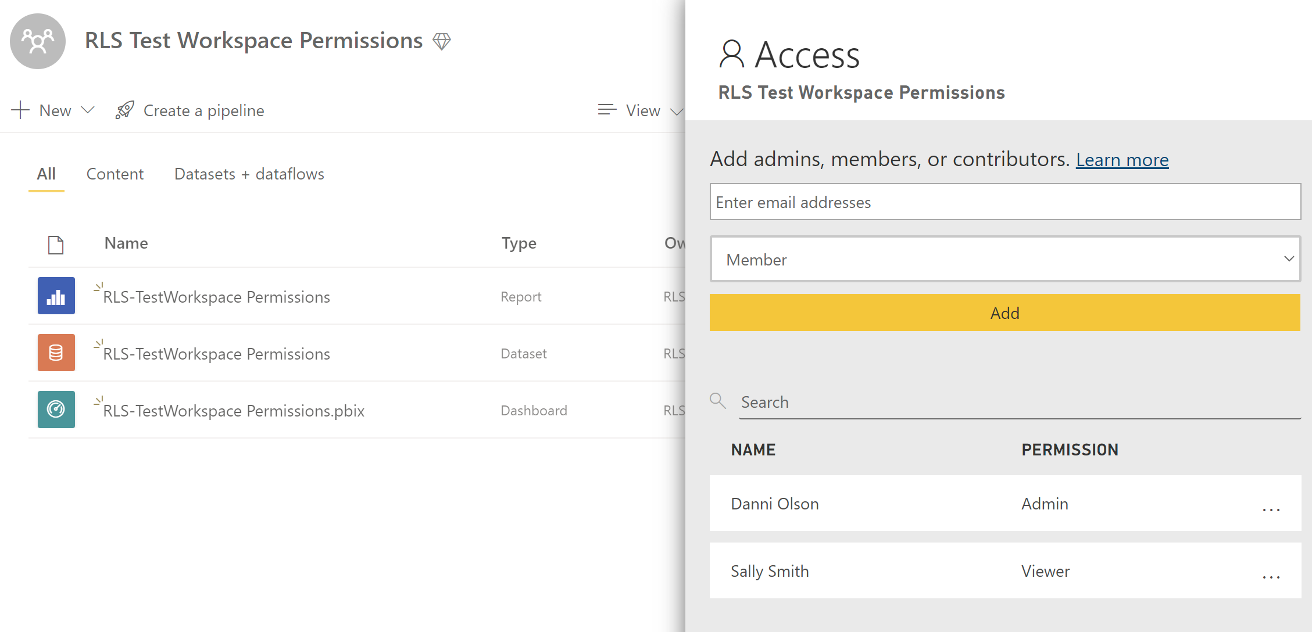
Test Workspace Permissions
Sally is a Viewer

Slide 31
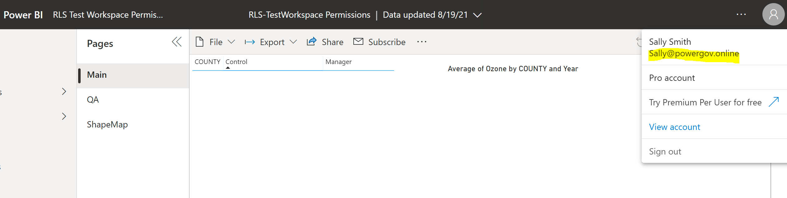
Test Workspace Permissions
Sally is a Viewer

Slide 32
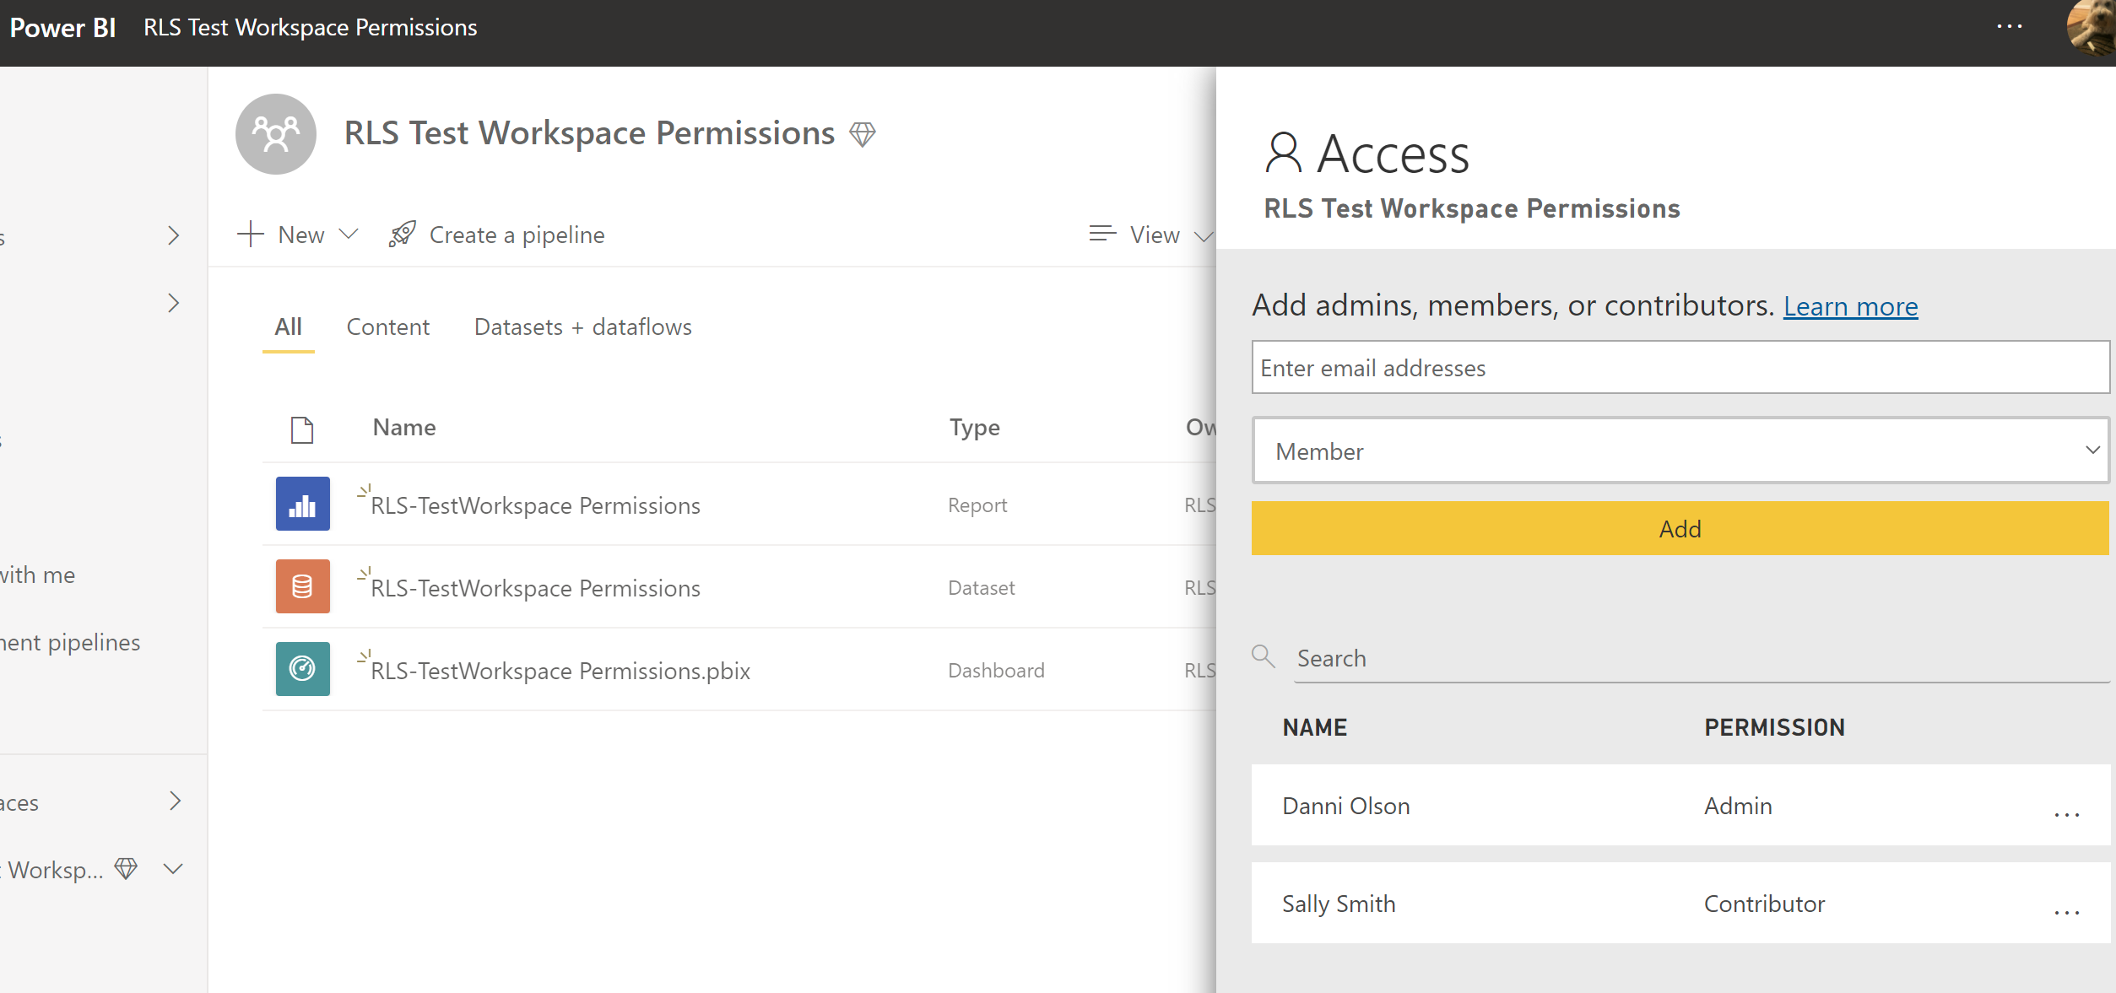
Test Workspace Permissions
Sally is now a Contributor

Slide 33
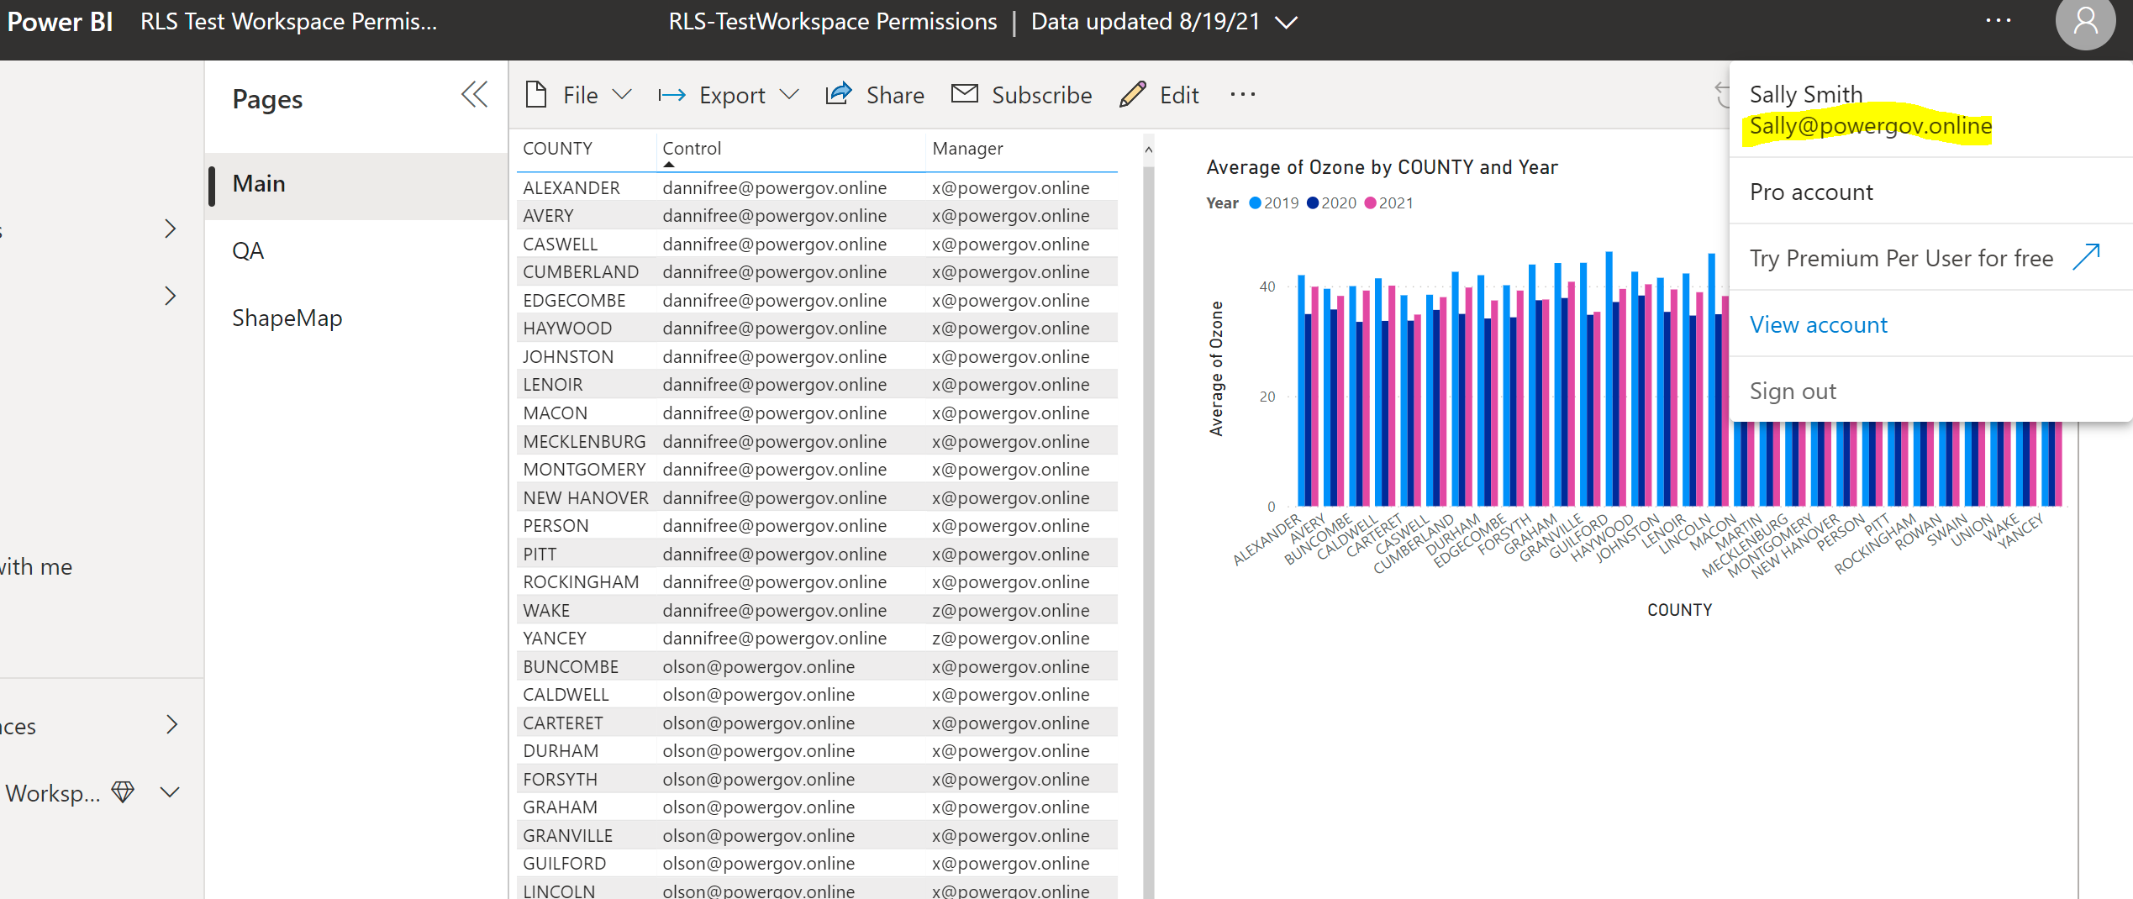
Test Workspace Permissions
Sally is now a Contributor

Slide 34
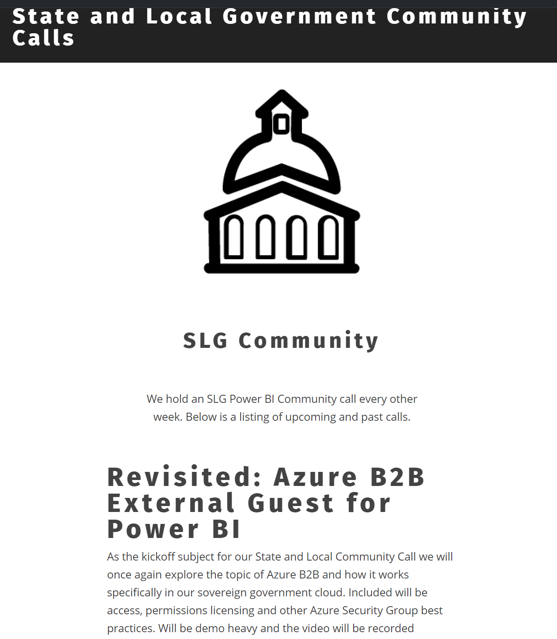
Increase your Knowledge
Register for Dashboard in a day
https://aka.ms/nextdiad
Online Professional Training from Microsoft Store
Explore MS Learning
https://docs.microsoft.com/en-us/learn/browse/?products=power-bi
Enterprise Skilling from MSFT:
Course DA-100T00-A: Analyzing Data with Power BI - Learn | Microsoft Docs
GCC Community Calls (Danni and Cyrus):
State and Local Government Community Calls – Power BI in Government (powergi.blog)

Slide 35
Sharing App
Distributing content broadly to a large number of users
Distributing some or all reports/dashboards from within the workspace
Using a separate level of security since which is decoupled from the workspace security
Controlling the publishing process and the timing when consumers can view report/dashboard changes
Pushing apps to the downstream users so they automatically appear in the user’s apps menu (this is disabled by default in the tenant settings - if you allow this for specific content authors who will use this feature prudently, it is a nice convenience for the app viewers to not have to go fetch the app)
Allowing users to copy the reports to their My Workspace and customize them [optional - can be disabled when you publish the app] Need Pro
Allowing users to connect to the underlying datasets to create their own reports without needing access to the workspace (this is known as the ‘build’ permission spoken of in relation to shared datasets)

Slide 36
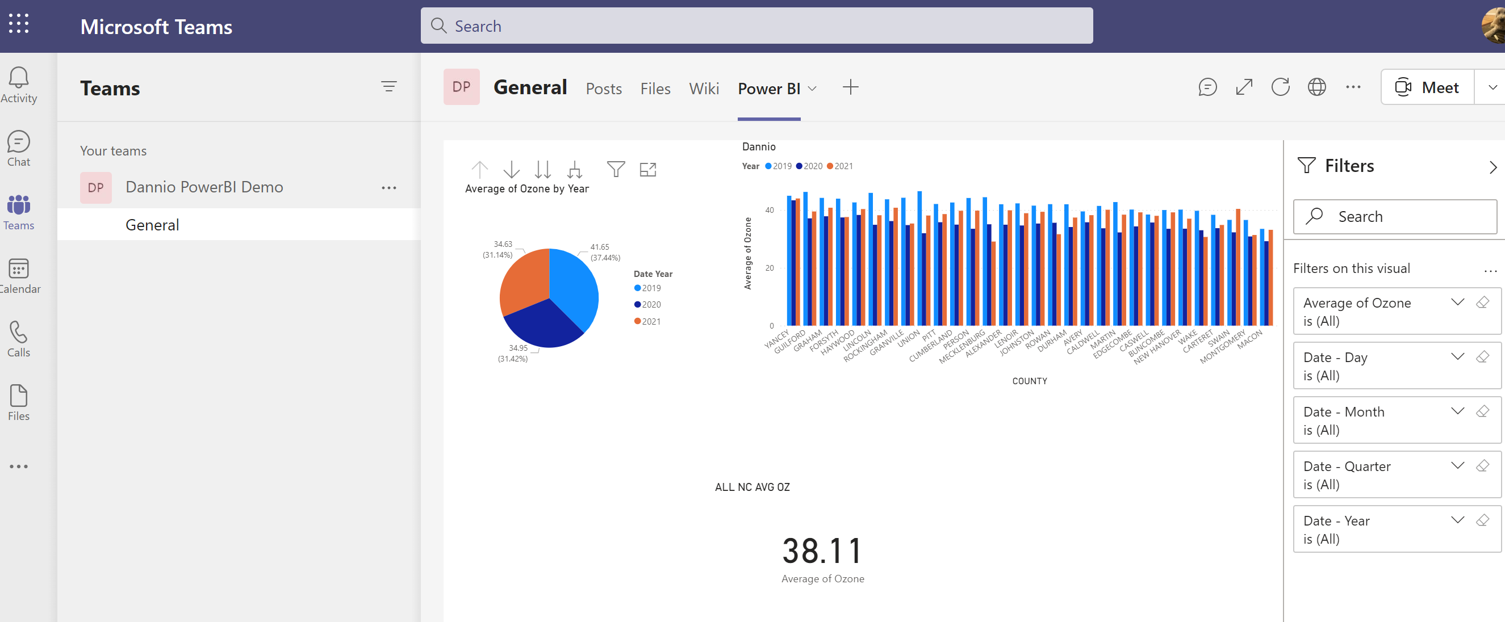
Embed a report in Teams
Microsoft Teams has a Power BI tab
To add a report in Microsoft Teams with the Power BI tab, you have at least a Viewer role in the workspace that hosts the report
To see the report in the Power BI tab in Microsoft Teams, users must have permission to view the report.
Does not save filters or personal bookmarks
Embed Power BI reports in Microsoft Teams - Power BI | Microsoft Docs

