Slide 1
Power BI + Azure AD B2B
Distribute Power BI content to partner organizations seamlessly

Slide 2
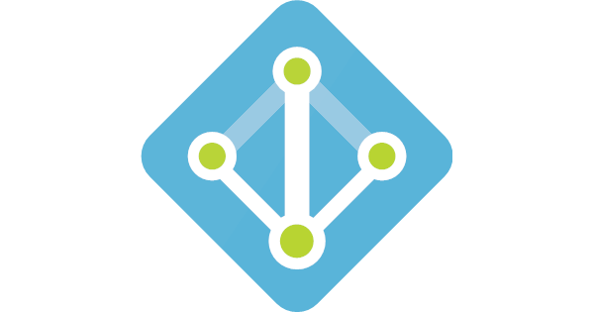
The Problem: Sharing reports with external organizations
Scenario
Contoso has a BI portal
Contoso O365
Contoso AAD
Contoso Power BI

Slide 3
The Problem: Sharing reports with external organizations
Suppliers
Scenario
Contoso has a BI portal
Contoso wants to securely give access to users in partner organizations
Supplier1
(Engine components)
Lucy@supplier1.com
Contoso O365
AAD
Contoso AAD
Supplier2 (airbags)
Jim@supplier2.com
AAD
Contoso Power BI
@supplier3
(Infotainment)
Alice@supplier.com
AAD

Slide 4
Solution 1: Create Native Accounts in Tenant
Suppliers
Scenario
Contoso has a BI portal
Contoso wants to securely give access to users in partner organizations
Proposed Solution
Create duplicate identities in the Contoso tenant
Undesired Outcomes
Contoso must manage all these identities
Contoso must keep in sync with employee movement in partners
This creates an identity nightmare for Contoso
Potentially require more advanced or expensive licensing
Supplier1
(Engine components)
Lucy@supplier1.com
Contoso O365
AAD
Contoso AAD
Supplier2 (airbags)
Jim@supplier2.com
Lucy_@supplier1@contoso.com
Jim_Supplier2@contoso.com
Alice_microchip@contoso.com
AAD
Contoso Power BI
@supplier3
(Infotainment)
Alice@supplier.com
AAD

Slide 5
Solution 2: Embedding with Custom Authentication
Suppliers
Scenario
Contoso has a BI portal
Contoso wants to securely give access to users in partner organizations
Proposed Solution
Build Power BI embedded application with custom auth
Undesired Outcomes
Highly technical development required
More complex licensing might be required
Added security risks when implementing authentication that is not native to Power BI.
Supplier1
(Engine components)
Lucy@supplier1.com
Contoso O365
AAD
Contoso AAD
Supplier2 (airbags)
Jim@supplier2.com
AAD
Contoso Power BI
@supplier3
(Infotainment)
Alice@supplier.com
Power BI embbeded application
with custom authentication
AAD

Slide 6
Solution 3: Azure B2B with External Guest Accounts
Suppliers
Scenario
Contoso has a BI portal
Contoso wants to securely give access to users in partner organizations
Proposed Solution
Leverage Azure B2B using External Guest Accounts
Desired Outcomes
Native user experience
Security is managed through trusted Azure AD provider
Passwords are not subject to compromise
Global O36 Admins have control over access
Supplier1
(Engine components)
Lucy@supplier1.com
Contoso O365
AAD
Contoso AAD
Lucy@supplier1.com
Jim@supplier2.com
Alice@supplier.com
Supplier2 (airbags)
Jim@supplier2.com
AAD
Contoso Power BI
@supplier3
(Infotainment)
Alice@supplier.com
Access granted to External Guest Users
AAD

Slide 7
Power BI + AAD B2B: How to Invite a Guest User

Slide 8
Power BI + AAD B2B - Steps
Create Power BI content
Invite Guest Users
Distribute Content
1
2
3

Slide 9
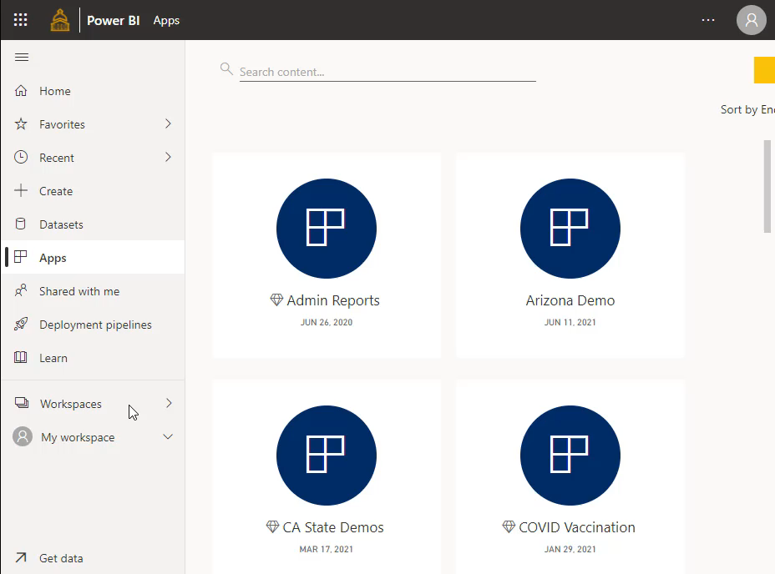
Contoso creates Power BI App to serve as the BI portal
  Create workspace
  Add other internal members to workspace
  Publish content inside workspace

Slide 10
Suppliers
Supplier1
(Engine components)
Lucy@supplier1.com
Once content is created, Contoso can invite guest users from partner organizations
AAD
Contoso O365
Contoso AAD
Supplier2 (airbags)
Jim@supplier2.com
AAD
Contoso Power BI
@supplier3
(Infotainment)
Alice@supplier.com
Power BI Workspace
AAD

Slide 11
Contoso invites users from partner organizations to its tenant.
Two Options:
1. Planned Invitations
Invite users ahead of time from the AAD portal
Invite large number of users
Create security groups for easy management
2. Adhoc Invitations
Ad-hoc invites by content creators during distribution

Slide 12
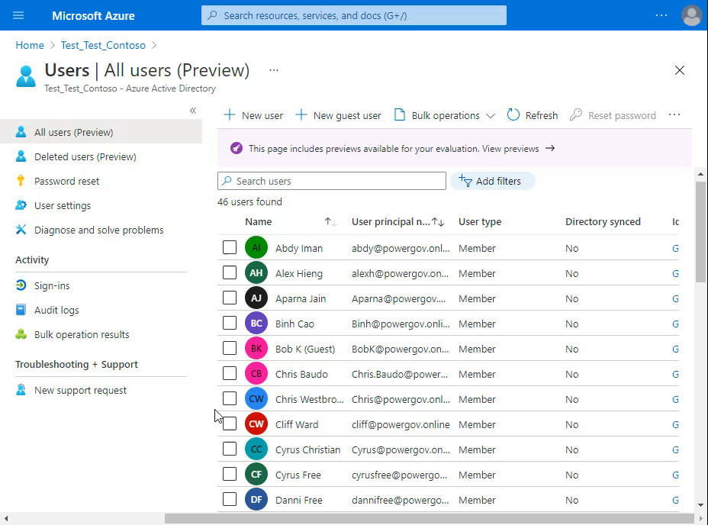
Method 1 : Planned invitations from Azure AD portal
AAD portal -> New guest user
Add message for external user and invite
Select Usage Location “United States” as this is required for licensing assignments later.

Slide 13
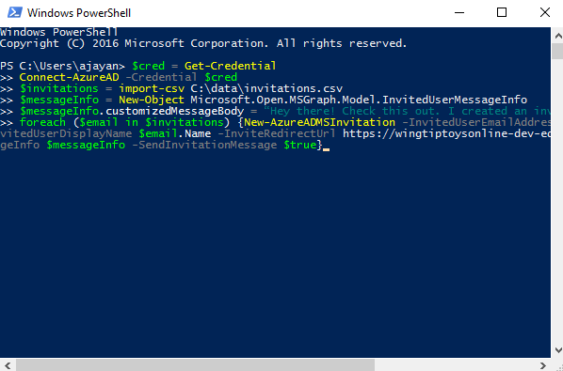
Method 2 :Planned invitations from PowerShell
For bulk invites, use PowerShell commandlets
https://docs.microsoft.com/en-us/azure/active-directory/active-directory-b2b-code-samples

Slide 14
Planned invitations workflow from AAD portal
Works with any business email address
AAD B2B Invite
Organization has AAD?
Guest User has AAD Identity?
User Signs in with existing Identity
Yes
Yes
No
No
User is prompted to create Viral Tenant and AAD identity
User is prompted to create identity in organization’s tenant
Access Power BI content

Slide 15
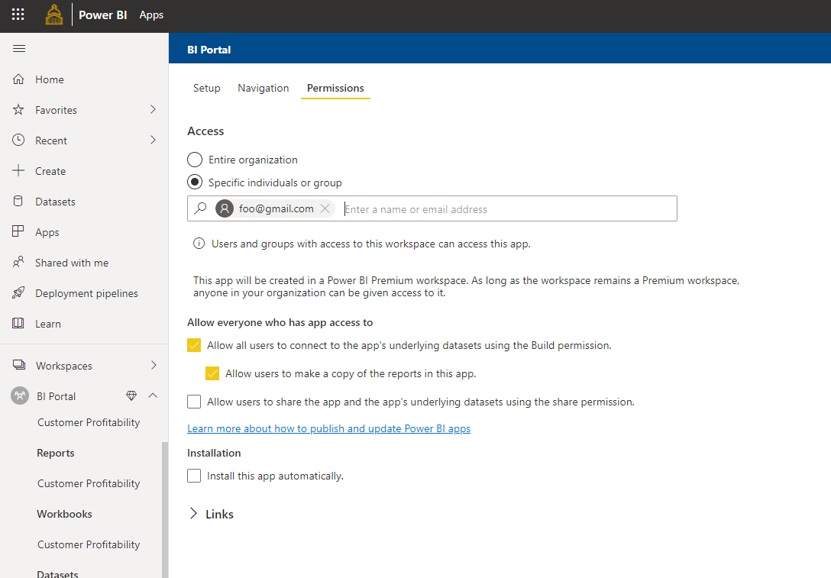
Adhoc invitations by end users
End users can ad-hoc invite guest users when distributing apps as well
For large scale deployments, we recommend the planned invitations approach along with Security Groups
Keep in mind tenant level setting can restrict this capability and are typically not allowed under best practices.

Slide 16
AAD B2B Invitation policies
Admins can set various policies for external B2B invites
  Turn off invitations by end users
  Only admins and users in the Guest Inviter role can invite
  Admins, the Guest Inviter role, and members can invite
  All users, including guests, can invite
https://docs.microsoft.com/en-us/azure/active-directory/active-directory-b2b-delegate-invitations

Slide 17
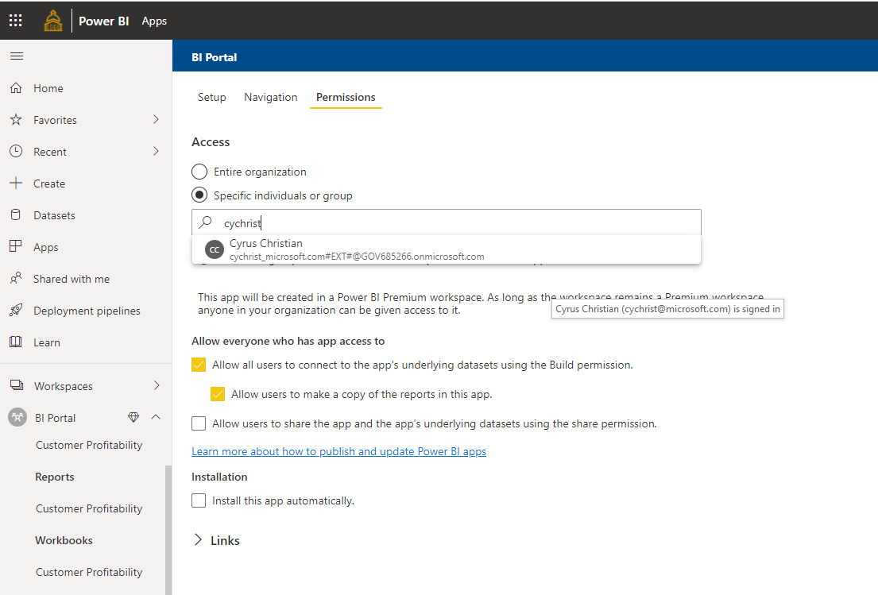
Contoso distributes content by publishing the App
Existing Guest users who have previously been added to Contoso’s tenant are auto-completed
Adhoc invitations to other users can also be sent at this point skipping the invite process.
Apps have specific permissions different than Workspaces

Slide 18
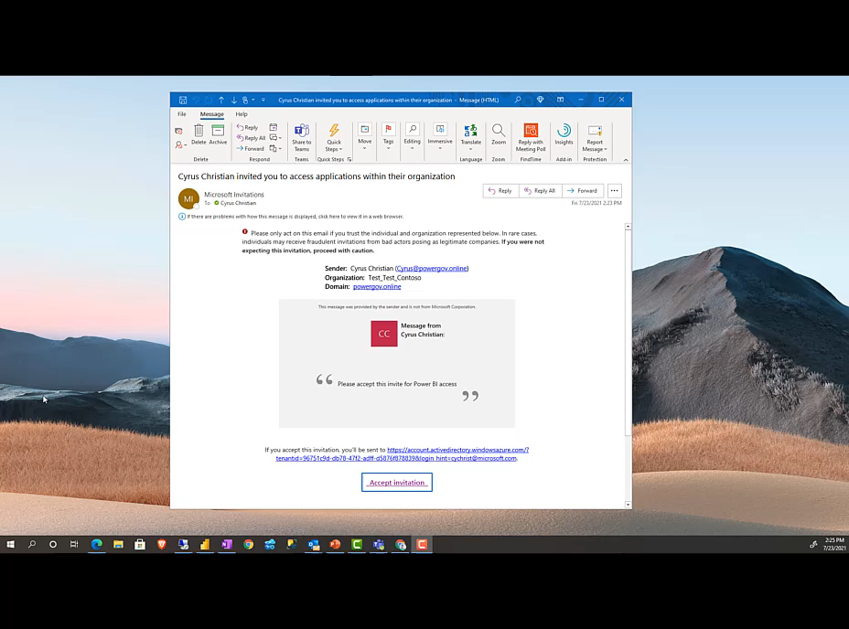
Accepting Invite from Azure AD
Guest users sign-in with their organization’s identity to consume Contoso’s app
Guest users must accept being added to the external tenant Azure AD

Slide 19
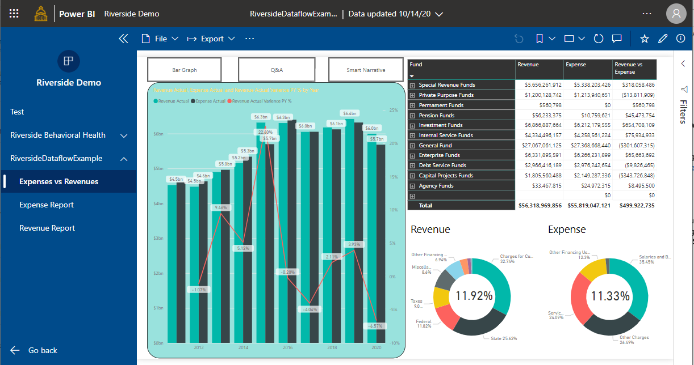
Guest user can access Contoso’s App or Workspace
External users cannot create or edit content in Contoso’s PBI tenant unless they have a Power BI Pro or Premium Per User license AND sufficient workspace permissions.
External users cannot embed reports in SharePoint
Guest users can subsequently get to Contoso’s app by clicking the link in the email or bookmarking the link.

Slide 20
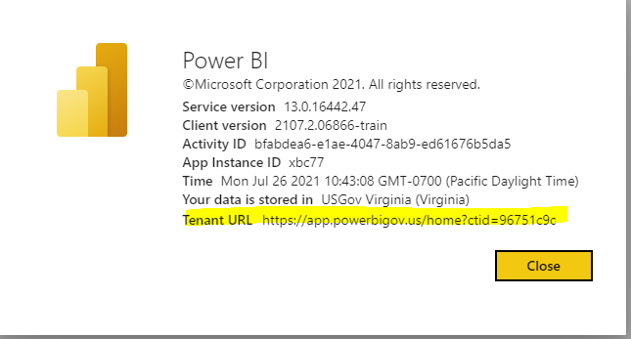
Tenant URL can allow for an indirect link
Tenant URL can be shared so users can access multiple Reports or Apps indirectly (About Power BI)
Invites are needed just the first-time content is shared with guest users.
Once guest users have been added to Contoso’s AAD, Contoso can subsequently share Power BI content without further invites

Slide 21
What about Power BI licensing?

Slide 22


Licensing Option 1: Contoso purchases Power BI Premium
Contoso O365
Supplier1
lucy@supplier1.com
Contoso AAD
AAD
Contoso assigns Power BI App content to premium capacity
1
Contoso Power BI
Power BI App

Slide 23
Licensing Option 1: Contoso purchases Power BI Premium
Contoso O365
Supplier1
lucy@supplier1.com
Contoso AAD
AAD
Contoso assigns Power BI App content to premium capacity
Guest users from partner organizations can access Contoso’s app without a Power BI license
**Contoso can also take advantage of other Power BI Premium capabilities for its app (increased refresh rates, dedicated capacity, large model sizes, paginated reports, etc)
1
2
Lucy has no Power BI license, but can still access Contoso’s app, since it is in premium capacity
Contoso Power BI
Power BI App

Slide 24
Licensing Option 2: Contoso purchases pro licenses for guest users
Contoso O365
Supplier1
lucy@supplier1.com
Contoso AAD
AAD
Contoso assigns pro-licenses to guest users from partner organizations
Guest users from partner organizations can access Contoso’s app without purchasing a license themselves
**Contoso’s pro license applies to guest users only when they access Contoso’s content.
1
[Contoso’s Power BI Pro license assigned]
2
Contoso Power BI
Power BI App

Slide 25
Licensing Option 3: Guest users can bring their own pro license with exception in GCC
Contoso O365
Supplier1
lucy@supplier1.com
Contoso AAD
AAD
Supplier1 assigns Power BI Pro licenses to Lucy
Lucy can access Power BI content in Contoso with the above Power BI Pro license
Note: Licensing is not recognized between sovereign cloud and commercial tenants.
1
[Supplier1 assigns Power BI Pro license to Lucy]
2
Contoso Power BI
Power BI App

Slide 26

Licensing Assignment with Dynamic Groups
Contoso O365
Supplier1
lucy@supplier1.com
Contoso AAD
After inviting guest users, Contoso can create Security Groups to manage user access
Security Groups can contain both internal and guest users
May require more advanced Azure AD licensing
https://docs.microsoft.com/en-us/azure/active-directory/enterprise-users/licensing-group-advanced
AAD
Security
Group
Contoso Power BI
Power BI App

Slide 27
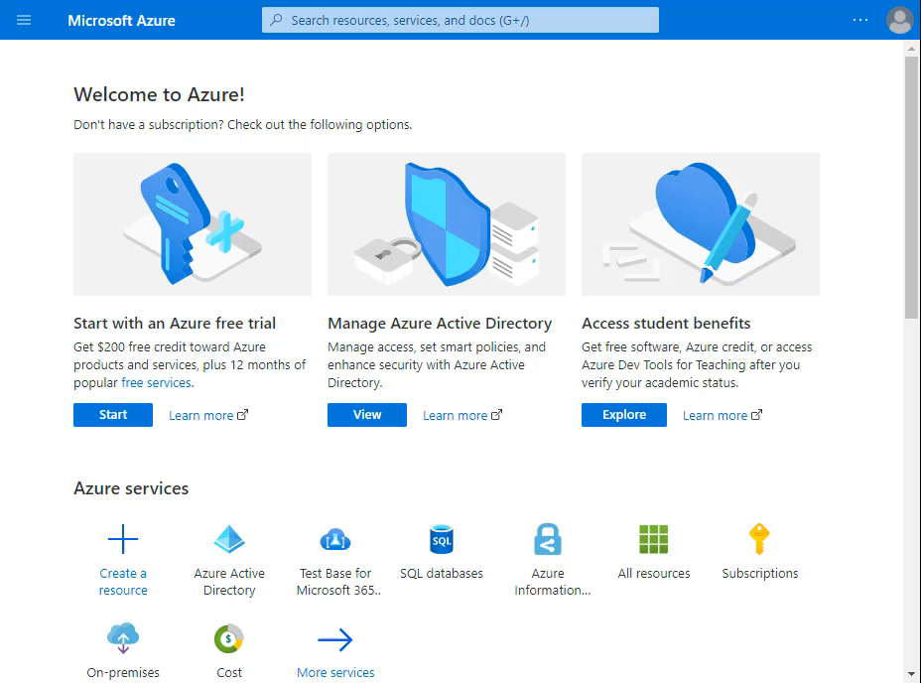
Licensing Assignment with Dynamic Groups
Verify Usage Group assignment
Create Dynamic User Group
Build Rule Expression to met guest account inclusion
Associate appropriate licensing to the Dynamic Group

Slide 28

Recap: Azure AD B2B Benefits
Guest users sign with their own identity
Guest user identity is managed by partner organization’s IT team
If guest user leaves the partner organization, they immediately lose access to Contoso’s BI portal
Contoso can apply governance policies to its content
Contoso does not need to build embedded applications with custom auth
Complete peace of mind for Contoso’s IT organization
Notes:
Change partner to guest user

Slide 29
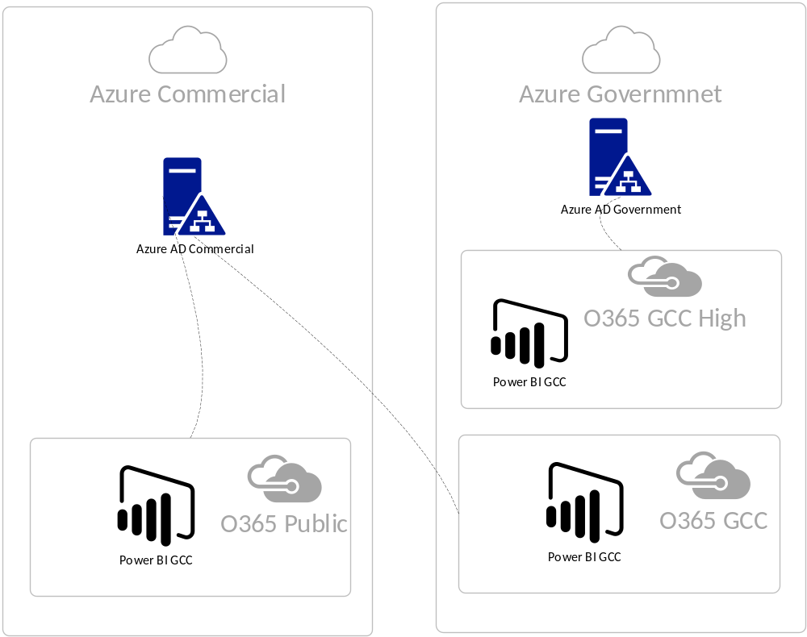

Slide 30
But Why?
The first Office 365 US Government environment, Government Community Cloud (GCC), was created when Microsoft had a single cloud directory. The Office 365 GCC environment was designed to use Azure AD Public while still adhering to controls and requirements outlined in FedRAMP Moderate, CJIS (Criminal Justice Information Services), IRS 1075, and National Institute of Standards and Technology (NIST) publication 800-171.
https://docs.microsoft.com/en-us/azure/azure-government/documentation-government-plan-identity#frequently-asked-questions

