Slide 1
Public Reporting Guidance for Power BI Publish to web

Slide 2
Considerations and Guidance
Publish to Web
Requires Power Bi Pro for publisher
Consumers need no licensing
Anonymous access
No auditing history
No role-based security
No Export capabilities
Can be limited based on tenant level security
Admin can view reports available in tenant
Secure Embedded
Requires all users to be licensed
Audits history in O365 logs
Secured access
Row Level Security capable
Exporting capable
Available for any report

Slide 3
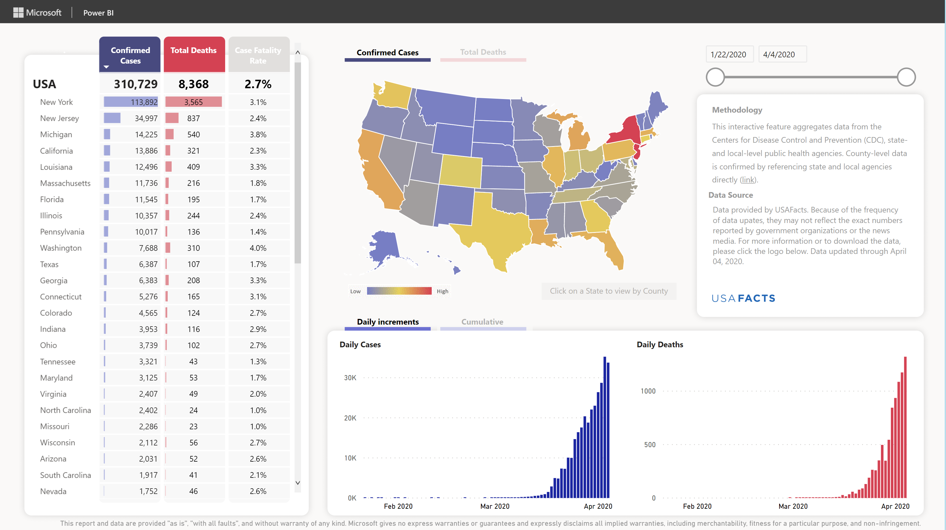
Get started quickly
Example solutions base on public reporting for COVID-10 response
Power BI Toolkit for State and Local Governments
Power BI Desktop
Power BI Service
Power BI Publish to web
USA samples for State and Local Governments
Relies on USAFacts data available publicly, may not represent most up-to-date or detailed internal data.
Provides detailed steps for multiple publishing options for a sample report.
Example solution architecture based on real world deployment
Solution Architecture
Guidance
Can be adapted to internal data systems to provide more up-to-date and details data publicly.
Requires development and maintenance of the data loading and reporting elements.
Toolkit announcement:
https://powerbi.microsoft.com/en-us/blog/how-public-agencies-keep-communities-informed-on-covid-19-with-power-bi/

Slide 4
Report Publishing
Create Power BI Desktop files
Publish to Power BI service (online)
Embed the report in your public website
Data Refresh
Create different layouts for web and mobile
Web layout file
Mobile layout file
Create a workspace for files to centralize management
Use Publish to web capability to create an embed code for each file
The embed code is an iFrame.
Your web developers will update
Include text on the page citing your methodology and update frequency
If your source system is a database or other self-updating source, you can schedule data refresh in the Power BI service.
Data is cached for 60 minutes in Publish to web (see data consistency slide for details)

Slide 5





Solution architecture
Public Reporting for State and Local Government websites
Data from internal / existing source systems
e.g. database, CSV files, Excel file, etc.
Data stored in central cloud location with standardized data schema
Power BI report authored in Power BI Desktop
Uploaded and refreshed in Power BI service (online)
Internal Team Review and Approval
Ensure data accuracy and reliability
Public Report embedded in Local/County/State website
Power BI Publish to web enables free, scalable viewing by members of the public

Slide 6



State Department of Health Solution Architecture
    Based on a State government in the USA that used Power BI Publish to web to build a COVID-19 related public report
    Chronology (Daily)
    23:59:59 PT data is locked for daily update
    8:00am PT – 12:00 PT: County team to reviews data for quality and signs off
    12:00pm PT – 13:00 PT: Internal system generates output files
    13:00 PT: data files propagated to SharePoint
    13:10 PT: update and stage Power BI for internal review prior to publishing externally
    14:00 PT: publish external Power BI
13:00 PT
data files distributed
13:10 PT
Power BI refresh
INTERNAL
14:00 PT
Power BI refresh PUBLIC
>14:00 PT
Available on
Government agency website
CSV files are generated from existing reporting systems
Update central repository with updated data
Update report in Power BI (online)
QA website
Data file 1
Data file 2
QA
Staging
PUBLIC
A
SharePoint folder
Table for website
Data file 3
Data file 4
PBIX File
No
Internal Team Review and Approval
Via iframe
Update?
Yes
A
PBIX File
Data file 5
Static reference file
Yes
Generate additional summary views as needed
Public
PBIX File - Mobile

Slide 7
Reports
Optimize layouts for user devices
Web Report Layout
Mobile Report Layout
Additional Guidance
Optimized for viewing on PC/Tablet
Larger screen size
Better network, though can vary
More details and interaction
Layout
Landscape (16:9)
Square (1:1)
Design considerations
Keep first page focused on summary metrics everyone needs to know
Use color consistently and sparingly
Keep a clear information hierarchy
Use drill-through with navigation hints to allow audience to explore the data
Optimized for viewing on mobile devices
Smaller screen size
Limited network
Fewer interactions
Layout
Square (1:1)
Portrait (8:10)
Design considerations
Fewer interactive elements
Bigger buttons (if used)
Ensure your report clearly indicates
When data was last updated
Any caveats that could affect the reporting
Consider performance up front
Limit number of queries on first page for faster initial load time
Avoid placing multiple reports (iFrames) on a single page, this causes bad load performance, especially on mobile devices
Consider accessibility from the start.
Power BI offers tools like alt-text, tab order, etc. to enable screen readers
Authors must choose colors for accessibility
Consider publishing tables of data, in addition to charts, maps, interactive reports
Enables fast load on mobile
Enables easy accessibility
Enables data re-use by others

Slide 8
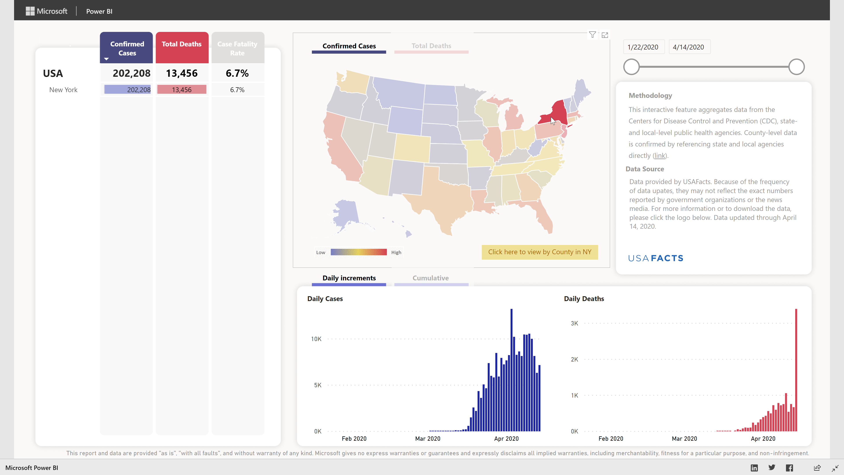
Data consistency with Publish to web
Power BI publish to web is highly scalable and free to use.
To achieve this, data is cached for 60 minute for each query
This has implications for data consistency.
Example
Each chart/map/number on the report is a separate query.
Typically, for the first page of the report, the default queries all are cached at approximately the same time.
When users interact with the report (click on data points, filter, navigate), additional queries are executed and results are cached.
Implications:
If the report in the Power BI service is refreshed at 1PM, it will take 60 minutes before all data in the report is fully consistent.
If a query as not been run in the previous 60 minutes, the most recent data available is shown
Data consistency strategies:
Refresh during low traffic times (most organizations)
  The caches will automatically purge
  Scheduling refreshes early in the morning when few users access the reports limits impact and visibility of inconsistencies
  It is important to communicate the data start and data refresh end times to consumers.
Manage separate reports and embed codes (some organizations), per update period
  Each update period, a new report is uploaded, a new embed code is published, and the public site is updated to show the new embed code.
  This process requires a daily process which may not be suitable for some organizations.
1
2
5
6
3
4
7
8
Queries 1 thru 4 execute with default state when the page first opens.
Queries 5 thru 8 are filtered based on user click on a specific state.

Slide 9
Example: Data Consistency
Data Refresh
Data Refresh
Time
Initial Page Load
Query Filter
60 minutes
1
2
3
4
Old data is shown
60 minutes
5
6
7
8
Any queries run before the data refresh show old data until the cache expires.
Any queries run after the data refresh show new data.

Slide 10
Data consistency Implications
Implications:
If the report in the Power BI service is refreshed at 1PM, it will take 60 minutes before all data in the report is fully consistent.
If a query as not been run in the previous 60 minutes, the most recent data available is shown
Data consistency strategies:
Refresh during low traffic times (most organizations)
  The caches will automatically purge
  Scheduling refreshes early in the morning when few users access the reports limits impact and visibility of inconsistencies
  It is important to communicate the data start and data refresh end times to consumers.
Manage separate reports and embed codes (some organizations), per update period
  Each update period, a new report is uploaded, a new embed code is published, and the public site is updated to show the new embed code.
  This process requires a daily process which may not be suitable for some organizations.

Slide 11
Why optimize your publish to web?
Fit perfectly
Support mobile
Better Loading Experience
Default iFrame sizes are never perfect
You’ll see gray areas at top/bottom or left/right of your report
It’s almost impossible to get it right due to screen size, resolution, orientation
Mobile devices have much smaller screens
Typically portrait not landscape
Reports designed for the web won’t work well on mobile
Networks and Devices are often slower than you think
Mobile networks are often slow (3G even 4G are sluggish
Devices vary greatly form iPhone X down to very economical Android devices
Web browsers and web pages limit the resources on a page
Memory, CPU, and even Threads are often limited
Solution
Use JavaScript to adjust the size of the iFrame on your page dynamically
Solution
Use JavaScript to show a mobile friendly version of your report
Solution
Use JavaScript to load reports only when needed
Use placeholder images for fast initial load experience

Slide 12
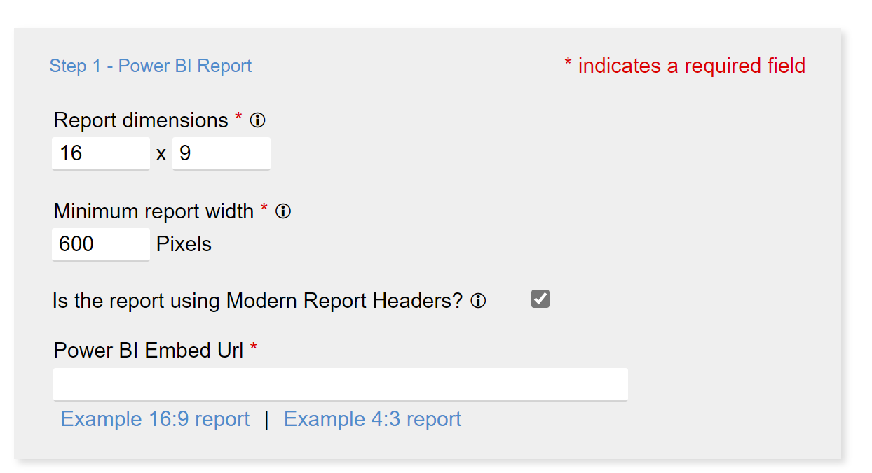
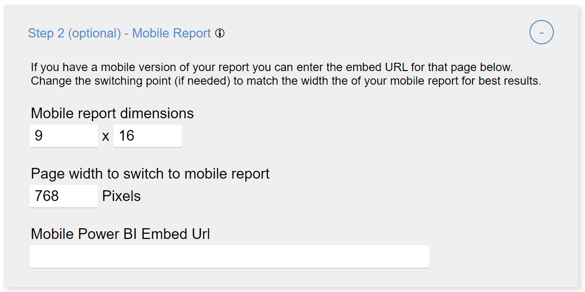
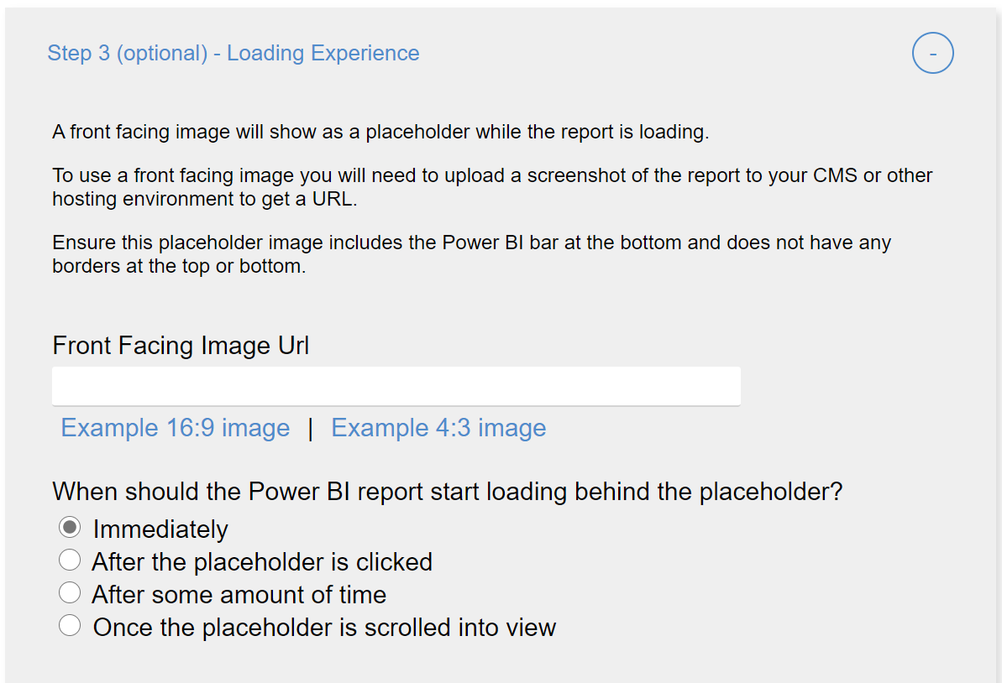
JavaScript made easy
Optimizing Publish to Web tool
Open the tool
https://lukaszpawlowski-ms.github.io/Optimize-Publish-To-Web/
Enable the embedded report to resize to be responsive to web/mobile users.
Achieve faster page loads.
Uses JavaScript that must be embedded on the page by a web developer
Step 1
Use step 1 to have a smooth resize experience for your report
Set the ‘Report dimensions’ are based on the page size for your report page.
Beware of minimum iFrame height/width (300px x 300px), which can impact reports designed with the default 16:9 page size.
Result: no letterboxing (ugly blank or gray areas on the sides of your report
Step 2
Use step 2 to show a mobile layout for your report
Set Page width to switch to mobile report to a clickstop where your page normally switches to a mobile view.
Result: users on phones and small tablets will have an optimized and clear experience.
Step 3
Use step 3 to optimize performance
Setting an image placeholder allows the page to load without loading an iFrame
The image can show latest data, if you have a process to update the image. Alternatively, a static placeholder can be acceptable
Result: much faster page load on mobile

Slide 13
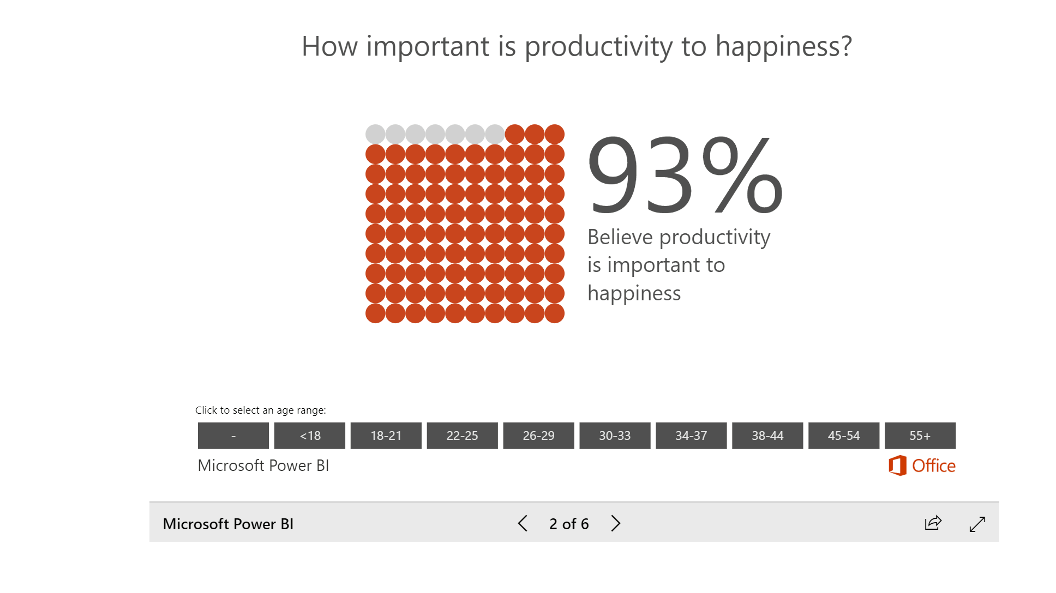
Optimized sizing experience
Resizing report dynamically

Slide 14
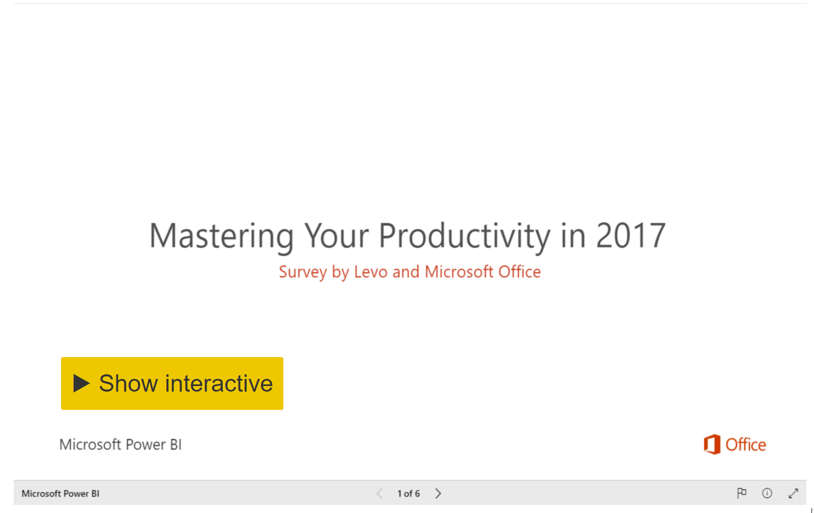
Optimized loading experience
Placeholder image with button to load report

Slide 15
Example Optimized Embed Code
HTML
JavaScript
Embed code for web layout
Embed code for mobile layout
<div pbi-resize="powerbi" pbi-resize-src="https://app.powerbi.com/view?r=xxxxxxxxxxxxxxxxxxxxxxxxxxxxxxxxxxxxxxxxxxxxxxxxxxxxxxxxxxxxxxxxxxxxxxxxxxxxxxxxxxxxxxxxxxxxxxxxxxxxxxxxxxx" pbi-resize-min-width="600" pbi-default-width="600px" pbi-default-height="506" pbi-resize-width="1280" pbi-resize-height="1000" pbi-resize-load-event="page-load" pbi-resize-header="true" pbi-resize-m-src="https://app.powerbi.com/view?r=xxxxxxxxxxxxxxxxxxxxxxxxxxxxxxxxxxxxxxxxxxxxxxxxxxxxxxxxxxxxxxxxxxxxxxxxxxxxxxxxxxxxxxxxxxxxxxxxxx" pbi-resize-m-width="900" pbi-resize-m-height="1200" style="position: relative;"><iframe frameborder="0" allowfullscreen="true"></iframe></div><script>!function(){if(void 0===window.powerbiresizescript){function L(e,t){if(e)for(var i=0;i<e.children.length;i++)if(e.children[i].tagName.toLowerCase()===t.toLowerCase())return e.children[i];return null}function C(e){if(e){var t=e.parentNode,i=L(t,"div");i&&t.removeChild(i);var r=L(t,"span");r&&t.removeChild(r),e.style.position="static",e.style.visibility="visible";var n=L(t,"img");n&&t.removeChild(n)}}function M(e,t){e.setAttribute("data-state",t);for(var i=[{state:"waiting",text:e.getAttribute("pbi-resize-wait-txt")},{state:"loading",text:e.getAttribute("pbi-resize-load-txt")},{state:"loadingnow",text:e.getAttribute("pbi-resize-load-txt")},{state:"ready",text:e.getAttribute("pbi-resize-rdy-txt")},{state:"readynow",text:e.getAttribute("pbi-resize-load-txt")}],r="",n=0;n<i.length;n++)i[n].state===t&&(r=i[n].text);var a=L(e,"span");switch(e.innerHTML=r+a.outerHTML,t){case"loading":e.onclick=function(){M(e,"loadingnow")},e.parentNode.onclick=function(){M(e,"loadingnow")};break;case"readynow":S(),C(L(e.parentNode,"iframe"));break;case"ready":S(),(a=L(e,"span")).style.display="none",e.style.width="auto",e.onclick=function(e){C(L(e.target.parentNode,"iframe"))},e.parentNode.onclick=function(e){C(L(e.target.parentNode,"iframe"))}}}window.powerbiresizescript=1,window.onmessage=function(e){if(function(e){try{if("reportPageLoaded"==JSON.parse(e.data).event)return!0}catch(e){return}}(e)){var t=function(e){for(var t=document.getElementsByTagName("iframe"),i=0;i<t.length;i++)if(t[i].contentWindow===e)return t[i]}(e.source);setTimeout(function(){if(t&&1<t.parentNode.children.length)switch(t.parentNode.getAttribute("pbi-resize-load-event")){case"click":C(t);break;case"page-load":case"seconds-timeout":case"in-view":var e=L(t.parentNode,"div");"loadingnow"===e.getAttribute("data-state")?M(e,"readynow"):M(e,"ready")}},1e3*(t.parentNode.getAttribute("pbi-resize-delay-show")||1))}};var e=function(){for(var e=document.querySelectorAll('[pbi-resize="powerbi"]'),i=0;i<e.length;i++){e[i].style.width="100%";var r=e[i].clientWidth,n=e[i].getAttribute("pbi-resize-min-width"),a=(e[i].getAttribute("height"),e[i].getAttribute("pbi-resize-img")),o=e[i].getAttribute("pbi-resize-m-img")||a,s=e[i].getAttribute("pbi-resize-width"),d=e[i].getAttribute("pbi-resize-height"),l=e[i].getAttribute("pbi-resize-src"),c=e[i].getAttribute("pbi-resize-m-width"),p=e[i].getAttribute("pbi-resize-m-height"),u=e[i].getAttribute("pbi-resize-m-src"),g=e[i].getAttribute("pbi-resize-load-event"),h=e[i].getAttribute("pbi-resize-header"),b=L(e[i],"img"),w=L(e[i],"iframe"),m=w?w.getAttribute("src"):null,f=c/p,v=s/d,y=n<r,x=l&&u?y?l:u:l,A=(w&&w.src==u||b&&b.src==o)&&y&&u!=l,z=(w&&w.src==l||b&&b.src==a)&&!y&&u!=l,N=1<e[i].children.length;if(!m){if(w&&(w.style.position="absolute",w.style.top=0,w.style.left=0,w.style.visibility="hidden"),b&&b.setAttribute("src",!y&&o?o:a),!a&&l&&y||!o&&u&&!y){w.setAttribute("src",!y&&u?u:l),C(w),S();break}if(a&&l||o&&u){var E=L(e[i],"div");switch(M(E,"waiting"),g){case"page-load":W(w.parentNode,x);break;case"seconds-timeout":var k=1e3*parseInt(e[i].getAttribute("pbi-resize-seconds"));t=setTimeout(function(){W(w.parentNode,x)},k);break;case"in-view":N&&!w.src&&H(b)&&W(w.parentNode,x),window.addEventListener("scroll",function(){N&&!w.src&&H(b)&&W(w.parentNode,x)},!1);break;case"click":E.onclick=function(){W(w.parentNode,x)},e[i].firstChild.onclick=function(){W(w.parentNode,x)}}}}m==a&&!a&&l&&y||m==o&&!o&&u&&!y?C(w):(z||A)&&I(e[i].children[0],y,N?a:l,N?o:u,x),N&&(z&&!o&&u||A&&!a&&l)?C(w):!N&&(z&&o&&!u||A&&a&&!l)&&C(w),b&&b.parentNode&&T(b,h,r,y,v,f,d,p),w&&T(w,h,r,y,v,f,d,p)}};function T(e,t,i,r,n,a,o,s){var d=!1;if(a&&s)var l=r?n:a,c=r?o:s;else l=n,c=o;var p="true"==t.toLowerCase()?36:56;if(i<569&&l===16/9)e.parentNode.style.width="568.88px",e.style.width="568.88px",e.style.height=320+p+"px",d=!0;else if(i<=437&&l===4/3)e.parentNode.style.width="426.66px",e.style.width="426.66px",e.style.height=320+p+"px",d=!0;else if(i<320||i/l<320||c<320&&l!==16/9&&l!==4/3){var u=Math.max(i,320)/l;u<320?(e.parentNode.style.width=320*l+"px",e.style.width=320*l+"px",e.style.height=320+p+"px"):(i<320?(e.parentNode.style.width="320px",e.style.width="320px"):(e.parentNode.style.width=i+"px",e.style.width=i+"px"),e.style.height=u+p+"px"),d=!0}else e.parentNode.style.width="100%",e.style.width="100%",e.style.height=Math.max(e.clientWidth/l,320)+p+"px";d&&console.warn("pbi-resize: requested iframe dimension is below the minimum supported dimensions. Minimum supported width is 320px. Minimum supported height is 376px. Change your Power BI report page size to ensure your content looks great when embedded in your web page or blog.")}function H(e){var t=e.getBoundingClientRect();return 0<=t.top&&0<=t.left&&t.bottom<=(window.innerHeight||document.documentElement.clientHeight)&&t.right<=(window.innerWidth||document.documentElement.clientWidth)}function I(e,t,i,r,n){if(i&&r){var a=e.nextElementSibling;e instanceof HTMLImageElement&&a.src&&n!=a.src&&(a.setAttribute("src",n),M(a.nextElementSibling,"loading"));var o=t?i:r;e.setAttribute("src",o)}}function S(){if(-1!==navigator.userAgent.indexOf("MSIE")||0<navigator.appVersion.indexOf("Trident/")){var e=document.createEvent("UIEvents");e.initUIEvent("resize",!0,!1,window,0),window.dispatchEvent(e)}else window.dispatchEvent(new Event("resize"))}function W(e,t){var i=L(e,"iframe"),r=L(e,"div");L(r,"span").style.display="block";var n=document.createElement("style");n.type="text/css";n.innerHTML="@keyframes pbi-resize-spinner { 0% { transform: rotate(0deg); } 100% { transform: rotate(360deg); } }",document.getElementsByTagName("head")[0].appendChild(n),i.setAttribute("src",t),i.setAttribute("frameborder","0"),i.setAttribute("allowFullScreen","true"),M(r,"loading")}document.addEventListener("DOMContentLoaded",e),window.addEventListener("resize",e),window.addEventListener("orientationchange",e)}}();</script>
The HTML generated varies based on input from Step 1, Step 2, and Step 3
The JavaScript included is a minified version of the script:
https://github.com/LukaszPawlowski-MS/Optimize-Publish-To-Web/blob/master/script.js

Slide 16
How to create a COVID-19 dashboard step by step
Open the instructions
https://docs.microsoft.com/en-us/power-bi/create-reports/sample-covid-19-us
Leverage the steps for the sample to achieve the updates in this solution.
Customize the Power BI Desktop files
Publish to the Power BI service
Create a Publish to web Embed code

Slide 17
Publish to Web Governance and Limitations
Publish to Web Governance
Customer may use the publish to web functionality to share content only on a publicly available website. Customer may not use this functionality to share content internally. Microsoft may display content published through the publish to web functionality on a public website or gallery.
Limitations https://docs.microsoft.com/en-us/power-bi/service-publish-to-web#limitations
  Publish to web is supported for the vast majority of data sources and reports in the Power BI service, however, the following are not currently supported or available with Publish to web:
  Reports using row level security.
  Reports using any Live Connection data source, including Analysis Services Tabular hosted on-premises, Analysis Services Multidimensional, and Azure Analysis Services.
  Reports shared to you directly or through an organizational content pack.
  Reports in a group in which you are not an edit member.
  "R" Visuals are not currently supported in Publish to web reports.
  Exporting Data from visuals in a report which has been published to the web
  ArcGIS Maps for Power BI visuals
  Secure confidential or proprietary information

